Slide 2
IACCGH: Innovating to maximize business opportunities

Slide 3
By
Energizing Houston in business, education, healthcare and energy
Connecting nations, businesses and people

Slide 4
Thank you for your trust and confidence
INDO-AMERICAN CHAMBER OF COMMERCE OF GREATER HOUSTON

Slide 5
A great team to work with
Board of Directors
Past President Sanjay Ramabhadran
President Elect for 2016 – Joya Shukla
Secretary Allen Richards
Our “financial wizard” Treasurer Swapan
Dhairyawan
The “glue” of the Chamber – Executive Director
Jagdip Ahluwalia

Slide 6
Suggestions, ideas, advice are greatly appreciated

Slide 7
Our Plan
Past Presidents, BOD and Jagdip have laid a strong foundation of events.
Will sustain and strengthen these events.
Will introduce two new programs

Slide 8
Our Plan
Aiming for two programs each month
Things do go off script with last minute
cancellations, will have 6 back up plans for such an eventuality

Slide 9
Networking doesn’t just work, it ROCKS!
Our Inaugural “Networking Works” event is at City Hall on January 6th.
Will try to get Council members, the Mayor and the Pro-Tem to participate in our event.
Will honor Manuel Gonzalez from SBA and Nya Igambi from the Department of Commerce, Houston at the event

Slide 10
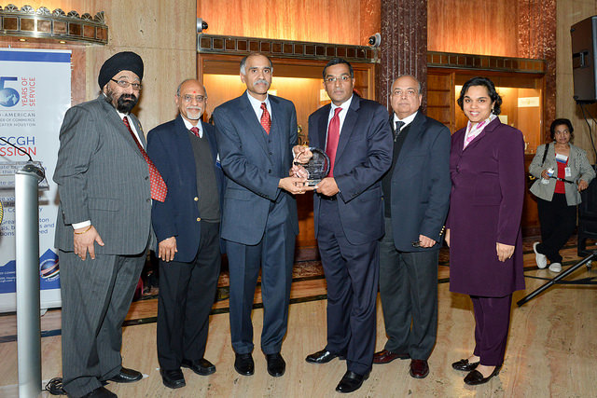
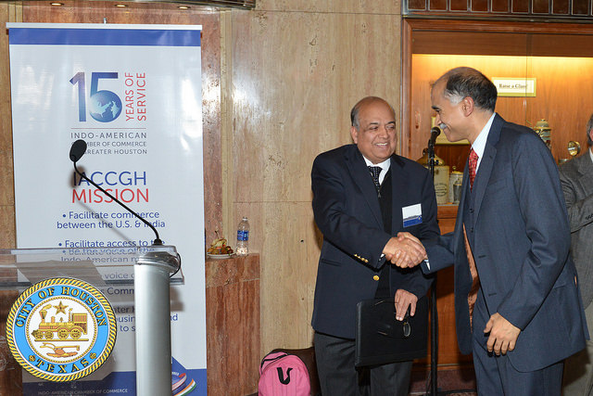
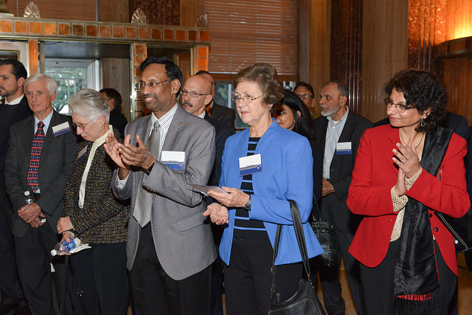
IACCGH Inaugural Networking Works Event January 6, 2015
INDO-AMERICAN CHAMBER OF COMMERCE OF GREATER HOUSTON

Slide 11
Tours
Two options:
A tour of TxDot for our top sponsors
Port of Houston tour to commemorate its centennial celebrations

Slide 12
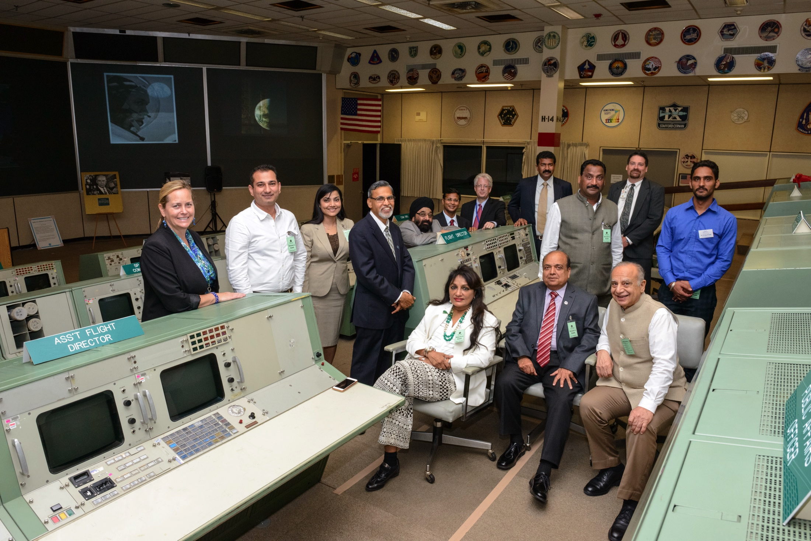
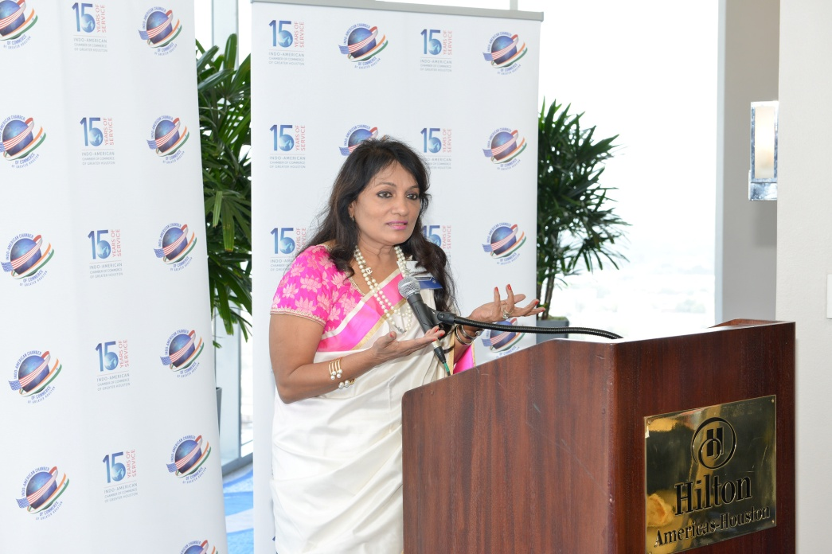
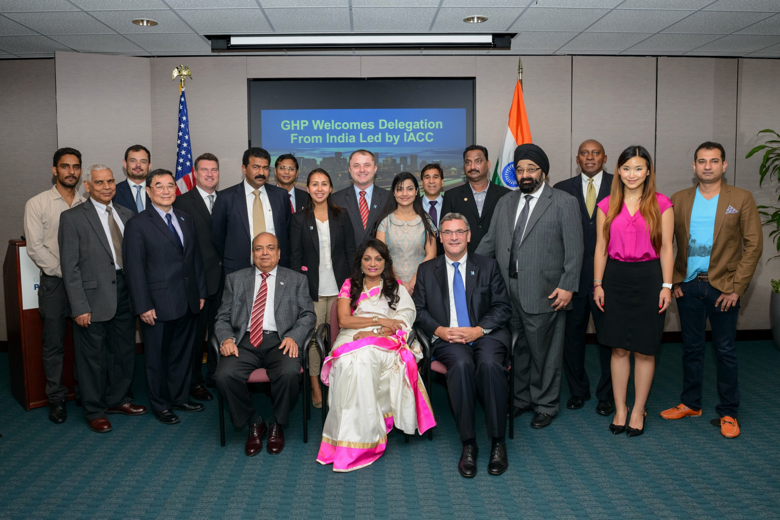
IACCGH host inbound delegation from IACC - Mumbai President , U.S – India Business Council July 9-10, 2015

Slide 13
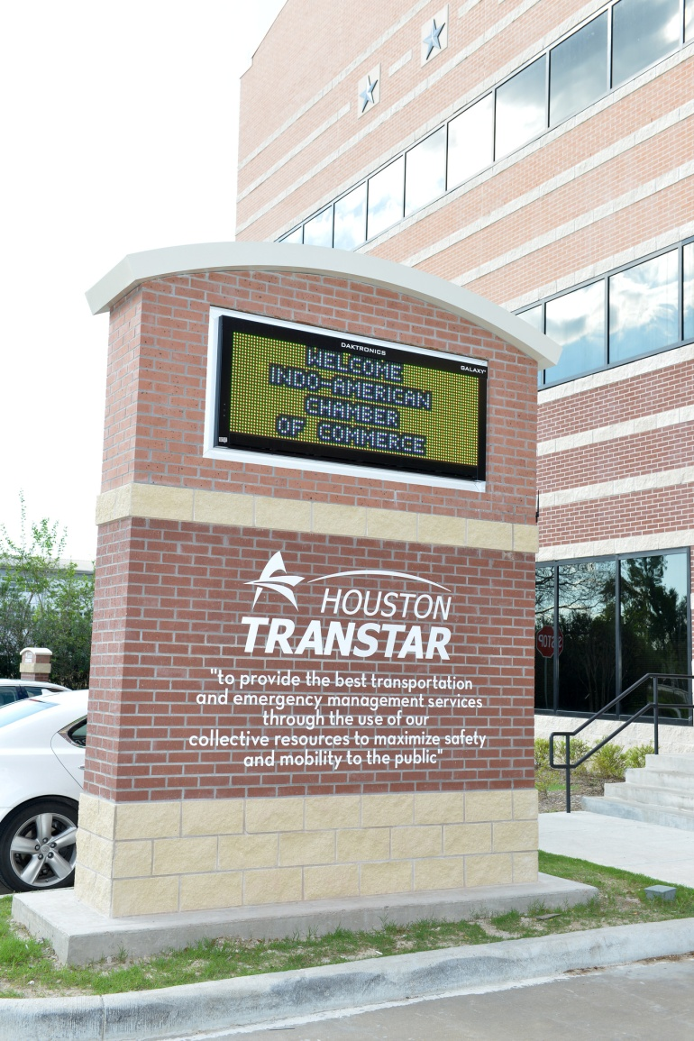
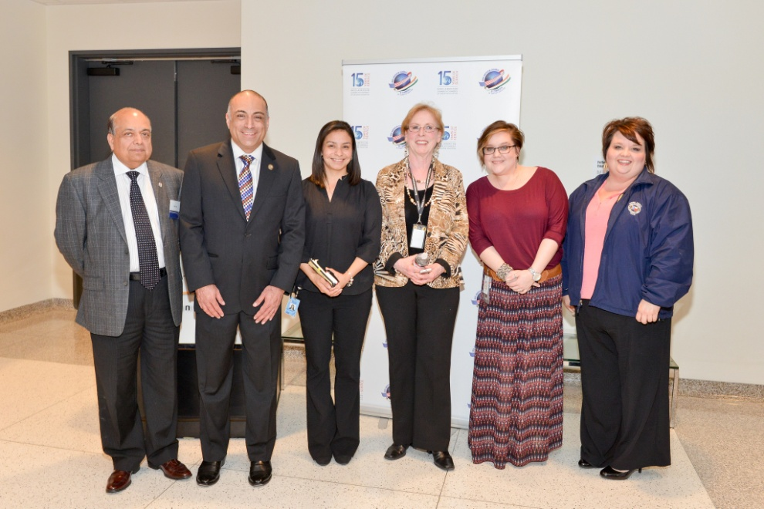
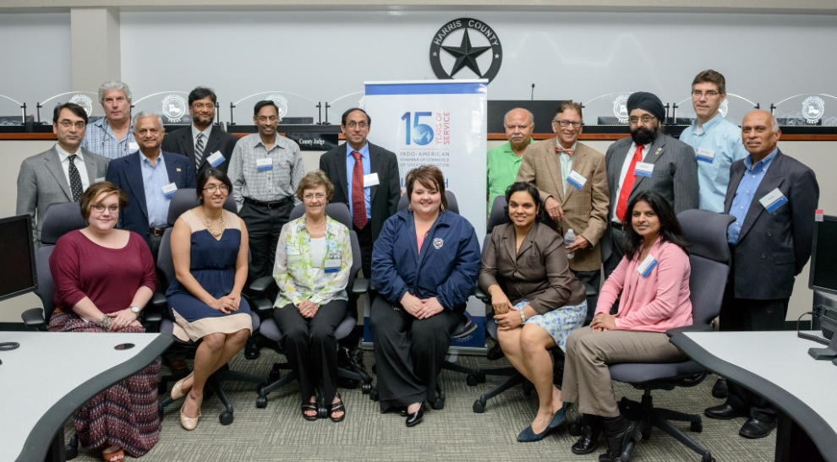
Tour of Houston Transtar| March 24, 2015

Slide 14
Distinguished Lecture Series
Will continue to invite leaders in their fields to share their life lessons and expertise
Three lectures planned
Names to be added

Slide 15
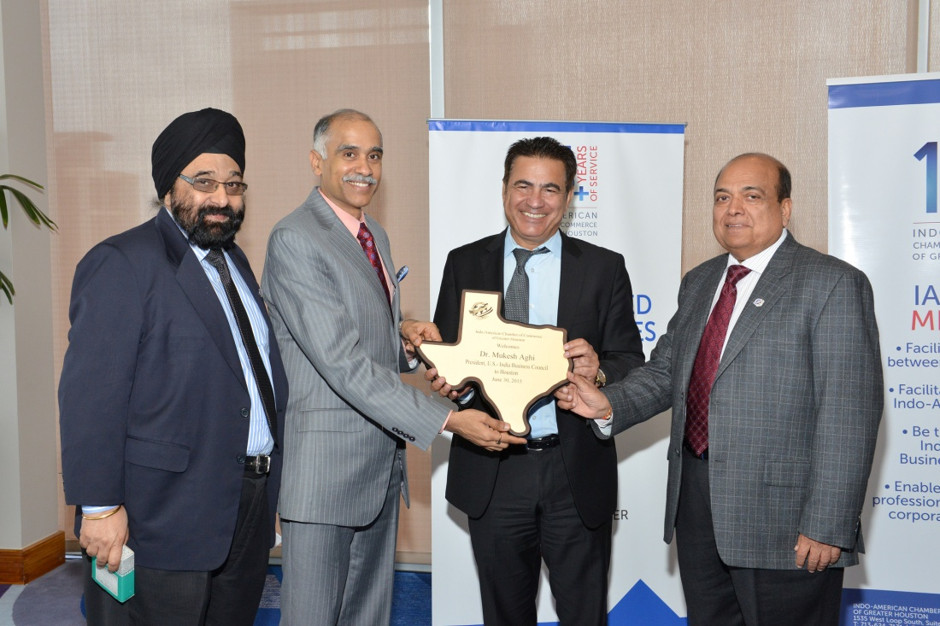
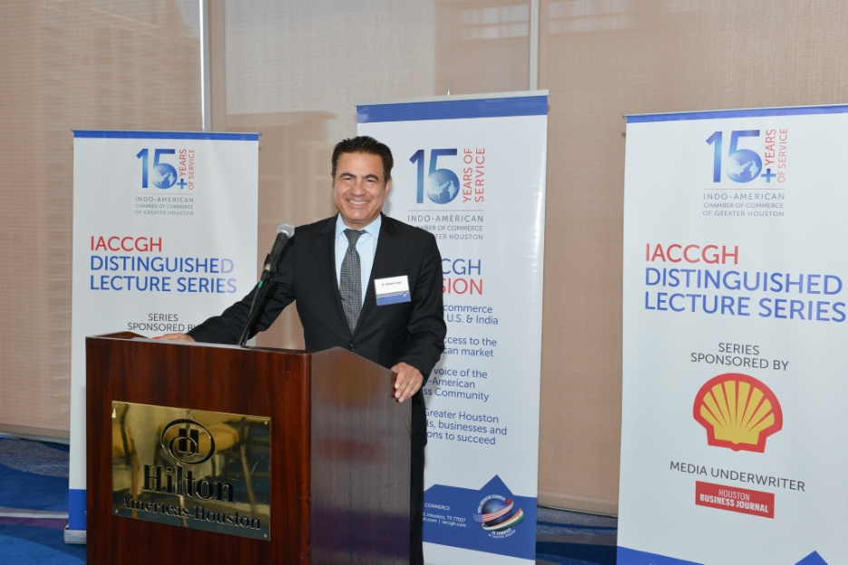
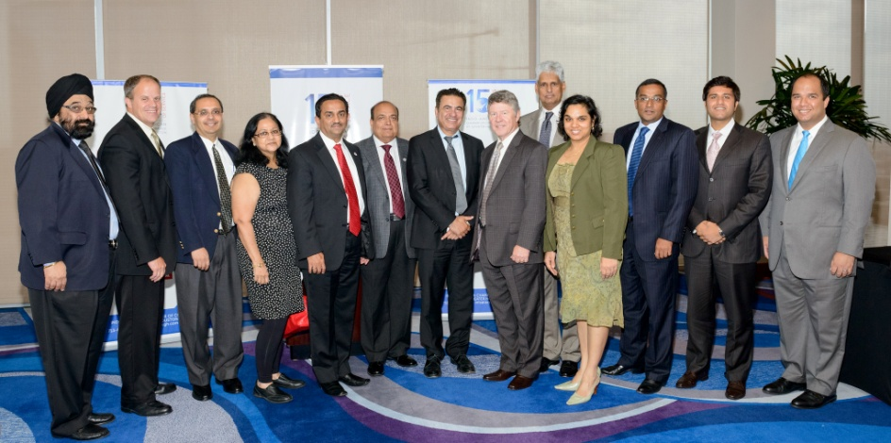
IACCGH Distinguished Lecture featuring Dr. Mukesh Aghi, President , U.S – India Business Council June 30, 2015

Slide 16
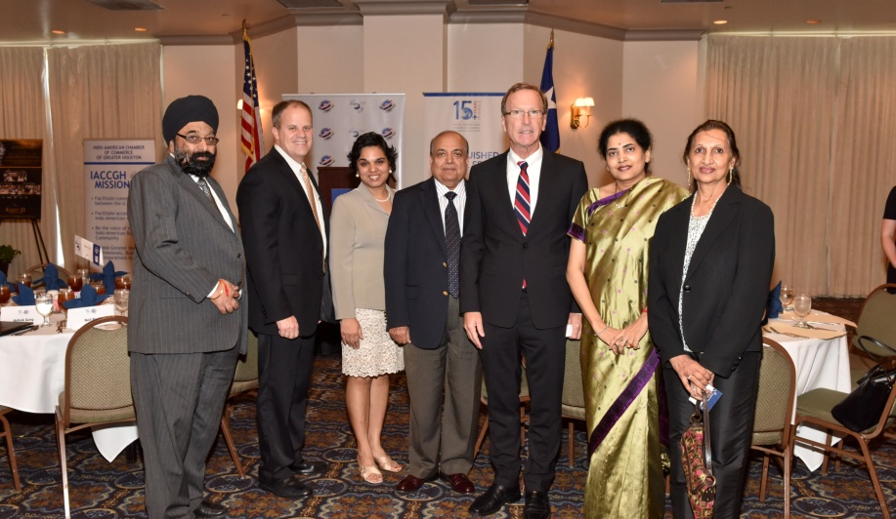
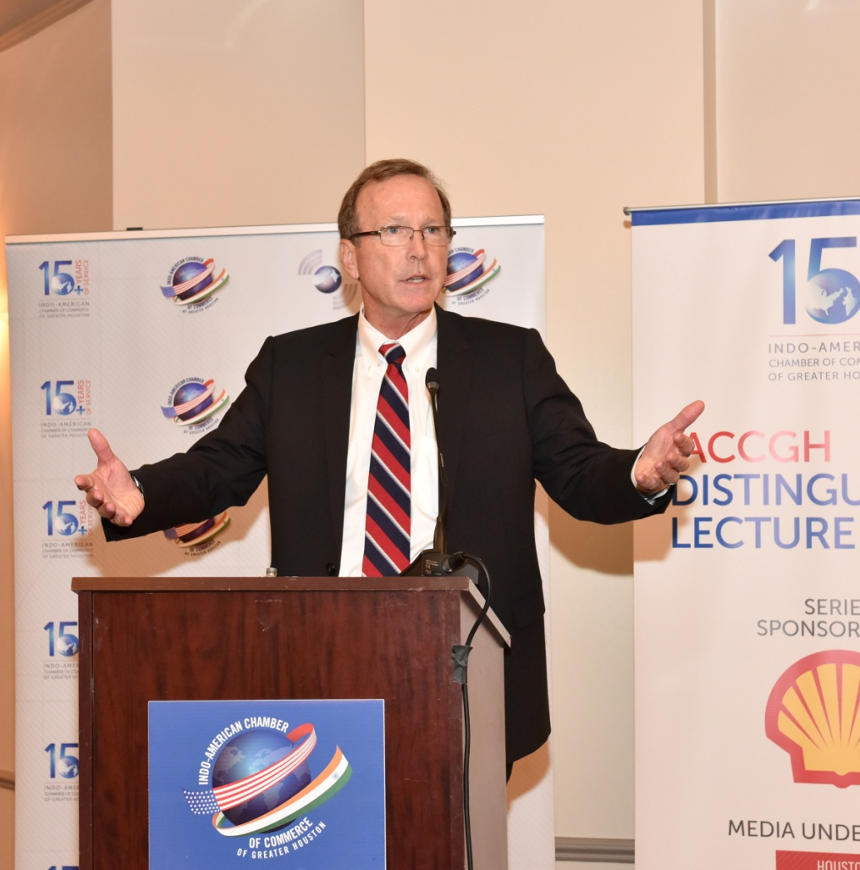
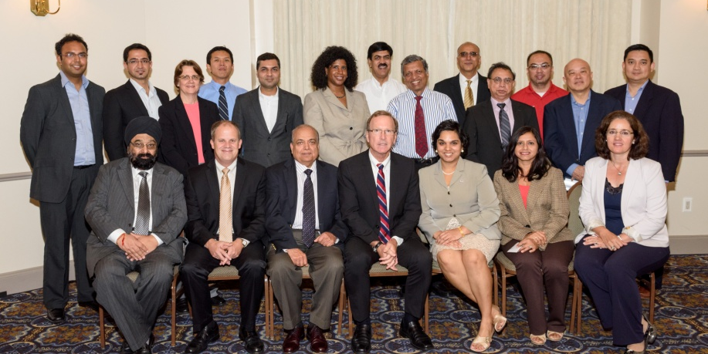
IACCGH Distinguished Lecture featuring Neil Bush Oct 13, 2015

Slide 17
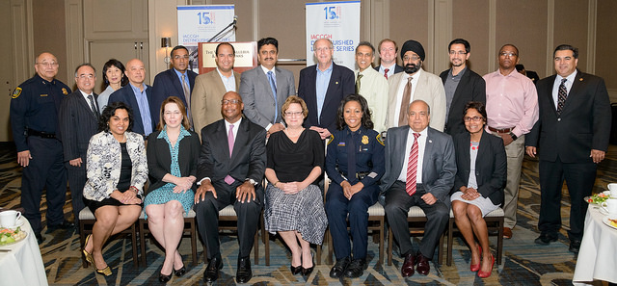
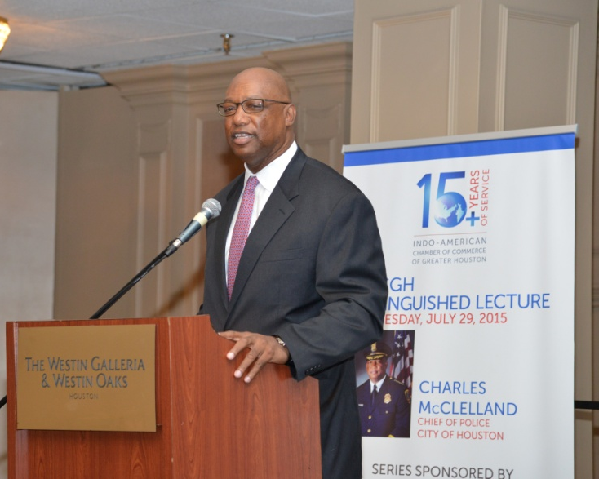
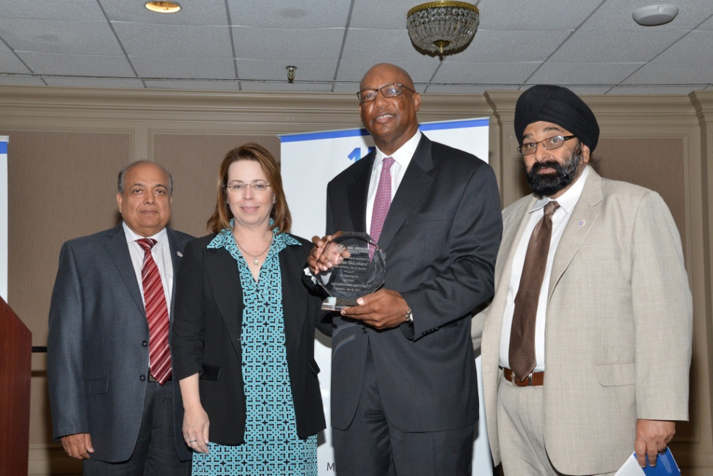
IACCGH Distinguished Lecture featuring Charles McClelland , Chief of Police of the City of Houston June 30, 2015

Slide 18
Women Mean Business
To encourage leadership skills, confidence building techniques and networking opportunities for women
Two events planned:
Programs to be planned and executed by President Elect Joya Shukla
Ping Sun/Rice University, Sabrina Singh, NASA scientist to conduct one WMB event
Dean of the University of St.Thomas Business School, Beena George to conduct the second WMB event

Slide 19
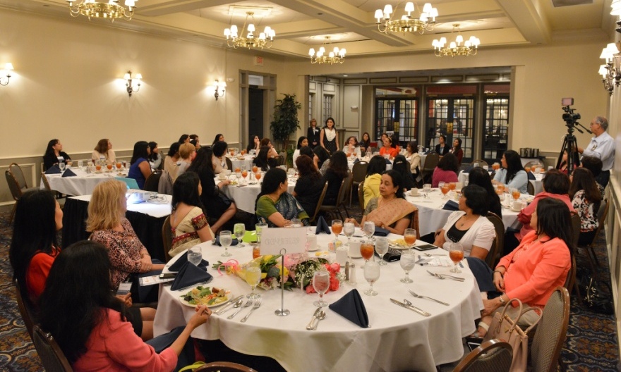
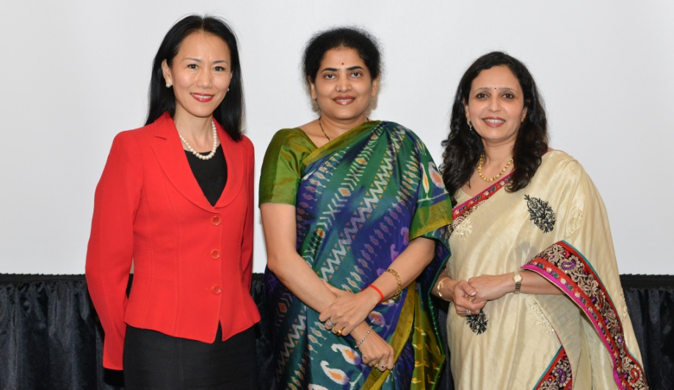
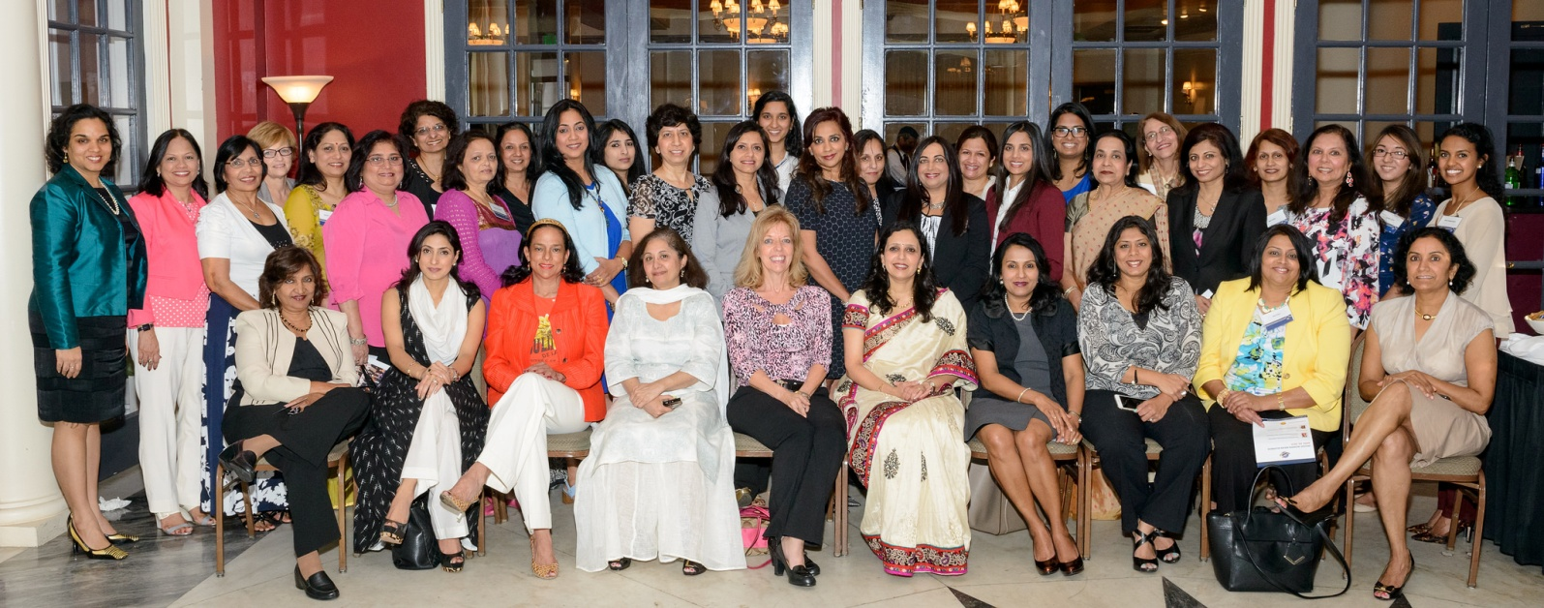
Women Mean Business | April 29, 2015

Slide 20
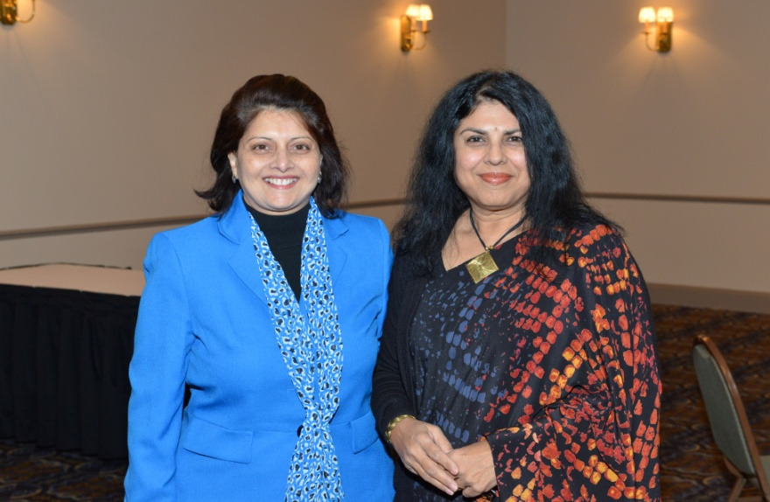
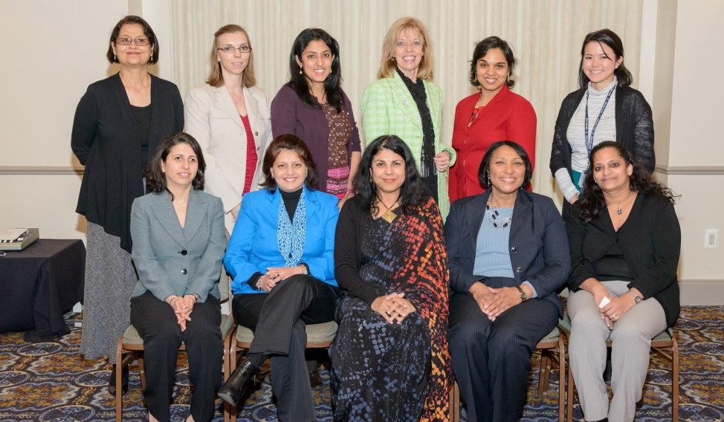
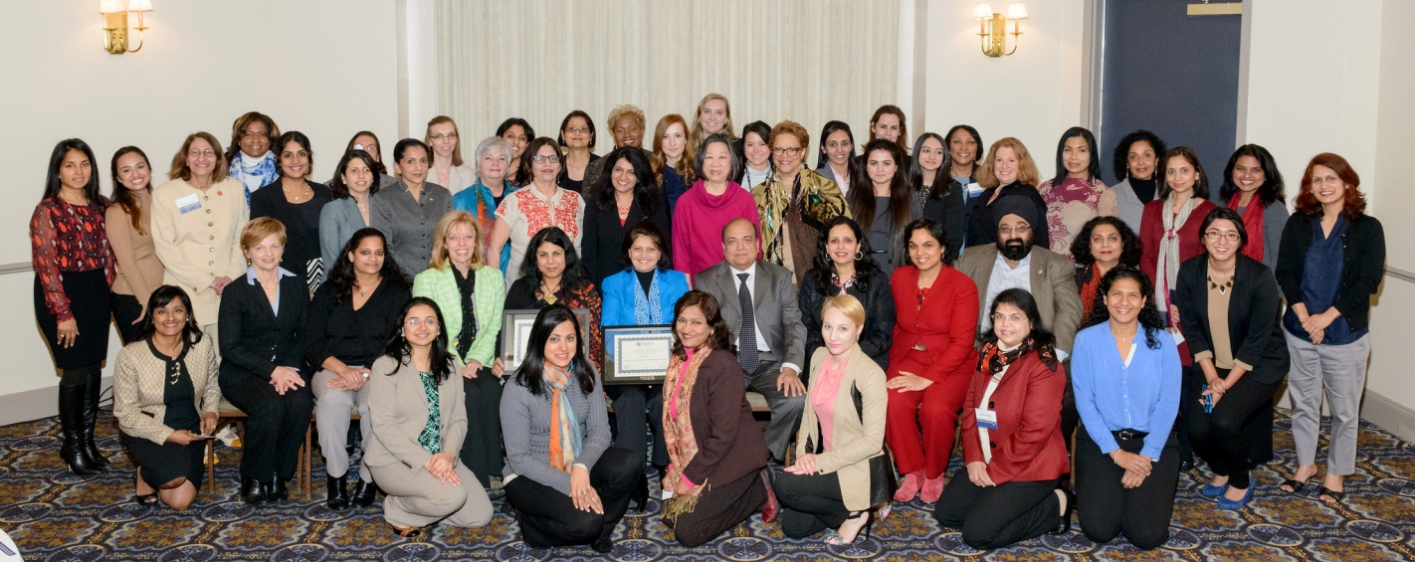
Women Mean Business | February 24, 2015

Slide 21
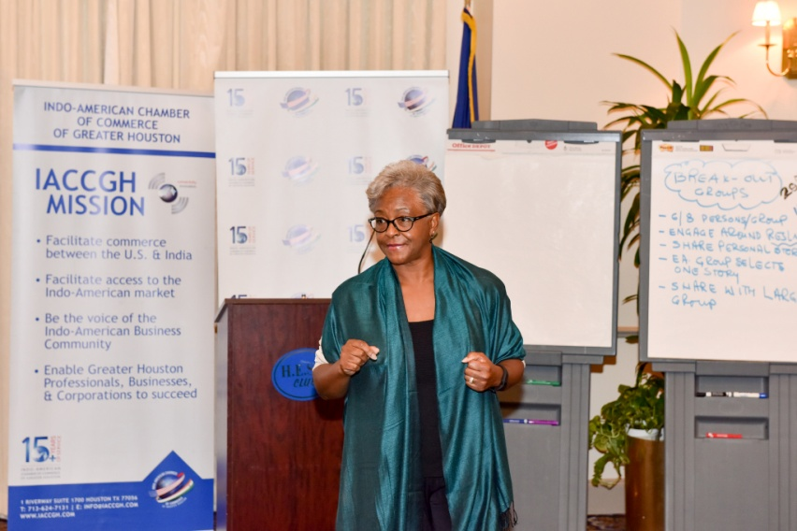
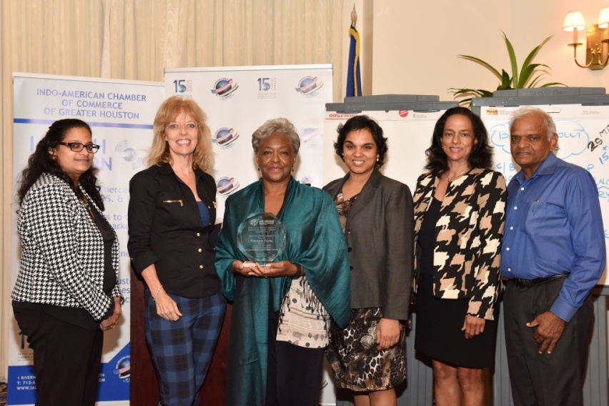
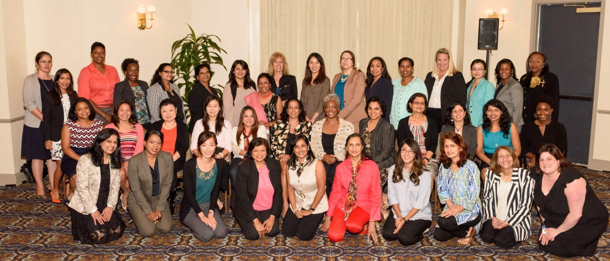
Women Mean Business | February 24, 2015

Slide 22
Mentoring Programs for Women
Two events planned to offer real time advice for the real world
Program to be planned and executed by President Elect – Joya Shukla
Francene Young, Dean Latha Ramchand to conduct two mentoring sessions

Slide 23
Power Breakfast Dialogues
Members meet elected officials/decision makers in a small group setting
Possibilities include:
Sheriff Adrian Garcia
Mayor Pro-Tem of Houston - Ed Gonzalez
Mayor of Sugar Land - James Thompson
More names to be added

Slide 24
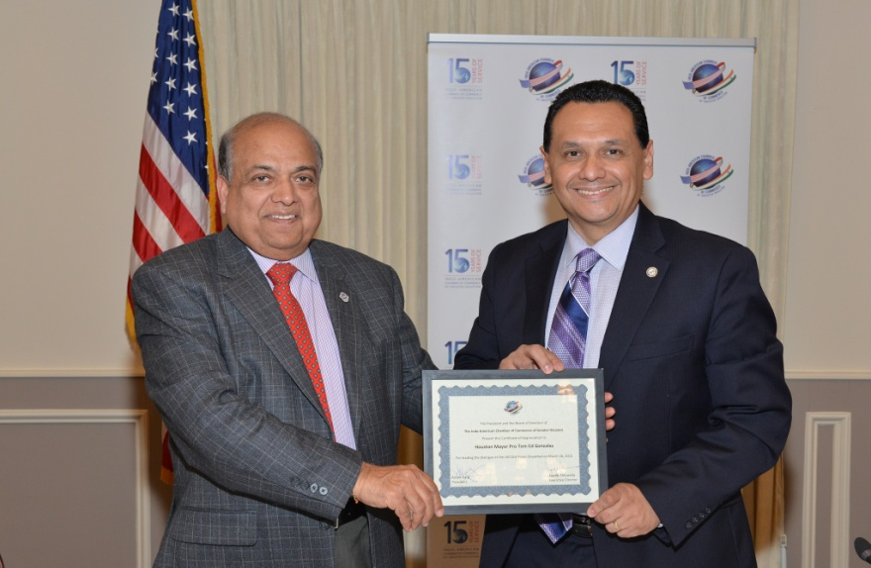
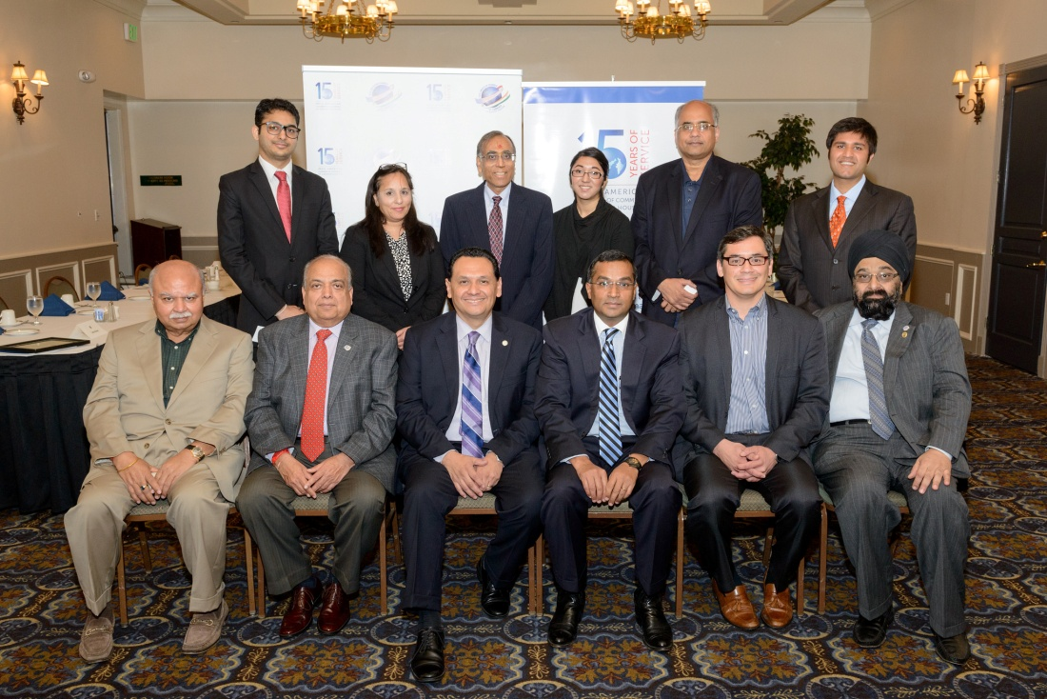
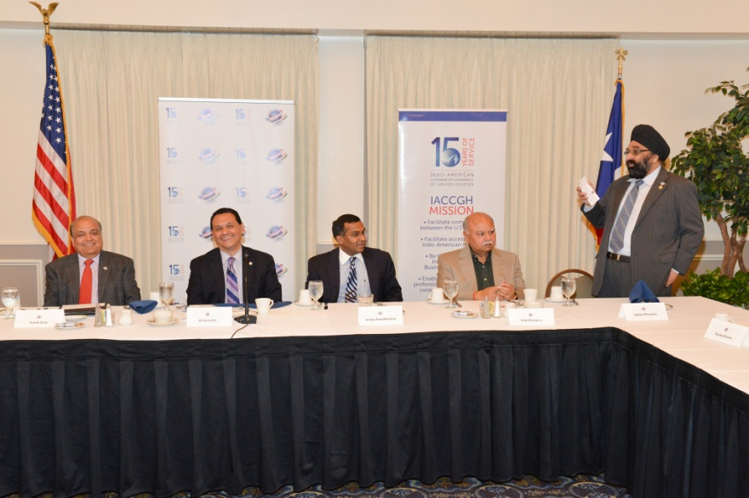
Power Breakfast with Mayor Pro-Tem Ed Gonzalez| March 26, 2015

Slide 25
Community / Small Biz Outreach
Planned events:
Indian Tax Laws Seminar on January 25, 2015
HCC Katy Campus in February
HCC Sugar Land Campus in April/May
Wallis State Bank in Q2
HCC at 610 & 59
Budget Update by Ernst & Young

Slide 26
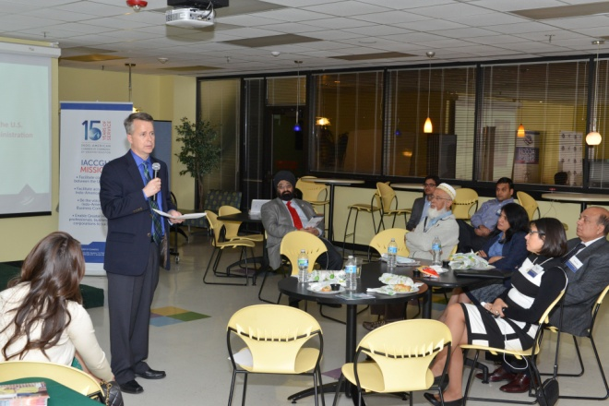
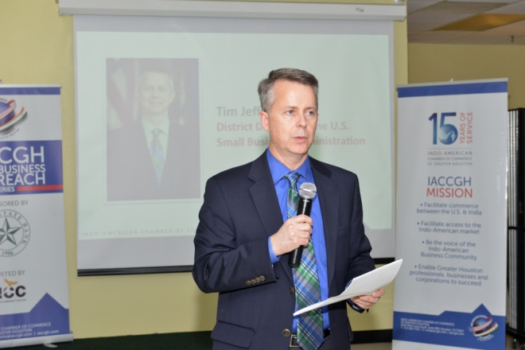
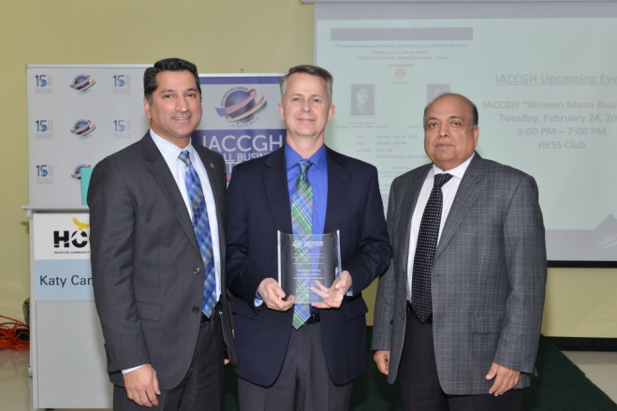
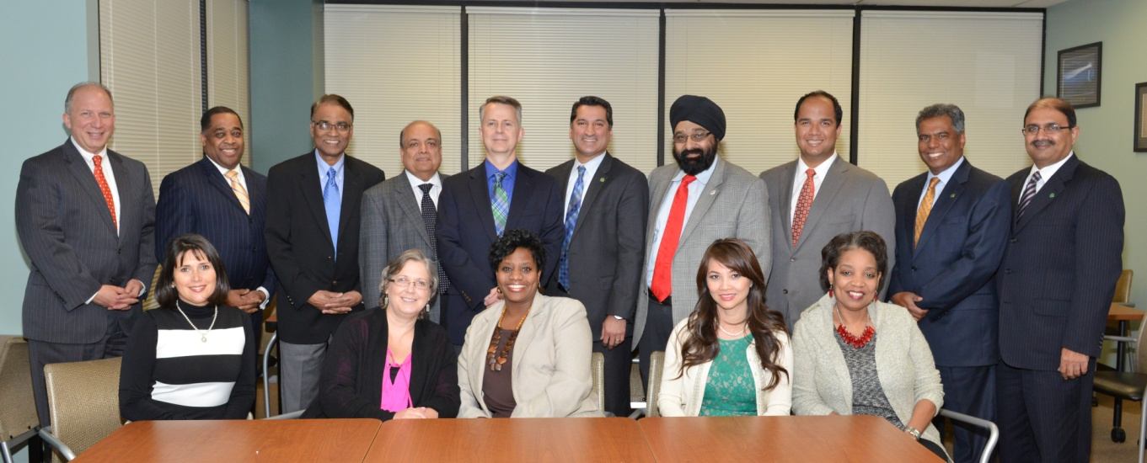
Small Business Outreach February 12, 2015

Slide 27
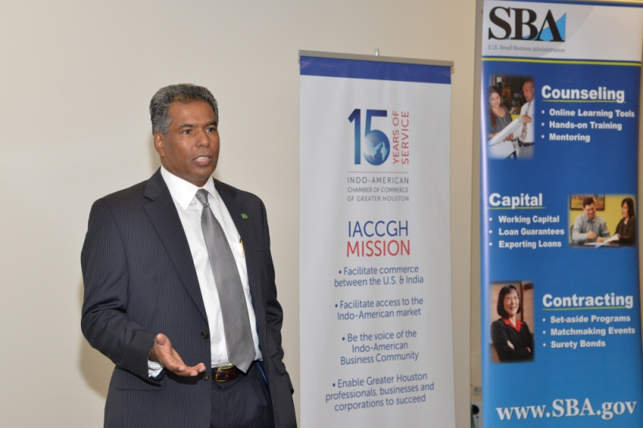
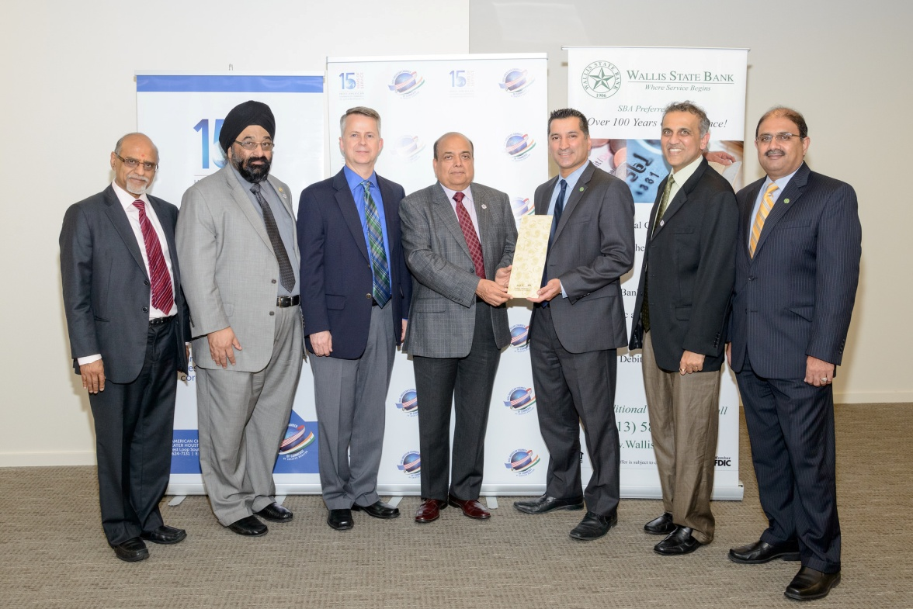
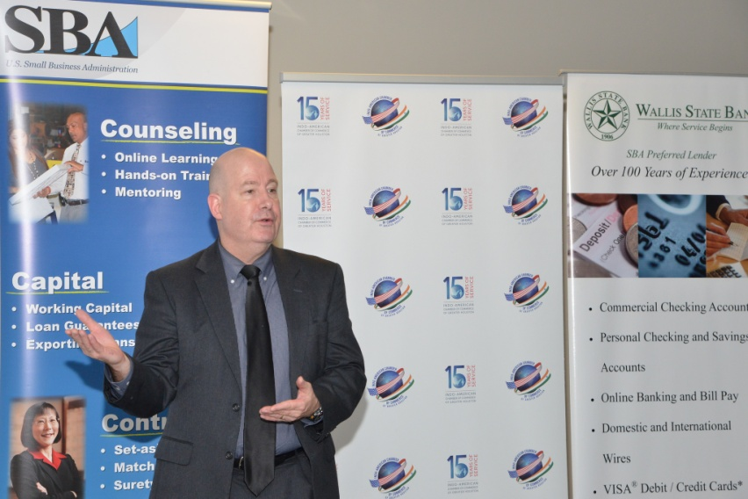
Small Business Outreach| May 20, 2015

Slide 28
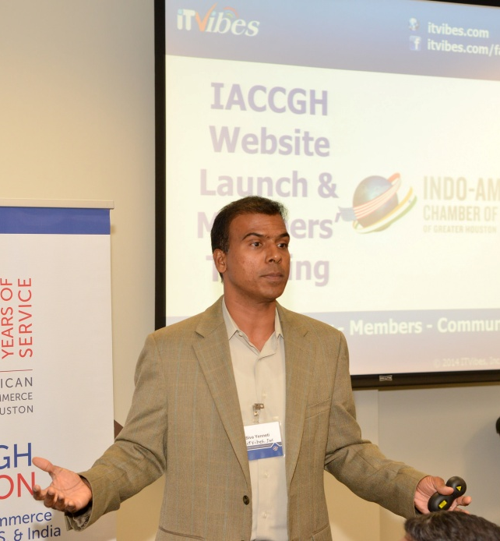
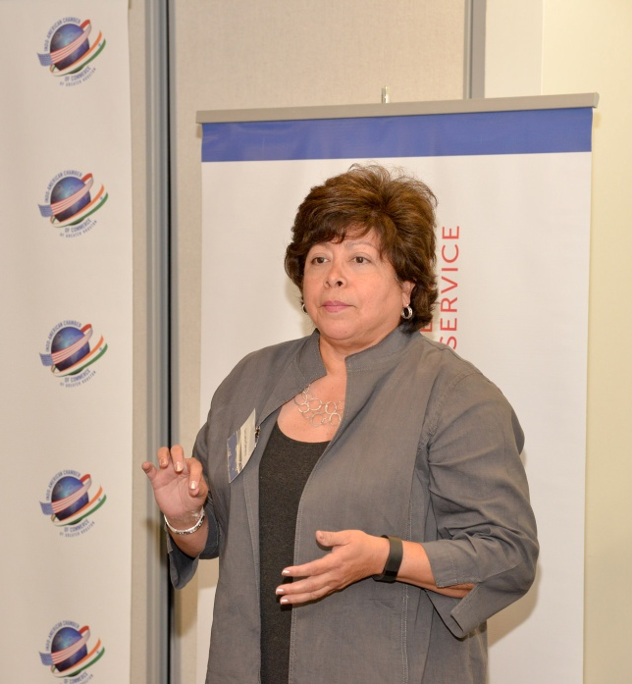
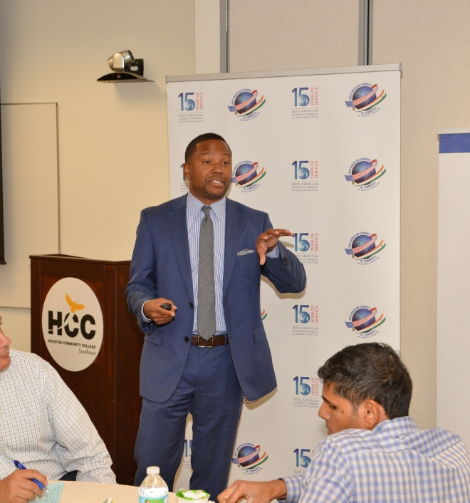
IACCGH Small Business Outreach HCC West Loop Campus August 26, 2015

Slide 29
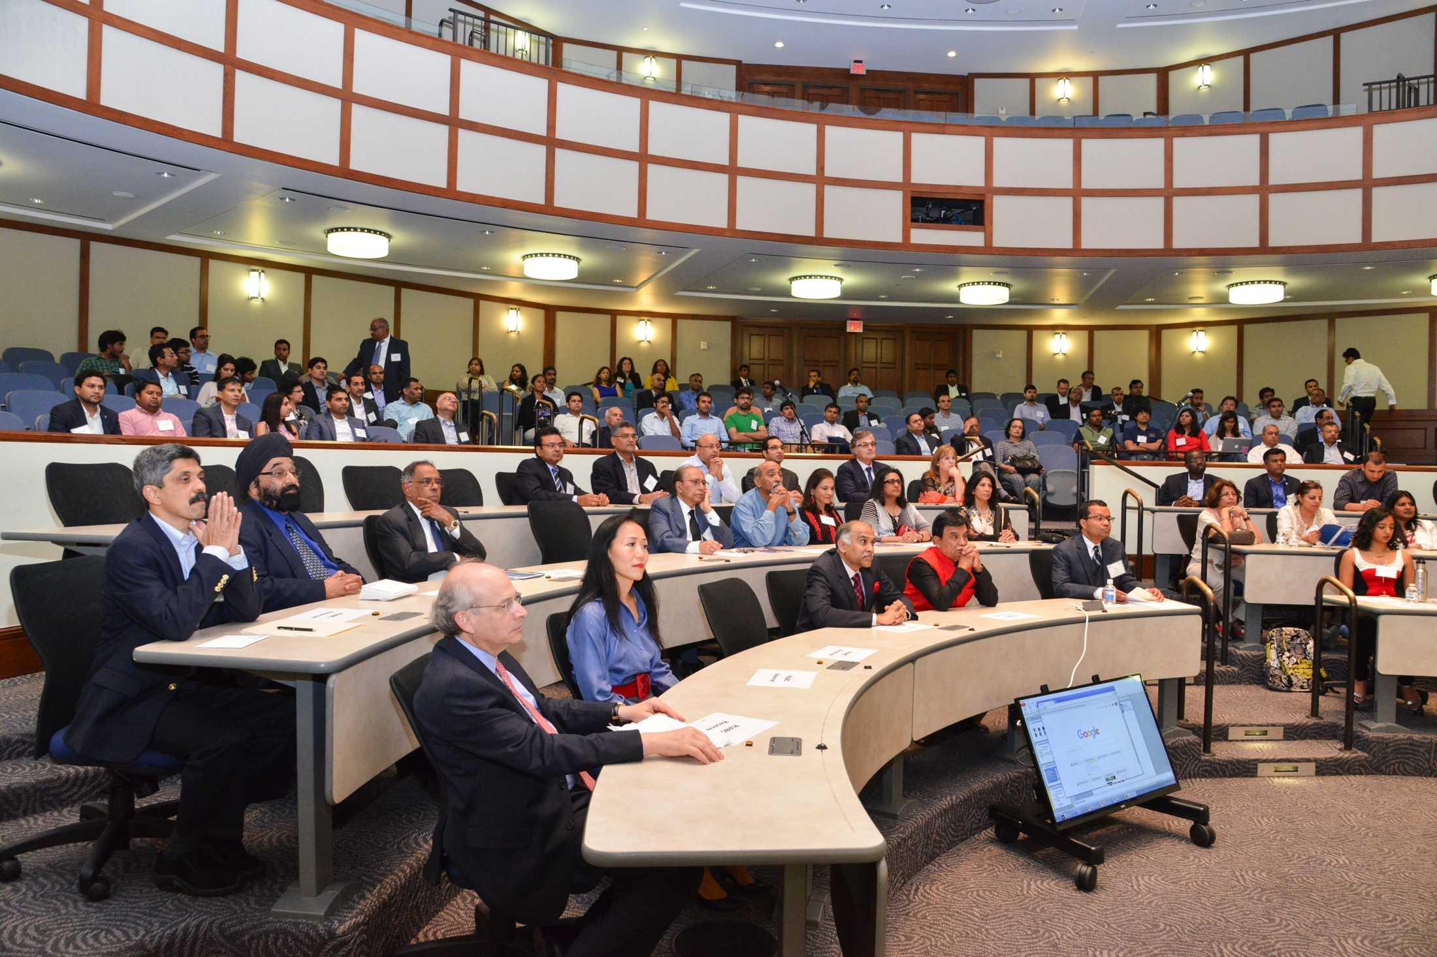
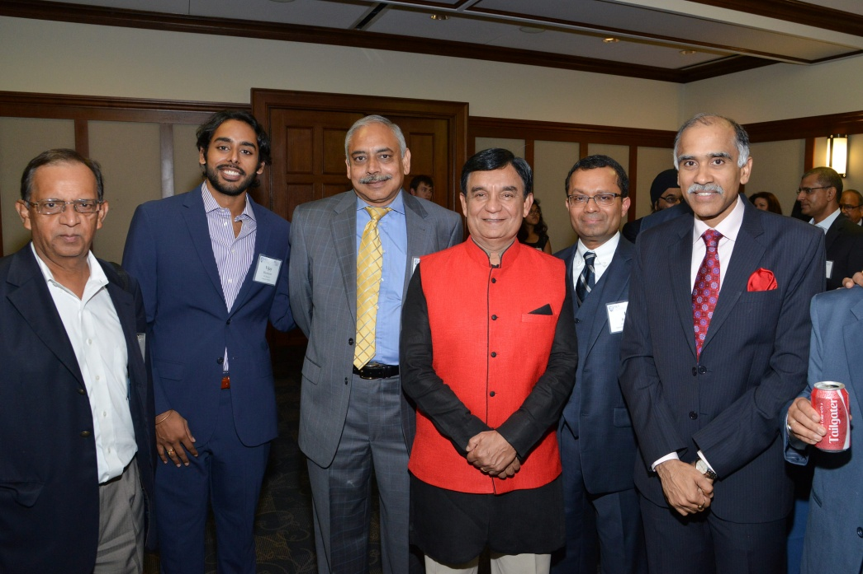
IACCGH Supports the Rice University Indo-American Business Club, September 2, 2015

Slide 30
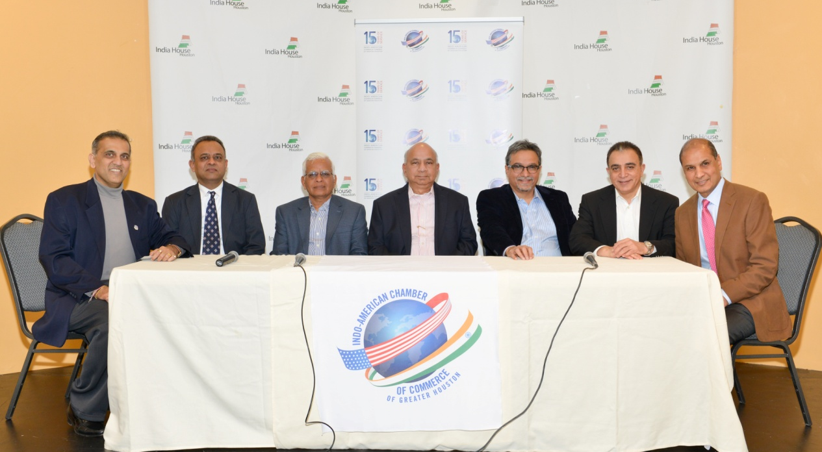
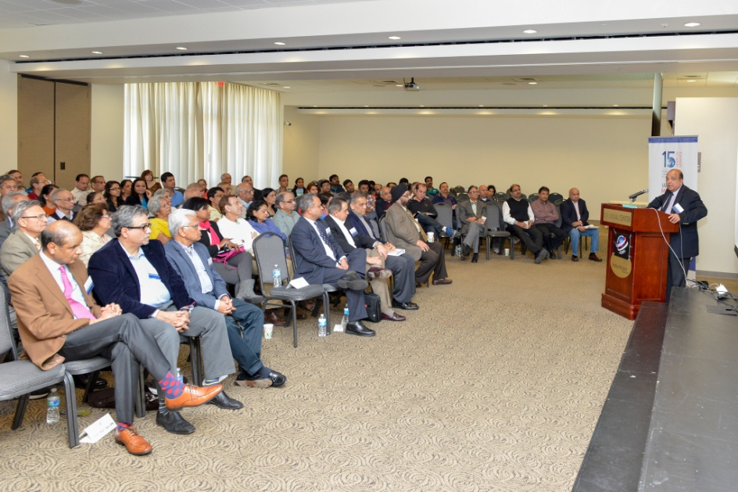
Tax Laws Seminar | January 25, 2015

Slide 31
Connecting for Growth Trade Delegation to India
Will facilitate Mayor Annise Parker’s trade delegation to India in April.

Slide 32
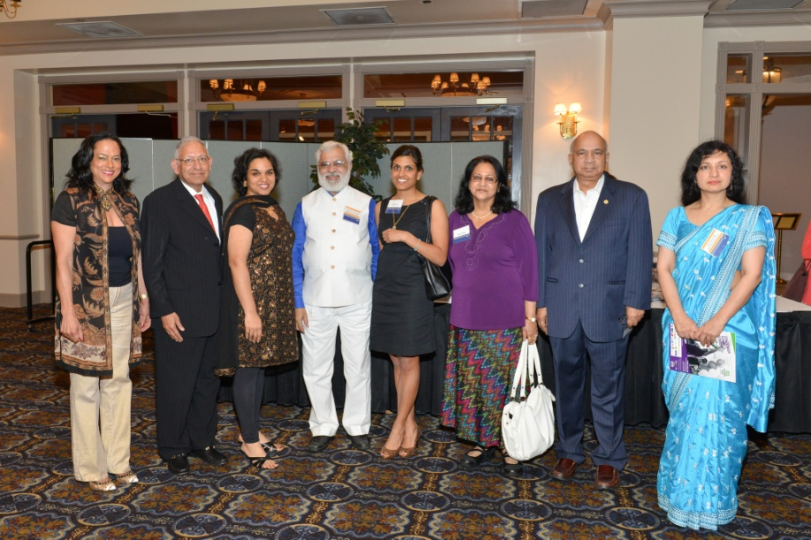
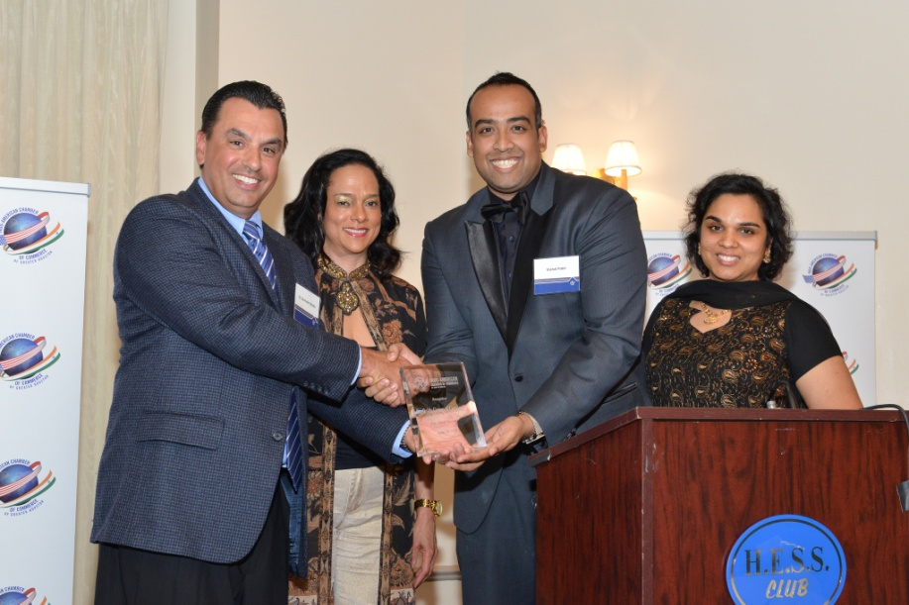
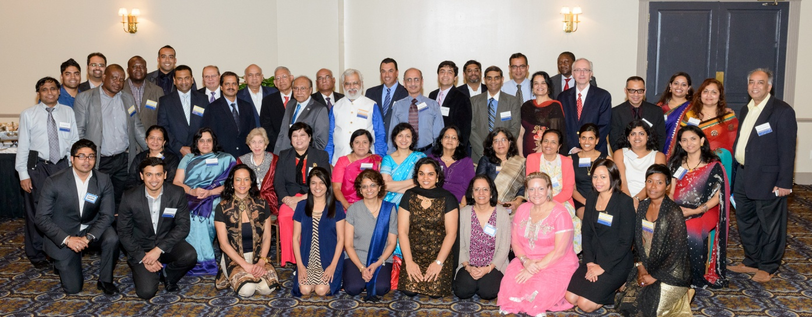
Doctors Reception| April 16, 2015

Slide 33
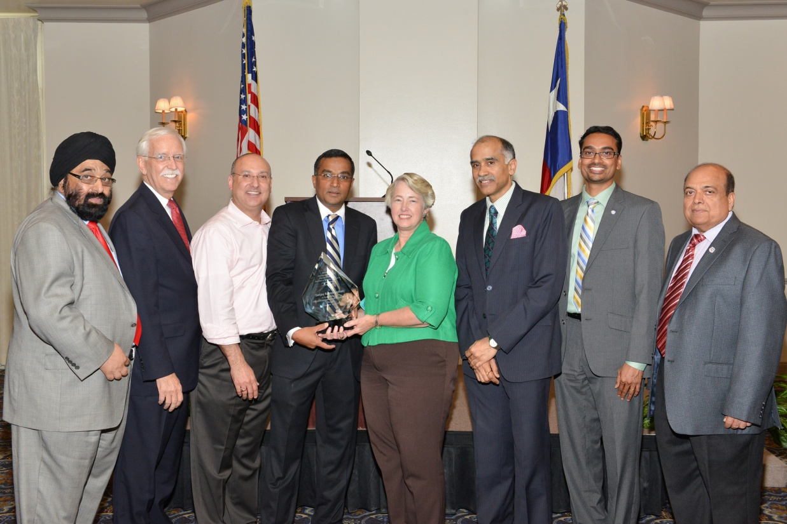
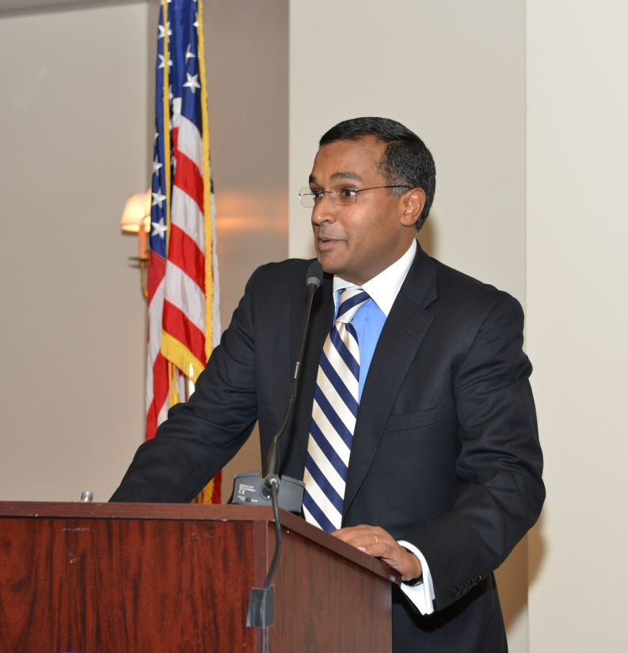
Sanjay Ramabhadran appointed to the METRO Board August 16, 2015

Slide 34
Broadening the scope of our activities with two new programs
Student Internship Program
In talks with Houston Universities and Indian companies for US students to intern at Indian companies
Energy Meet
Members from the energy field meet and greet

Slide 35
Gala
Our Biggest Event of the Year - the Gala, to be held
in Q3/Q4
Keynote Speaker to be decided

Slide 36
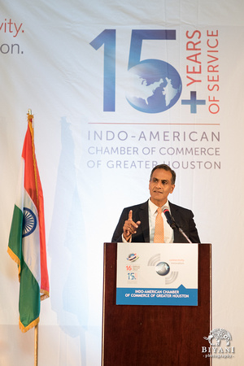
IACCGH 16th Annual Gala September 19, 2015

Slide 37
In addition, continue to partner with other economic agencies, educate the business community, offer volunteering opportunities to our members and be the voice of the Indo American community

Slide 38
Cheers to a wonderful and exciting 2015!

