Slide 1
Mahesh Desai CPA, CFP, CFA CPA & Financial Advisor
Report of Foreign Bank and Financial Accounts (FBAR)
FinCEN (Financial Crime Enforcement Center)
Form 114
&
Business Tax Reform
Indo-American chamber of commerce – greater Houston (Iaccgh)

Slide 2
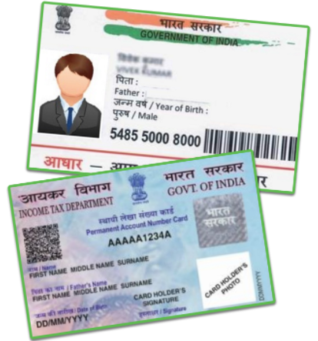
Aadhaar Card / PAN Card
As per Unique Identification Authority of India(UIDAI), established under Aadhaar Act 2016, “US Citizen/NRI/OCI (Overseas Citizen of India) are not eligible to obtain Aadhaar and hence are fully exempted to produce Aadhaar for any verification... NRI/OCI need not verify their bank account or PAN with Aadhaar.
If required, they may inform the service provider(s) that they being NRI/OCI are exempted from Aadhaar verification". UIDAI clarified that it is NOT mandatory for NRIs or OCIs holding accounts in India to get their Aadhaar card linked by the March 31 deadline.
You can have PAN card for Indian Income tax reporting purpose and for filing Indian Income tax Return.

Slide 3
Who must file form 114 – failure to file and voluntarily disclosure
US laws impose an obligation on the US person to file FBAR FinCEN Form 114 and Form 8938 – Statement of Specified Foreign Financial Assets
United States persons with financial interest in or signature authority over at least one financial account located outside of the United State; and
The aggregate value of all foreign financial accounts exceeded $10,000 at any time during the calendar year reported.
FBAR - a calendar year report, must be filed electronically by April 15th through FinCEN’s BSA E-Filing System.
Similar to tax return- six months extension to file FBAR is available.
Questions on Schedule B of Form 1040 - ask about your Foreign Bank Account & FBAR filing
2019 FBAR Update: No New Rules but Enforcement Threat Looms.
If IRS sends you letter and ask you to file - Civil penalty assessment:
If non-willful, up to $10,000 per violation;
If willful, up to the greater of $100,000 or 50% of the account balances and criminal penalties may also apply.

Slide 4
What if you failed to file FBAR? Taxpayer Voluntarily Disclose
Offshore Voluntary Disclosure Program (OVDP): - ENDED on Sept 28, 2018
The IRS claims - Since the launch of the program, taxpayers with undisclosed offshore accounts have paid a total of $11.1 billion in back taxes, interest, and penalties.
Streamlined Domestic Offshore Procedures (SDOP)- Open Currently – File delinquent FBAR, File Amended returns, pay back taxes with interest and penalty by including overseas income
*** if non willful claim is accepted by IRS- FBAR Penalty is only 5% of highest account balance
If IRS finds - failure to file was willful and rejects your request, it may open audit or assign case for Criminal investigation.

Slide 5
Financial Assets-Reporting Form 8938
Marital Status | Year-end Aggregate Value of All Specified Foreign Financial Assets Exceeds: | Any time during the year Balance Exceeds:
Single or MFS living in the US | $50,000 | $75,000
MFJ, living in the US | $100,000 | $150,000
Single or MFS living outside the US | $200,000 | $300,000
MFJ, living outside the US | $400,000 | $600,000

Slide 6
Foreign Tax Withheld and Double Tax Avoidance Treaty
The amount of foreign tax that qualifies as a credit is not necessarily the amount of tax withheld by the foreign country. If you are entitled to a reduced rate of foreign tax based on an income tax treaty between the United States and a foreign country, only that reduced tax qualifies for the credit. Include on Form 1116 Part II ONLY the amount of creditable taxes. Amounts for which you are not legally liable (such as taxes in excess of the treaty rate) should be excluded from the amount reported in Part II

Slide 7
US Residency Tax Certificate
Certification of U.S. Residency for Tax Treaty Purposes
Many U.S. treaty partners require U.S. citizens and U.S. residents to provide a U.S. Residency Certificate in order to claim income tax treaty benefits, and/or certain other tax benefits, in those foreign countries. The IRS provides this residency certification on Form 6166, a letter of U.S. residency certification.
Form 6166 is a computer-generated letter printed on stationary bearing the U.S. Department of Treasury letterhead certifying that the individuals or entities listed are residents of the United States for purposes of the income tax laws of the United States.
To obtain Form 6166, a letter of U.S. Residency Certification, you must submit a completed Form 8802, Application for United States Residency Certification and pay a user fee of $ 185 each year.

Slide 8
Overview of Business Changes - the way businesses are taxed - What to expect in 2019
Corporate tax rate C-Corp | Reduced from 35% to 21%
New deduction for small business owners – Sole, Partnership, S-Corp- Pass through entities | 20% deduction on “Qualified Business Income” (QBI), subject to limitations
Enhanced expensing for capital spending | For the next five years, immediately expense capital investments
Increase in Estate tax exemption | $11.4 Million per person till 2026(will be reduced if democratic congress and democratic president comes to power in 2021)
Notes:
A key area of this comprehensive tax law is the overhaul of business-related taxes. Prior to the law, the 35% corporate tax rate was the highest in the world. Reducing it to 21% brings it in line with developed nations. However, most businesses in the U.S. are not large corporations but are structured as “pass-through” entities such as S Corps, LLC’s, partnerships, and sole proprietorships. While the top marginal tax rate of 37% applies, many of these businesses will benefit from a 20% deduction of their business income. Another attractive benefit for corporations is 100% expensing over the next five years which will provide an incentive for companies to expand and purchase equipment. On the negative side, companies who employ leverage to raise capital may see their borrowing costs rise as they are limited in deducting those net interest payments. For four years, the 30% limitation is based in earnings before interest, taxes, depreciation and amortization (EBITDA). After that, the deduction is limited to 30% of earnings before interest and taxes (EBIT). Lastly, due to tax reasons, many large corporations hold significant amounts of profits overseas. As part of the law, these overseas profits will be considered repatriated whether or not the company brings the assets back to the U.S.

Slide 9
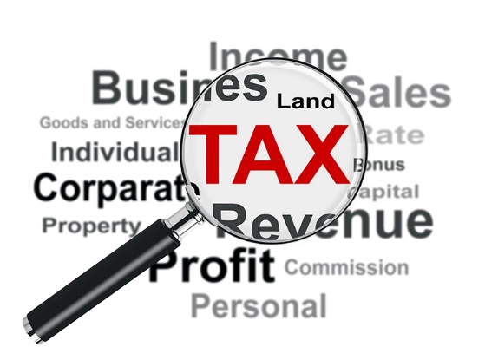
Overview of Business Changes
Special rules for pass-throughs (Sec. 199A)
Expensing of assets - increases to Sec.179 ($1 million and threshold $2.5 million)
Expanded accounting method exceptions for small businesses – Cash Basis up to $ 25 Million
No Carry back of NOL(net operating loss) only Carry forward allowed going forward indefinitely
Personal service corporations taxed at same rate (no more surtax)
Changes for Sec. 1031 exchanges - like-kind exchanges it applies only to exchanges of real property and not to exchanges of personal or intangible property.
Notes:
Here is an overall summary of the changes: We will discuss these in more detail in further slides.
Corporate rate reduction to flat 21%
Repeal of corporate AMT
A new 20% deduction for pass-through income (Sec. 199A)
Loss limitation for other than C corps (Sec. 461)
Repeal of Sec.199-domestic production deduction
Expensing of assets (bonus depreciation provisions plus increases to Sec.179 ($1 million and threshold $2.5 million)
Expanded accounting method exceptions for small business
Changes to various fringe benefits including provision of meals and entertainment by employer
No more carrybacks of NOL and 80% limit on current year use of NOL
30% limitation on interest expense deduction for non-small businesses (over $25 million receipts); limited exceptions
Corporate shift from worldwide to territorial system

Slide 10
20% QBI Deduction for Pass Through - S 199A
Section 199A provides for a deduction of the lesser of domestic “qualified business income” (“QBI”) or 20% of taxable income generated by a partnership, S corporation or sole proprietorship
Calculation of the Section 199A deductions required careful analysis and application of entirely new terms and concepts: Qualified Trade or Business; Specified Services Business; Qualified Business Income; Qualified Investment Property; Complicated Deduction Limitation Calculations
QBI is all domestic business income other than investment income (e.g., dividends and interest (other than qualified REIT dividends and cooperative dividends).
Most service businesses (law, accounting, health, financial services, athletics, consulting, hedge fund managers) are Specified Services Business and are subject to phase out limitations.

Slide 11
How the QBI deduction works
*The deduction may be subject to a wage limitation based on total wages paid (50% of W-2 wages) or a combination of wages paid and unadjusted basis of property held by the business (25% of W-2 wages plus 2.5% of unadjusted basis of depreciable property).
Taxable income of $157,000 (individuals) or $315,000 (married/filing jointly) or less | 20% deduction available (including service businesses)
Over $157,500 but under $207,500 (individuals) or $315,000 but under $415,000 (married/filing jointly) | 20% deduction available to non-service businesses subject to a wage limitation*; deduction begins to be phased out for service businesses
At least $207,500 (individuals) or $415,000 (married/filing jointly) | No deduction for specified service business. Other businesses can qualify for a deduction equal to 20% of qualified business income*
Notes:
Here’s more detail on the new 20% deduction for pass-through business income works. Small business owners should work with a tax expert to make the most of new 20% deduction. The 20% deduction for qualified business income (QBI) is a new addition to the tax code so business owners should take steps to understand how it works, and how timing of income and other actions may impact the deduction — both positively and negatively

Slide 12
Depreciation - Expensing of Capital Investments
Allow businesses to immediately write off new investments in depreciable assets including for residential rental property
Expansion for certain real property (roofs, HVAC)
Increases to Sec. 179 ($1M of deduction and threshold of improvement up to $2.5M)
Bonus depreciation- 100% for property acquired after 9/27/17
Now allowed for new and used property
automobile depreciation limits – (10K/16K/9.6K for 1st,2nd and 3rd year and $5,760 for subsequent years)
SUV (over 6K -lbs. gross weight) if used 100% for business - write off available
Notes:
The new law increases the bonus depreciation to 100% for property acquired and placed in service after 9/27/17.
There is a new phase-down schedule for years after 2022 (80% 2023; 60% 2024; 40% 2025; 20% 2026; 0 2027 and forward).
For the 2017 year, if property was purchased and placed in service after 9/27, there is an election to apply the 50% bonus rather than 100%.
Another change is that the requirement that the original use of qualified property must begin with the taxpayer has been removed. So, both new and used property is available for bonus depreciation.
The new law keeps the increased $8k depreciation for luxury auto placed in service in 2018 (eliminating the phase down for autos placed in service after 2017).
The depreciation limits for luxury auto starting in 2018 allow $10k for year of service; $16k for 2nd year; $9,600 for 3rd year; and $5,760 for 4th and later years). These limits will be indexed for inflation.
Sec. 179 has been increased to $1M with a phase out threshold of $2.5M. The $25,000 sport utility limit was maintained. The new law also expands the definition of Sec. 179 property to include personal property connected with lodging for residential rental property. In addition, improvement to nonresidential real property was expanded to include roofs, HVAC, fire/alarm systems and security systems.

Slide 13
Tax rates on capital gains – use OZ to your advantage
*Does not include the 3.8% surtax on net investment income, which applies to single filers over $200,000 in modified adjusted gross income (MAGI) and for married couples with more than $250,000 in MAGI.
Individuals | Married/filing jointly | Tax rate*
$0–$38,600 | $0–$77,200 | 0%
$38,601–$425,800 | $77,201–$479,000 | 15%
Over $425,800 | Over $479,000 | 20%
Notes:
In general, tax rates on long-term capital gains and qualified dividends do not change as a result of the new law. However, they are based on the previous brackets where the long-term capital gain / qualified dividend rate was as follows:
10% and 15% brackets = 0% capital gain and qualified dividend rate
25%, 28%, 33%, and 35% brackets = 15% capital gain and qualified dividend rate
39.6% bracket = 20% capital gain and qualified dividend tax rate
Because the brackets and corresponding tax rates have been modified, the capital gain/qualified dividend rates do not align with the income tax rates anymore. They are based on certain income levels as shown in the chart above.

Slide 14
Opportunity Zones
Opportunity Zones are an economic development tool—
designed to spur economic development and job creation in distressed communities
by providing tax benefits to investors.
capital gains realized by an investor in the 180 days before an Opportunity Fund investment are eligible for the tax benefits of investment in Opportunity Funds
Notes:
For 2018 and forward, except in certain situations (specific farming losses for one), the 2 year carryback has been repealed.
The NOL carryforward period is indefinite, but only 80% of taxable income can be reduced by the NOL. This is another provision that may affect the calculation of the tax provision for deferred tax assets generated by NOLs.

Slide 15
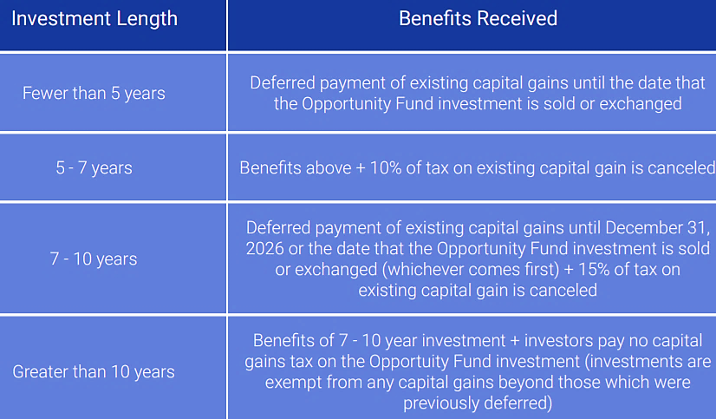
The Opportunity Zone program is designed to incentivize long term investments:

Slide 16
Qualified Opportunity Zone Property
Qualified Opportunity Zone Stock (Qualified Opportunity Zone Business)
Qualified Opportunity Zone Partnership Interest (Qualified Opportunity Zone Business)
Qualified Opportunity Zone Business Property

Slide 17
Federal gift and estate taxes
18% to 40% | Range of marginal tax rates on estates and gifts in excess of lifetime exemption amount
$11.4 million (For 2019) | Lifetime gift and estate tax exemption
$15,000 | Annual gifts to as many recipients without resulting in a taxable gift and reducing the lifetime exemption amount
Notes:
With the Tax Cuts and Jobs Act, less estates will be subject to the estate tax. This is because the lifetime estate/gift exemption amount doubles to over $11 million per individual. That means that a married couple can effectively shelter over $22 million in net worth from estate taxes. Of course, these rules sunset after 2025 when the exemption amount will revert to current levels (adjusted for inflation). Also, the annual gift exemption increases by $1,000 to a total of $15,000 in 2018.

Slide 18
Estate planning considerations
Even with the higher lifetime exclusion amount, estate planning remains critical to efficiently transfer wealth and plan for contingencies
Be mindful of state death taxes
Plan for low cost-basis property
Ensure stepped-up cost basis is maintained when property is transferred at death
Work with an estate planning professional to account for the potential “sunset” of the law in 2026
May be short lived if Democratic congress and President starting 2021
Assumptions about life expectancy become important
Life insurance trust probably still relevant - <10 year grantor retained annuity trust (“GRAT”)
Dynasty trust planning with repeal of GST
10 year qualified personal residence trust (“QPRT”)
Make annual gift tax exclusion gifts -Pay tuition and medical expenses – unlimited exclusion amounts
Notes:
The doubling of the lifetime exclusion changes the landscape for many in terms of planning for estates and gifts. However, many states still have their own “death taxes” in place. For example, estates over $1 million in value in Massachusetts are subject to state estate tax. Residents in those states need to consider options such as life insurance which may provide liquidity at death for the survivors to pay the tax bill. Since full step-up in cost basis at death is still available, many families will want to assess which property has low basis and try to maximize step-up at death. For example, gifting assets while living will result in carryover basis to the person who receive the gift. Additionally, certain trusts may be decanted or “poured over” to new trusts which may account for step up in cost basis. For those in high income states (CA for ex.), creating trusts in other tax-friendly states may be a means of mitigating state taxes (NV or DE trusts for ex.). For those who have funded trusts (bypass trust for ex. at the death of the first spouse), decanting these trusts may make sense to structure assets in a way where they will benefit from step-up in cost basis at death. This depends on whether there is the appropriate amount of estate/gift tax exemption in place. Lastly, it’s critical to work with a qualified estate planning professional since estate and gift tax laws are very complex and ever-changing.

Slide 19
Estate planning is more than just the taxes
Wills, beneficiary designations | Critical to review and update periodically
Revocable living trust | Transfers property outside of the probate system
Health-care proxy and advanced medical directive | Facilitate decisions around medical treatment or end-of-life wishes
Power of attorney | Assigns decision-making responsibilities in case of unforeseen circumstances
Guardianship | Planning for minors or other extended family members
Notes:
While many estates will fall below the exemption level, this does not mean that only individuals and families with significant wealth need to focus on estate planning. The reality is that proper estate planning extends well beyond minimizing or preparing for federal estate taxes. It’s critical to have the right documents in place to address the risk of an unforeseen circumstance such as incapacitation as well as plan for the orderly and efficient transition of property at death.

Slide 20
Planning for 2019 and beyond
The Tax Cuts and Jobs Act represents the most sweeping changes to the tax code in decades
Careful attention must be made to determine the impact on your financial situation
Work with professionals to assess income and estate tax planning strategies
Guidance needed on Sec. 199A (pass-through deduction)
Definitions: qualified business income; qualified trade/business; small business
Effect of corporate rate reduction to 21% on choice of entity
Re-examine entity choice: S-Corp v. LLC v. C-Corp
Always conduct annual meetings and memorialize in writing business decisions
Ratify tax planning decisions
Helps secure entity level liability protection
Revisit regularly partnership and shareholder agreements
Notes:
Significant changes may be on the horizon in the future as our nation grapples with federal debt and the pressures of entitlement programs. Investors would be well served to keep a close eye on how these changes will impact their personal finances. The best preparation is to consult with a financial advisor or tax professional, who can offer some perspective on your specific financial and tax situation, help you understand the risks, and position your assets accordingly. The markets and the regulatory environments are always changing, and in uncertain times like these, sound financial advice should be at the foundation of any long-term investment strategy.

Slide 21
Planning Opportunities
Complicated ?
Complexity = possible savings opportunities
Take advantage of tax cut and tax saving options made available to you under TCJA
A CPA can provide both tax & wealth planning
help so its up to you take advantage.
Notes:
So many decisions a business makes have tax consequences – choice of entity, debt financing, changes to employee benefits, lease or buy equipment decisions, even planning a company party. Today, we touched on the major topics at a very high level, but with the complexity of the new tax law it is a good idea to review how the tax laws affect your business. That is where we can help. It is what we do year-round.
We can answer quick questions or provide an in-depth tax projection/analysis to help you anticipate how these new tax laws will affect your returns. So, don’t hesitate to reach out to us after today’s presentation if you’d like to discuss something in more detail.
And with that, we’ll move on to Q&A and take any questions you have. (Note to Presenter: After this last statement, move forward to the next slide and open up the floor for participant questions).

