Slide 1
PPP FORGIVENESS PROGRAM
IACCGH WEBINAR – NOVEMBER 24, 2020

Slide 2
PPP FORGIVENESS – BASIC INTRODUCTION
“PPP” – Paycheck Protection Program
5.2 million loans totaling $525 billion
PPP is a loan that converts to a grant once SBA approves and funds the lender
Not the same as “EIDL” – Economic Injury Disaster Loan
HOWEVER: “emergency” advances of up to $10,000 are tied to PPP forgiveness
PPP Forgiveness is reduced by the amount of emergency advance received
8303 Southwest Fwy, Suite 960, Houston, TX
(713) 774-6533 swapan@mdassociatescpas.com

Slide 3
PPP LOAN FORGIVENESS PROCESS
Fill out one of three forms: Form 3508S; 3508-EZ; 3508
Whichever applies
Attach required documentation specific to the form
Submit to the same lender that funded the PPP loan
Lender has 60 days plus SBA has another 90 days to approve
8303 Southwest Fwy, Suite 960, Houston, TX
(713) 774-6533 swapan@mdassociatescpas.com

Slide 4
WHEN TO APPLY
Within 10 months after the end of your forgiveness period (called “covered period”)
Forgiveness period is period during which money was spent
Starts on date the loan proceeds were received
Choice of 8 weeks or 24 weeks for loans received before June 5, 2020
24 weeks if loan received June 5, 2020 or later
Example – loan proceeds received on April 6
8 weeks end on May 24 so last date would be March 24, 2021
24 weeks end on Sep 13 so last date would be July 24, 2021
Can apply for forgiveness now, even if 24 weeks have not expired
8303 Southwest Fwy, Suite 960, Houston, TX
(713) 774-6533 swapan@mdassociatescpas.com

Slide 5
WHICH FORM TO USE
Use Form 3508S if loan was $50,000 or less
No penalty even if there was wage reduction or workforce headcount reduction
Use Form 3508EZ if:
Loan of more than $50,000 but less than $2.0 million; AND
Wage reduction or FTE reduction does not apply
EITHER because there were no reductions OR Safe Harbors were met
See later discussion on this topic
Affiliation rule – if group of businesses are affiliated, then must add up all the loan amounts
If total for group is $2.0 million or more, then must use Form 3508
8303 Southwest Fwy, Suite 960, Houston, TX
(713) 774-6533 swapan@mdassociatescpas.com

Slide 6
FORM 3508S
8303 Southwest Fwy, Suite 960, Houston, TX
(713) 774-6533 swapan@mdassociatescpas.com

Slide 7
FORM 3508EZ
More
details
8303 Southwest Fwy, Suite 960, Houston, TX
(713) 774-6533 swapan@mdassociatescpas.com

Slide 8
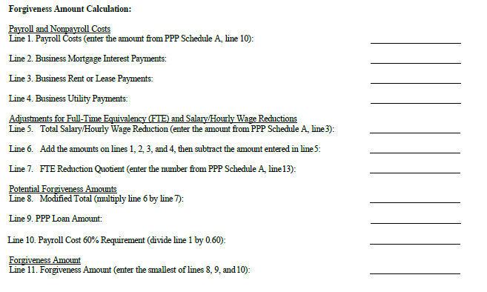
FORM 3508
Even more detail
8303 Southwest Fwy, Suite 960, Houston, TX
(713) 774-6533 swapan@mdassociatescpas.com

Slide 9
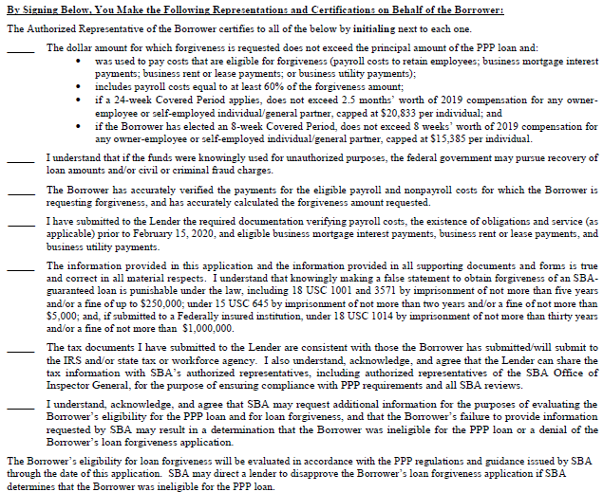
FORM 3508S
Certifications:
8303 Southwest Fwy, Suite 960, Houston, TX
(713) 774-6533 swapan@mdassociatescpas.com

Slide 10
FORM 3508EZ
Additional
Certifications:
←
←
←
8303 Southwest Fwy, Suite 960, Houston, TX
(713) 774-6533 swapan@mdassociatescpas.com

Slide 11
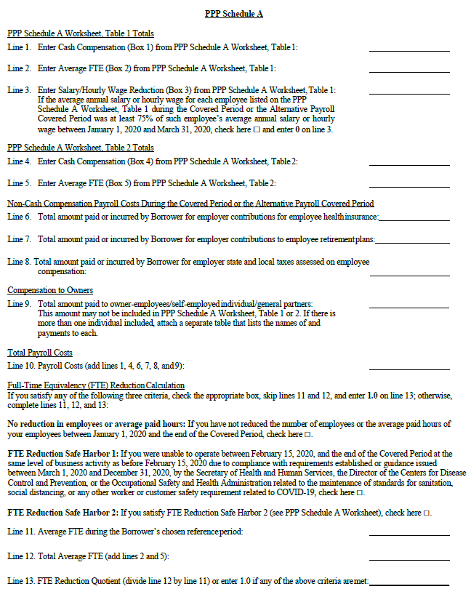
FORM 3508
Additional
Certification
And
Schedules
←
←
8303 Southwest Fwy, Suite 960, Houston, TX
(713) 774-6533 swapan@mdassociatescpas.com

Slide 12
USEFUL LINKS
SBA website to download forgiveness forms
https://www.sba.gov/document/sba-form-paycheck-protection-program-loan-forgiveness-application
SBA FAQs
https://www.sba.gov/document/support-frequently-asked-questions-ppp-loan-forgiveness
PPP forgiveness tool
https://www.pppforgivenesstool.com/
8303 Southwest Fwy, Suite 960, Houston, TX
(713) 774-6533 swapan@mdassociatescpsa.com

Slide 13
DOCUMENTATION
No “automatic” forgiveness. Documentation is still required
Gather and send:
Payroll service provider reports (e.g. from ADP, Paychex)
Bank statements for covered periods
Payroll tax forms 941s, TWC
Invoices and cancelled checks for payment of other costs, IF claimed
Paid during covered period; PLUS
One month after end of covered period; PLUS
Also Feb 2020 evidence of mortgage, rent, lease, utilities
Keep documentation for 6 years in case of audit
Loan “necessity” for loans over $2 million total for affiliated group
Form 3509
8303 Southwest Fwy, Suite 960, Houston, TX
(713) 774-6533 swapan@mdassociatescpas.com

Slide 14
CHOOSING BETWEEN 8 WEEKS OR 24 WEEKS WORTH OF SPENDING
Start date is date loan proceeds were received
In the case of payroll costs
If weekly or biweekly payroll, can choose to start on first day of pay period
Can count payroll cost INCURRED even if paid after end of covered period
Must use 24 weeks if loan received June 5, 2020 or later
Choice of 8 weeks or 24 weeks for loans received before June 5, 2020
Choose whichever results in greater forgiveness
If reduced headcount (FTE) then choose carefully
24 weeks is usually better since per-employee allowance is higher
8303 Southwest Fwy, Suite 960, Houston, TX
(713) 774-6533 swapan@mdassociatescpas.com

Slide 15
WHICH COSTS QUALIFY FOR FORGIVENESS
Gross wages and salaries (i.e. box 5 of W-2) paid or incurred during covered period
If 8 weeks, then max allowance is $15,384 per employee
If 24 weeks, then
Max $46,154 per non-owner employee
Max $20,833 per owner employee
Bonus payments also qualify
BEWARE: if 2019 compensation was at lower rate, then forgiveness is less
Benefits
Health insurance, including vision and dental
Not clear if long term care insurance counts
Retirement contributions limited to 8- or 24-weeks’ worth of 2019 contribution
Payment in 2020 toward 2019 contribution is allowed
8303 Southwest Fwy, Suite 960, Houston, TX
(713) 774-6533 swapan@mdassociatescpas.com

Slide 16
WHICH COSTS QUALIFY FOR FORGIVENESS - contd
State payroll taxes (TWC)
Non-payroll Costs
Rent (including equipment, auto)
If paid to a related party – limited to mortgage interest paid
Utilities
Interest, but only if property is mortgaged
If paid to related party, then not a qualified expense
Paid or “incurred” means can use cost paid after forgiveness period
As long as paid on next normal due date
8303 Southwest Fwy, Suite 960, Houston, TX
(713) 774-6533 swapan@mdassociatescpas.com

Slide 17
WHICH COSTS DO NOT QUALIFY FOR FORGIVENESS
If less than 60% of PPP loan is spent on payroll costs
Forgiveness is limited to a maximum number of actual payroll cost divided by 60%
Prepaid costs related to dates after forgiveness period
8303 Southwest Fwy, Suite 960, Houston, TX
(713) 774-6533 swapan@mdassociatescpas.com

Slide 18
OWNER-EMPLOYEES BEWARE
C-Corp and S-Corp: Owner is anyone who owns 5% or more
Non owner spouse is treated like any other employee
Max allowance for 24 week applicants is $20,833 per owner employee
Legal structure can impact how much can be forgiven
8303 Southwest Fwy, Suite 960, Houston, TX
(713) 774-6533 swapan@mdassociatescpas.com

Slide 19
IMPACT OF LEGAL STRUCTURE ON FORGIVENESS
C-Corp: no limit on health insurance premiums paid for owner
S-Corp: owner health insurance is counted as compensation, so subject to salary limit
Partnership: owner is limited to 92.35% of 2019 net self-employment income
Sole proprietor: limited to 2.5 months of 2019 Net Sch C Income
No retirement contribution or health insurance premium counted
No guidance if change in entity type between 2019 and 2020
8303 Southwest Fwy, Suite 960, Houston, TX
(713) 774-6533 swapan@mdassociatescpas.com

Slide 20
IF YOU REDUCED WORKER’S PAYRATE OR SALARY
If rate of pay is reduced by more than 25%
Then forgiveness is reduced dollar for dollar
Only if RATE is decreased, not hours decreased
Hours decrease is covered under the FTE reduction rules
Does not apply to PPP of $50,000 or less
Only applies to reduction in cash compensation
i.e. does not apply to reduction in benefits
Safe Harbor is met if payrate was reduced between 2/15/20 and 4/26/20 but restored by EARLIER of the date of forgiveness application or 12/31/20
If rate was reduced after 4/26/20, then no safe harbor
8303 Southwest Fwy, Suite 960, Houston, TX
(713) 774-6533 swapan@mdassociatescpas.com

Slide 21
IF YOU REDUCED THE EMPLOYEE NUMBER OR HOURS
FTE (Full Time Equivalent) reduction can affect forgiveness
Does not apply to PPP of $50,000 or less
40 hours = 1 FTE; Less than 40 hours = 0.5 FTE on employee-by-employee basis
Exception- do not reduce FTE if you can prove that:
Unable to hire similar employee on or before 12/31/2020
Employee rejected good faith written offer to restore reduction in hours
Employee was fired for cause, resigned, or volunteered for reduction in hours
8303 Southwest Fwy, Suite 960, Houston, TX
(713) 774-6533 swapan@mdassociatescpas.com

Slide 22
IF YOU REDUCED THE NUMBER OF EMPLOYEES OR THEIR HOURS - contd
Count the total FTEs (Full Time Equivalent) for the following periods:
(A) LOWER OF 2/15/19 to 6/30/19 OR 1/1/20 to 2/29/20
(B) Your forgiveness period
If percentage of B divided by A is less than 100%, then forgiveness is reduced accordingly
Unless exception applies (see prior slide)
Unless Safe Harbor applies
Safe Harbors:
Unable to operate as normal between March 1 and December 31 due to requirements from the Secretary of Health and Human Services, the Director of the Centers for Disease Control and Prevention, or the Occupational Safety and Health Administration
FTE count is restored to 2/15/2020 level by earlier of
12/31/2020 OR date of filing of Form 3508
8303 Southwest Fwy, Suite 960, Houston, TX
(713) 774-6533 swapan@mdassociatescpa.com

Slide 23
MISCELLANEOUS
Tax Deduction for expenses paid with PPP loan –
IRS said NO. Congress likely to say YES
Rental Activity can qualify but only if had W2 wages (which is unlikely)
Unforgiven PPP turns into a loan
Payable over 2 years at 1% p.a interest starting 2021
8303 Southwest Fwy, Suite 960, Houston, TX
(713) 774-6533 swapan@mdassociatescpas.com

Slide 24
RECOMMENDATIONS
Prepare application but wait to submit if:
Wages or FTE was reduced but able to restore by December 31 or date of forgiveness application
Received an EIDL emergency advance. Heavy lobbying to forgive this
You have a loan of more than $50,000 but less than $150,000 AND
You had a wage reduction or FTE reduction
It is possible that Congress might increase the $50,000 threshold of Form 3508S to $150,000
It is possible that Congress might provide automatic forgiveness for loans below $150,000
Documentation to be maintained but not submitted
8303 Southwest Fwy, Suite 960, Houston, TX
(713) 774-6533 swapan@mdassociatescpas.com

Slide 25
RECOMMENDATIONS - contd
Check out appeals process if forgiveness is denied under certain circumstances
Loans that were mistakenly overfunded – better to pay it back
1099 contractors as payroll
Error in calculations
8303 Southwest Fwy, Suite 960, Houston, TX
(713) 774-6533 swapan@mdassociatescpas.com

Slide 26
THANK YOU!
Imtiaz Munshi, CPA
Munshi CPA. P.C.
1600 Hwy 6 South, Suite 250, Sugar Land, TX 77478
(281)-547-0001
imunshi@munshicpa.com
Swapan Dhairyawan, CPA
MD & Associates, LLP
8303 Southwest Fwy, Suite 960, Houston, TX
(713) 774-6533 swapan@mdassociatescpas.com

