Slide 1
Individual Tax – International- Income, Assets, Sale and Repatriation
1 US CITIZEN AND RESIDENT - LIVING IN USA
Citizenship or GC test Or substantial presence test – 31 days in a year or 183/ 3 years including current year. > USA TAX RESIDENT > KYC - US Person
File Resident tax Return> Include worldwide income - US Tax Return> claim
credit of foreign tax payment the prof of payment > IRS Form 1116 up to treaty Rates> PAY TAX
Foreign Bank Account-> File FinCEN Form 114, Report of Foreign Bank and Financial Accounts (FBAR) >$10K
Form 8938 Report holding of - Specified Foreign Financial Assets 100K>
Mutual fund, Stock, Bond, Cash Value Life insurance
Form 5471 : US Investor >10% of ownership in the foreign Entity – or penalty of $ 10K/year
Form 3520 Receipt of Gift and Estate from Nonresident- A foreign gift> money or other property received by a U.S. person from a foreign person that the
recipient treats as a gift or bequest and excludes from gross income.
Tax Credit under DTAA: U.S. Person who receives income from a treaty country and who is subject to taxes imposed by foreign countries may be
entitled to certain credits, deductions, exemptions, and reductions in the
rate of taxes of those foreign countries.
Tax Residency Certificate: Form 8802 – Annual Requirement FOR Tax Deduction at Treaty Rate U.S. treaty partners require U.S. citizens/ residents to provide a U.S. Residency Certificate on Form 6166
Inter government Agreement – IGA Legally Binding AND Sharing of Information is ongoing
– Bank update >KYC
Taxpayer attempt to stop sharing of information – Rejected by Judiciary Sabena Puri Case 2020 IRS wanted info from a Bank> Taxpayer wanted to prevent IRS from getting info.
Increased Enforcement as IRS has now manpower and resources ($$)with improved technology.

Slide 2
What if I or my tax prepare failed/missed to File as required under the rules:
Failed to file FBAR ACCURATELY - late or not at all > A violation subject to penalties.
IRS hasn’t contacted you about a late FBAR AND not under civil or criminal investigation by the IRS, file late FBARs to keep potential penalties to a minimum.
IRS has contacted you? Have a meeting with tax professionals.
Failed to include worldwide Income/Failed to include all the assets on 8938 or failed to file 5471 > Seek professional advice to Amend Tax Return
Streamlined Filing Compliance Procedures
Non-Willful Omission – and IRS has not initiated Civil examination of return for any taxable year. > Consult tax professional for Voluntary Disclosure> Pay tax, Interest and reduced penalty by amending past year tax return
Willful and intentional disregard: Subject to Criminal Investigation >Consult with tax professional/ legal advisers.
Feb 2022: IRS New Form 14457 For Comprehensive Domestic and International Voluntary Disclosure Program incuding IRS-CI Voluntary Disclosure - Preclearance
Covers Domestic, Offshore, Virtual currency, Trust, HUF, Gift, Estate, Corporations and Partnership
Timeliness is Critical to come forward.- IRS must NOT have started Civil or criminal exam, non-receipt of third party information or informant or Jon Deo Summons.

Slide 3
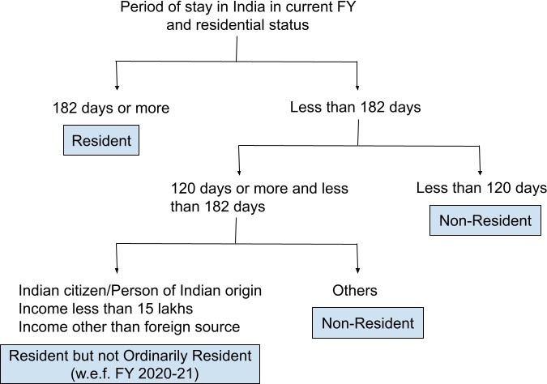
2: US CITIZEN AND RESIDENT LIVING ABROAD – OUTSIDE USA
Know Tax Treaties - AS it generally reduce the U.S. taxes of residents of foreign countries treaties
> Tax credit is based on Treaty rates.
Be familiar with Term “TAX RESIDENT” Most country tax worldwide income to RESIDENT TAX PAYERS INCULDING INDIA
Disclosure and FBAR reporting requirements apply – as you continue to be US CITIZEN OR GC HOLDERS aka US PERSON.

Slide 4
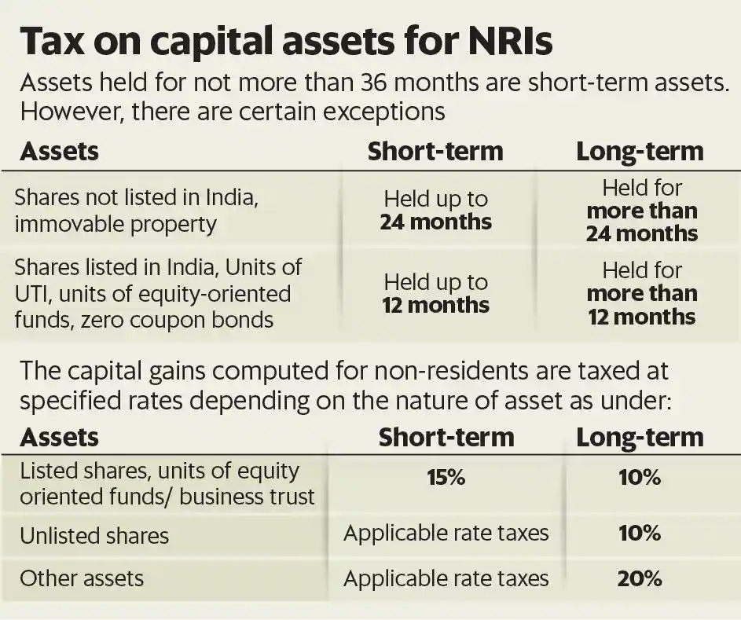
3: India Investment Sale of Assets- Taxes and Repatriation
Indexation of Cost: Cost is determined based on FMV (if acquire prior to 1st April 2021) as on 1st April 2001 and indexed for inflation to calculate resulting Gain - subject to Stamp Duty value in case of land and buildings as of April 1 2001
Sale the assets AND Repatriation of proceeds> Deposit the money in to NRO Account > File a return in India and Pay taxes > Get a Certificate of Indian Chartered Accountant in the form of 15CB > File Form 15CA with Indian Income tax Department > Take it to the bank where your NRO account is with Form A2 (FEMA Declaration form) and wire the money to your US BANK account. Report this transaction/income on US TAX return to claim appropriate tax credit for tax paid to Indian Government.

Slide 5
4: Business International tax:
Know the term “United States Persons or US Person”
o A citizen or resident or a domestic partnership or corporation, any estate other than a foreign estate or trust domiciled in the United States.
Foreign Persons
Nonresident alien individual, foreign corporation, Foreign partnership, Foreign trust, A foreign estate - Any other person that is not a U.S. person
U.S. branches of foreign persons
o W-8 IMY, Certificate of Foreign Intermediary, Foreign Flow-Through Entity, or Certain
U.S. Branches for United States Tax Withholding and Reporting Withholding on Payments of U.S. Source Income to Foreign Persons Under IRC 1441 to 1443 (Form 1042)
W-8BEN- Certificate of Foreign Status of Beneficial Owner for United States Tax Withholding and Reporting (Individuals)
Fixed, Determinable, Annual, Periodical (FDAP) Income- The 30% (or lower treaty) applies to the amount of U.S. source fixed or determinable, annual, or periodical gains, profits, or income.
Foreign persons are subject to U.S. tax at a 30% rate on income they receive from U.S. sources.
Effectively Connected Income (ECI)
Foreign person engages in a trade or business in the United States, all income from sources within the United States connected with the conduct of that trade or business is considered to be Effectively Connected Income (ECI)- Tax rate based on Graduated rates as it applies to regular US PERSON. – Form W-8 ECI given by foreign person to Withholding Agent to withhold taxes.

Slide 6
5:Frequently Asked Questions:
Can my relative who lives in India invest in real-estate with me?
Yes, Form 8288, U.S. Withholding Tax Return for Dispositions by Foreign Persons of U.S. Real Property Interests. Also need ITIN.
Who can own an S-Corporation (be an S-Corp shareholder)?
A foreigner that is a non-resident alien cannot own an S-Corp. As per the IRS, a non-resident alien is an individual who is not a US citizen or a US resident alien.
No S Corporation Tax Election for LLC if its members are non US Person and wants to be treated as S Corp- Must file 1065 Partnership Return.
Can a Non-U.S. Business or Entity Create and run/manage a U.S. LLC? Yes. Typically, there are no restrictions on foreign entities and businesses forming, owning and running an LLC in the U.S.
Who Can Be a Member of an LLC or run and manage LLC?
U.S. citizens. Residents, Non-U.S. citizens, On-resident aliens, U.S. business entities, NON-U.S. business entities.
5. Can I have LLC Members that are NOT U.S. Residents or Citizens? AND What are the Tax Implications for Non-U.S. Resident Owners of an LLC?
Yes. The nationality of an LLC’s business owner has no impact on ownership in an LLC. However, you Must have a withholding agent: You are a withholding agent if you are a U.S. or foreign person that has control, receipt, custody, disposal, or payment of a income of a foreign person that is subject to withholding.
An LLC member, wherever they are located, will need to pay U.S. taxes on any LLC profits earned in the USA, specifically if they are “engaged in a trade or business in the USA.” It means Filing the relevant tax returns and forms with the IRS and states where you do business, including Form 5472, Information Return of Foreign-Owned U.S. or Foreign Corporation Engaged in a U.S. Trade or Business. Paying taxes on income earned in the U.S. including federal taxes, state taxes, self-employment taxes on Partnership K- 1 Income and estimated taxes. Withholding Agent is responsible.

