Slide 4
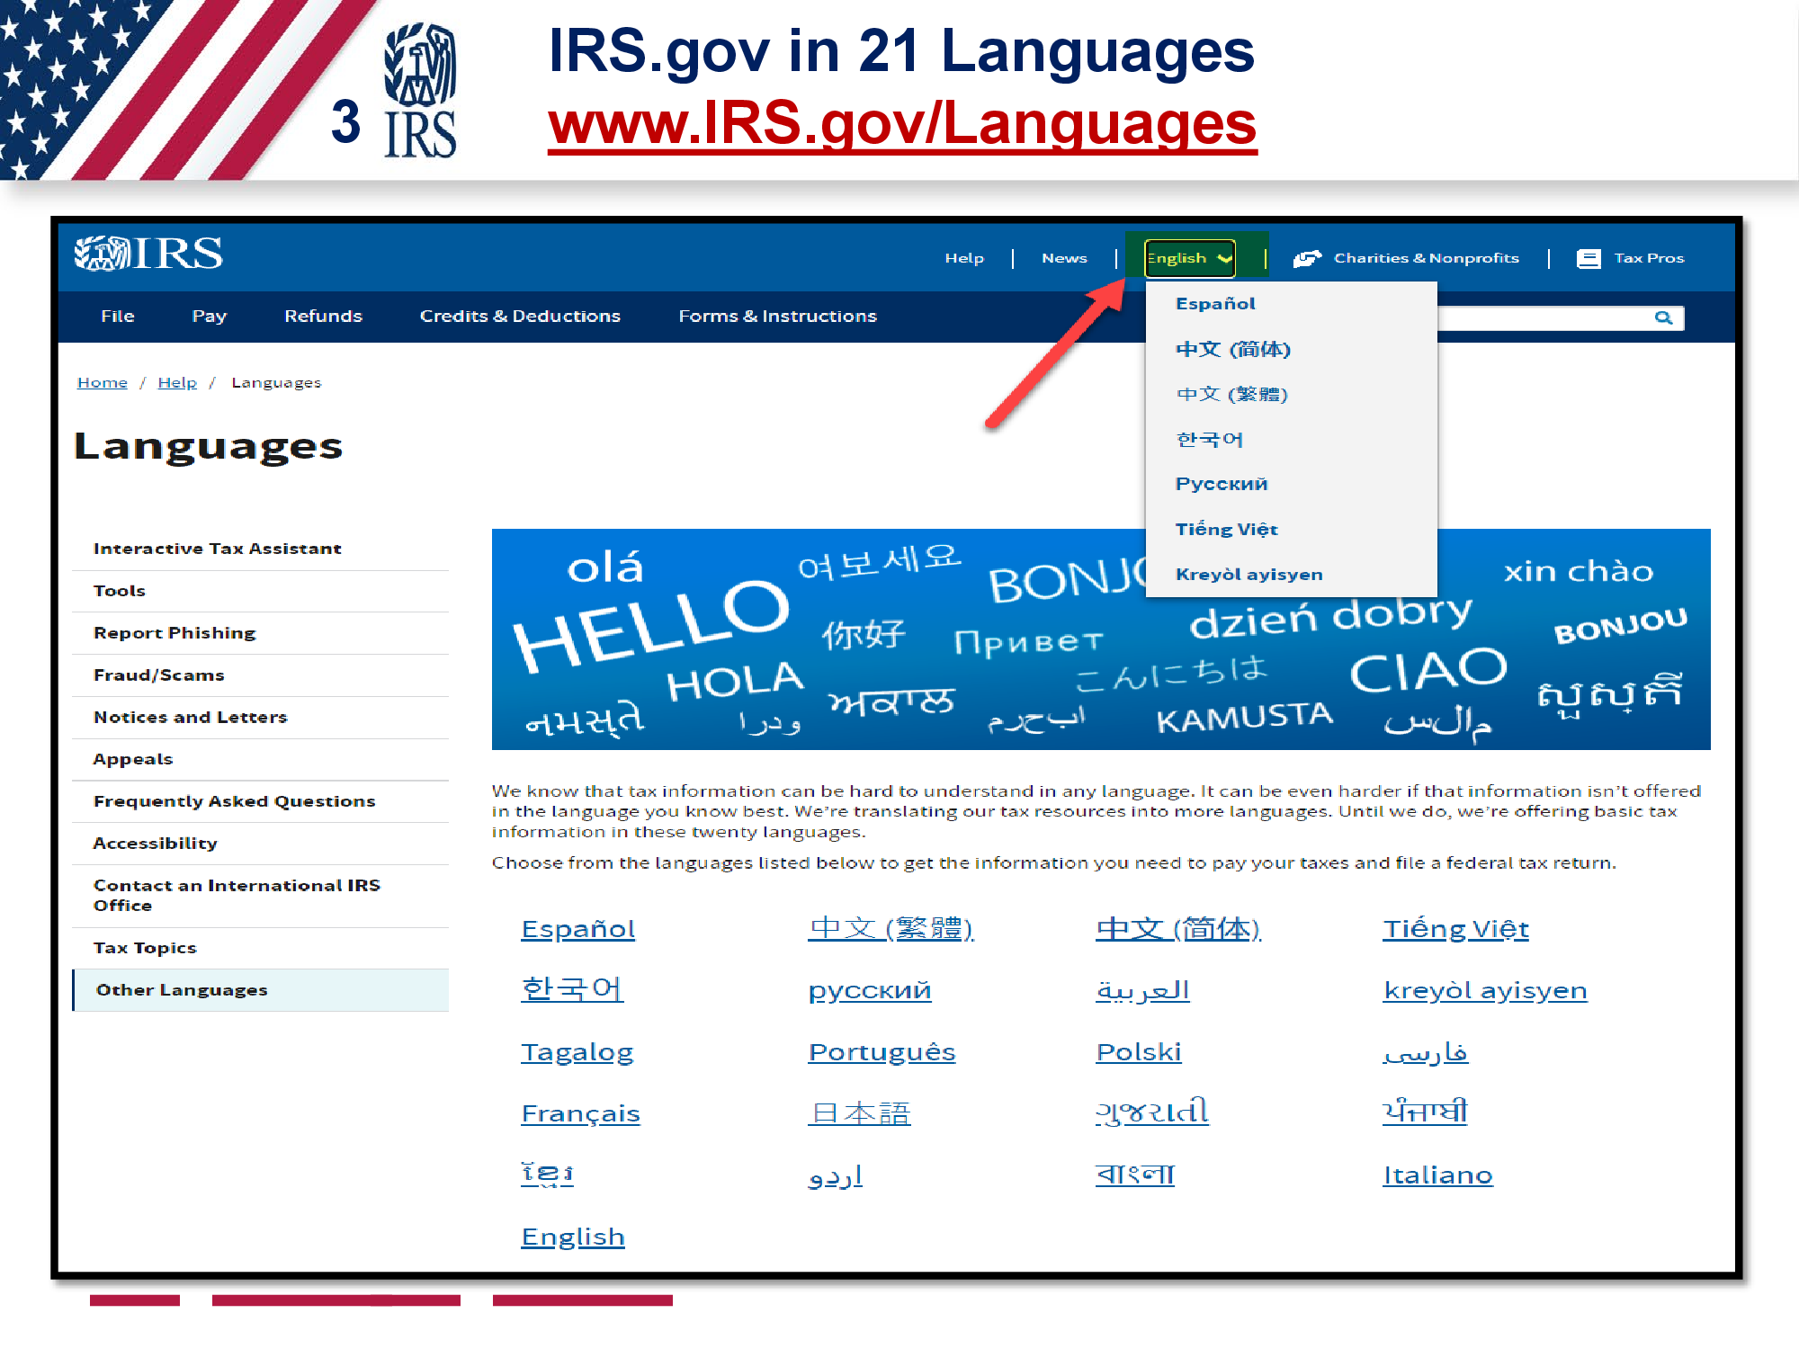

Slide 5
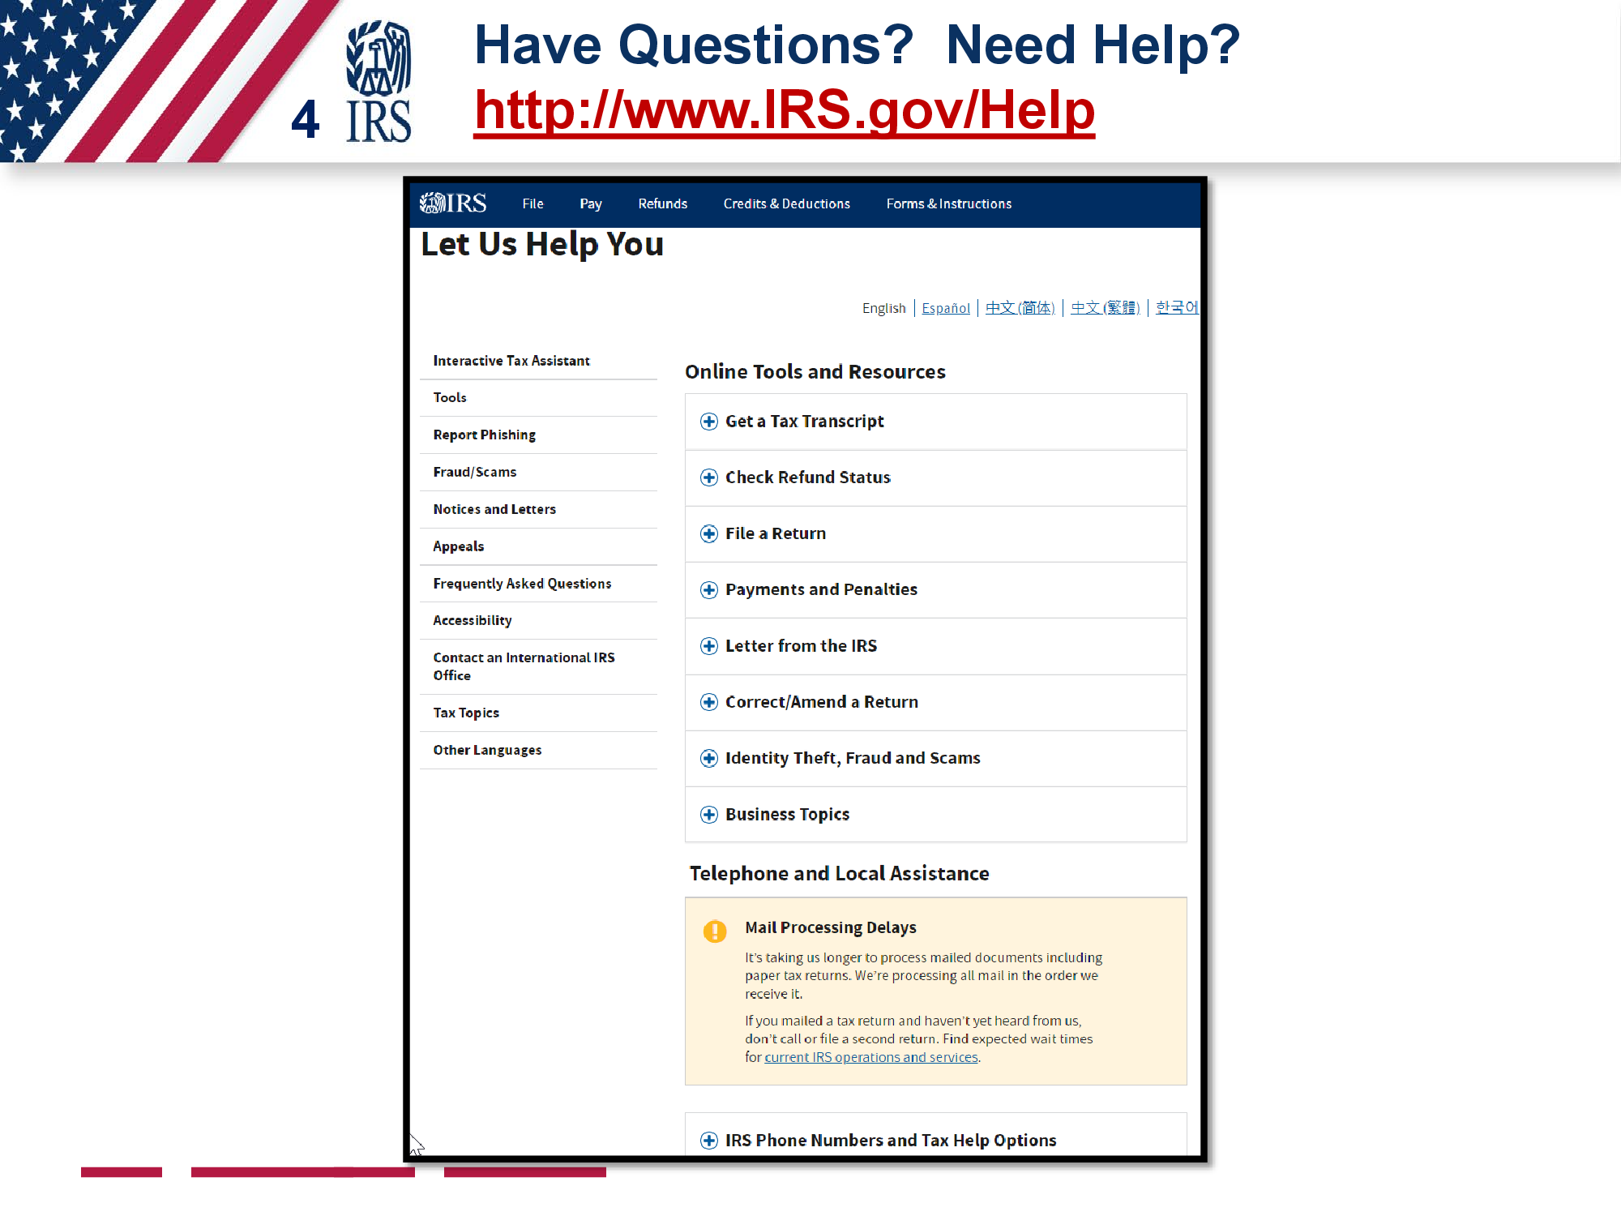

Slide 6
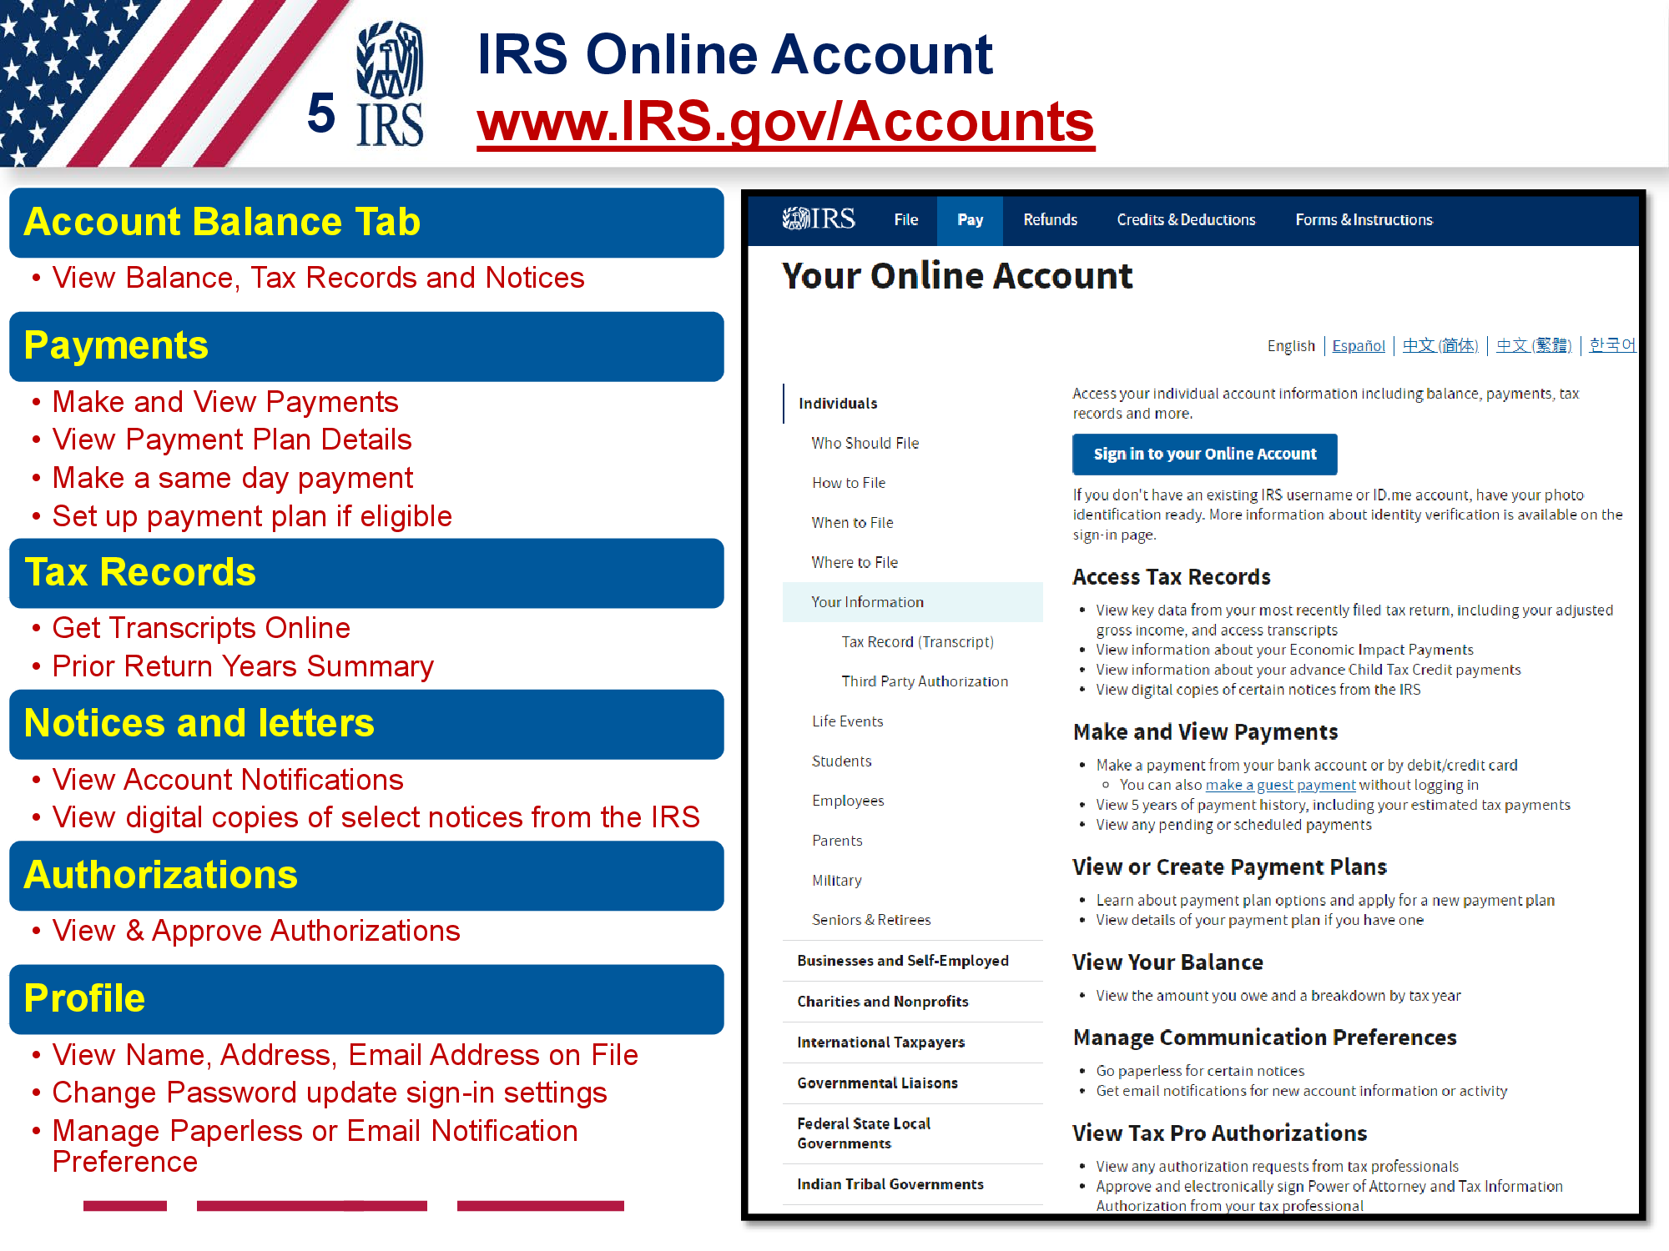

Slide 13
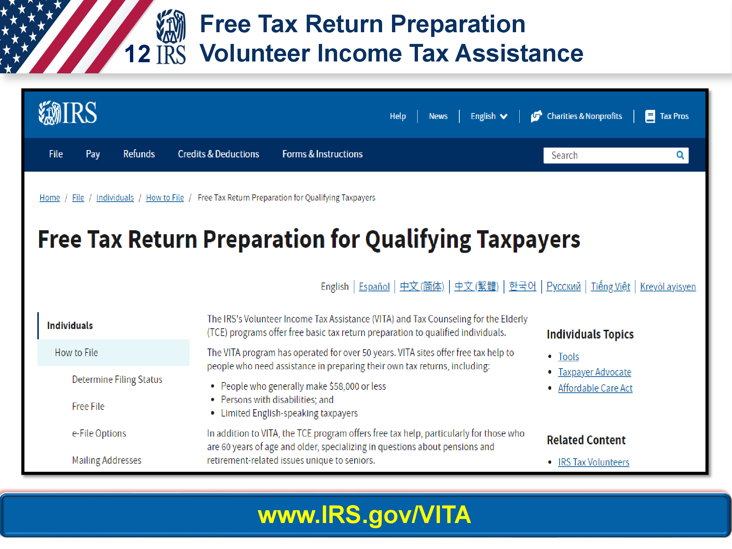

Slide 14
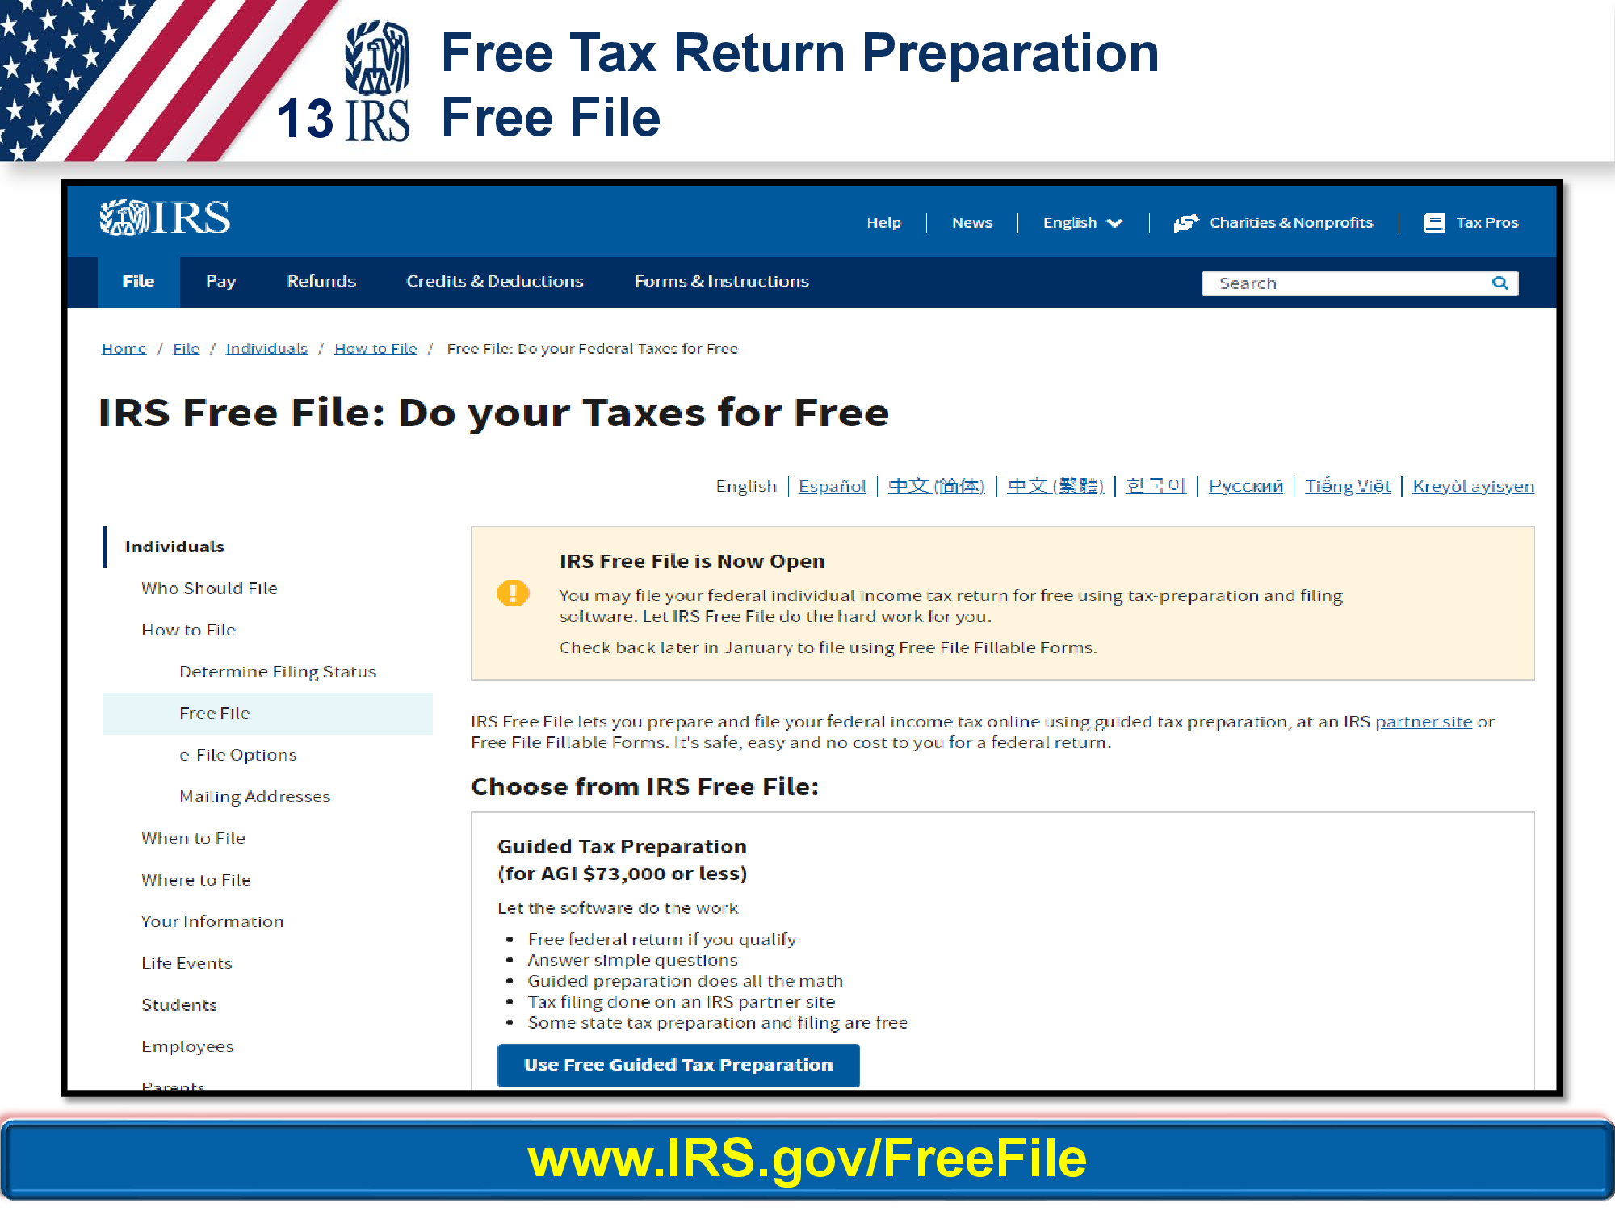

Slide 16
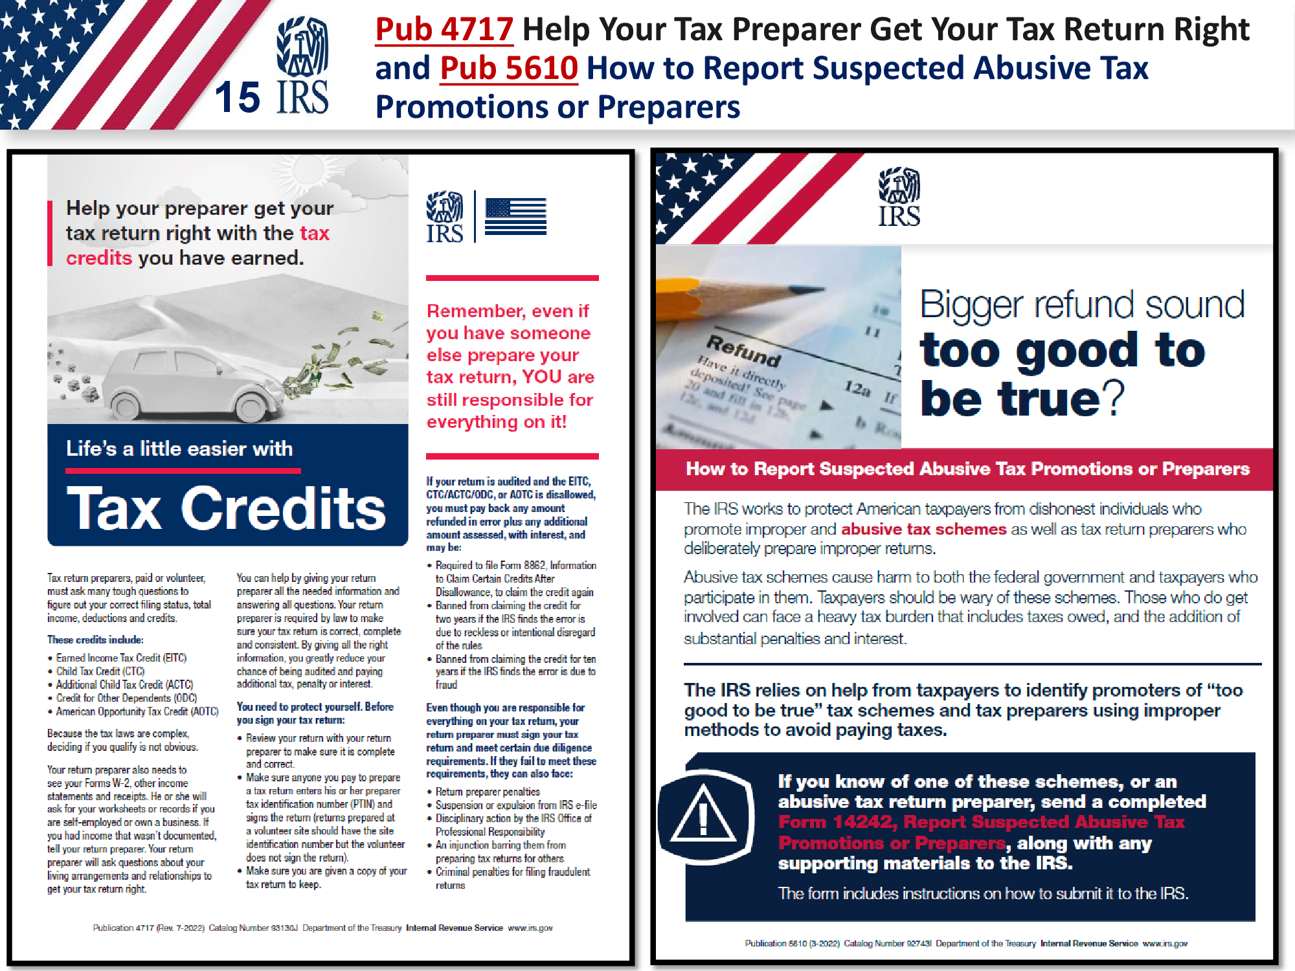

Slide 17
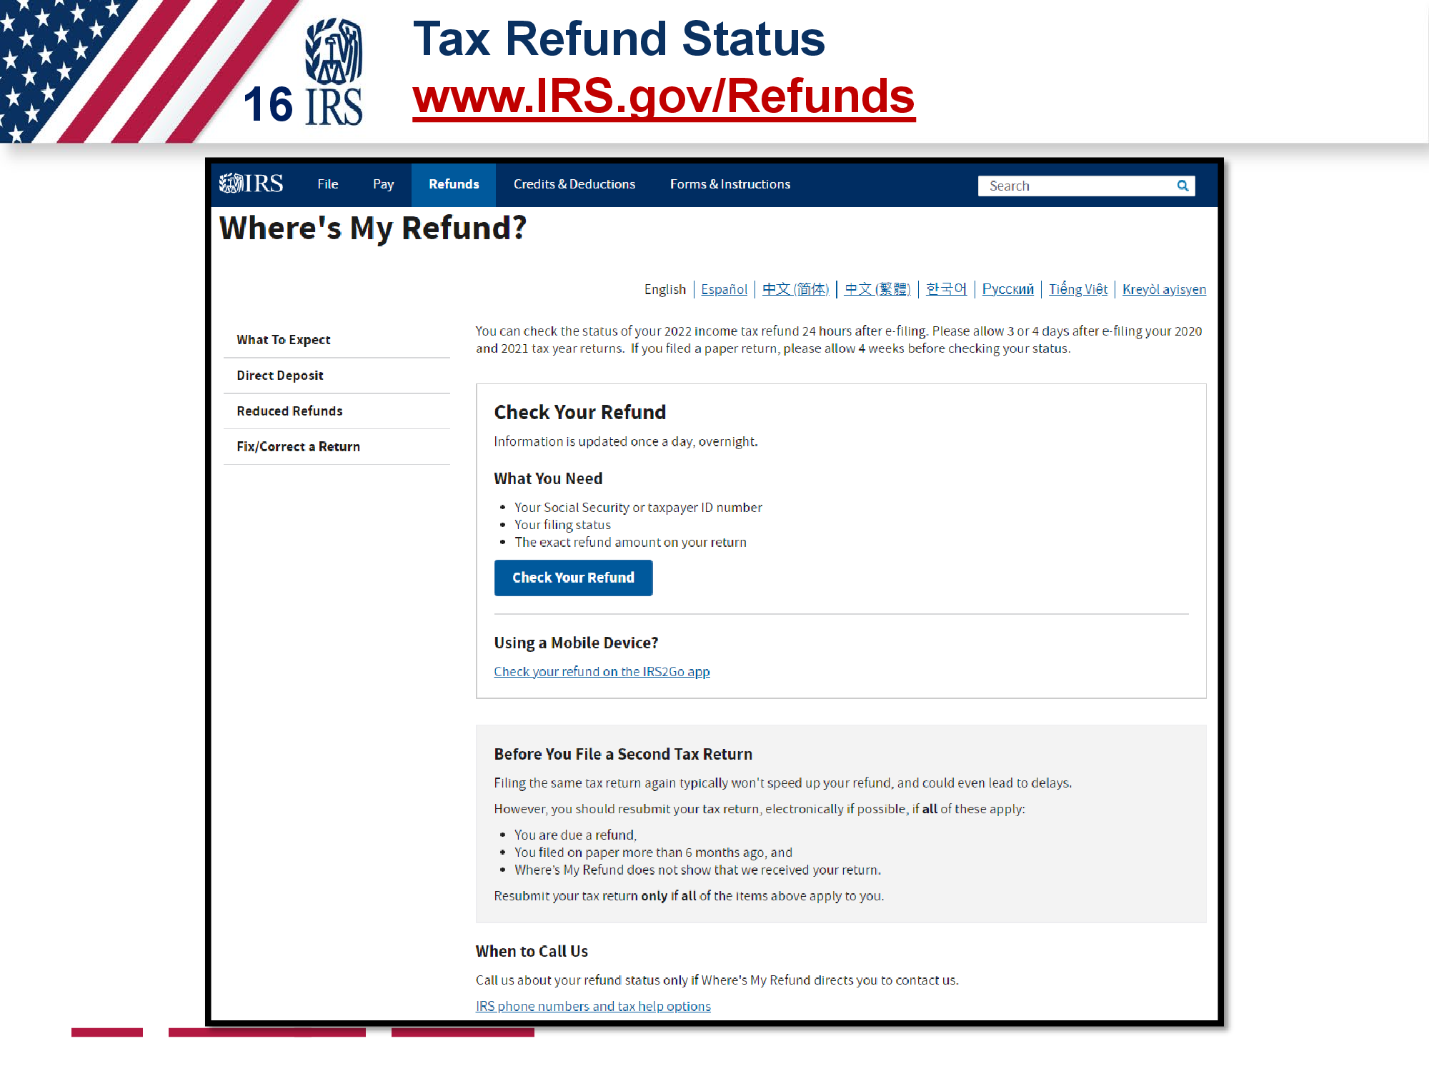

Slide 19
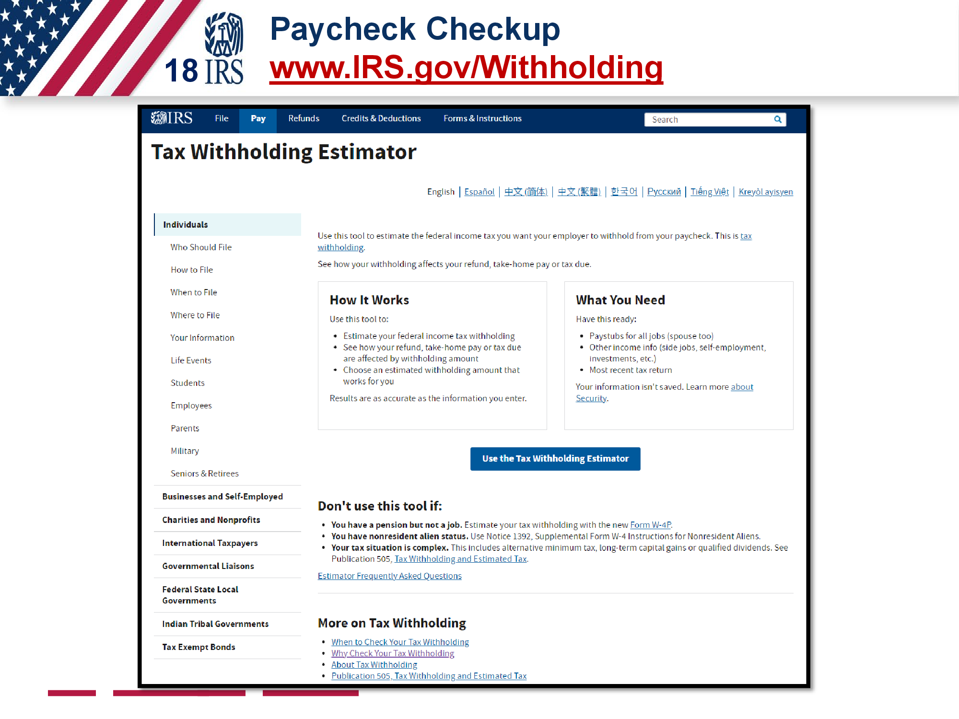

Slide 25
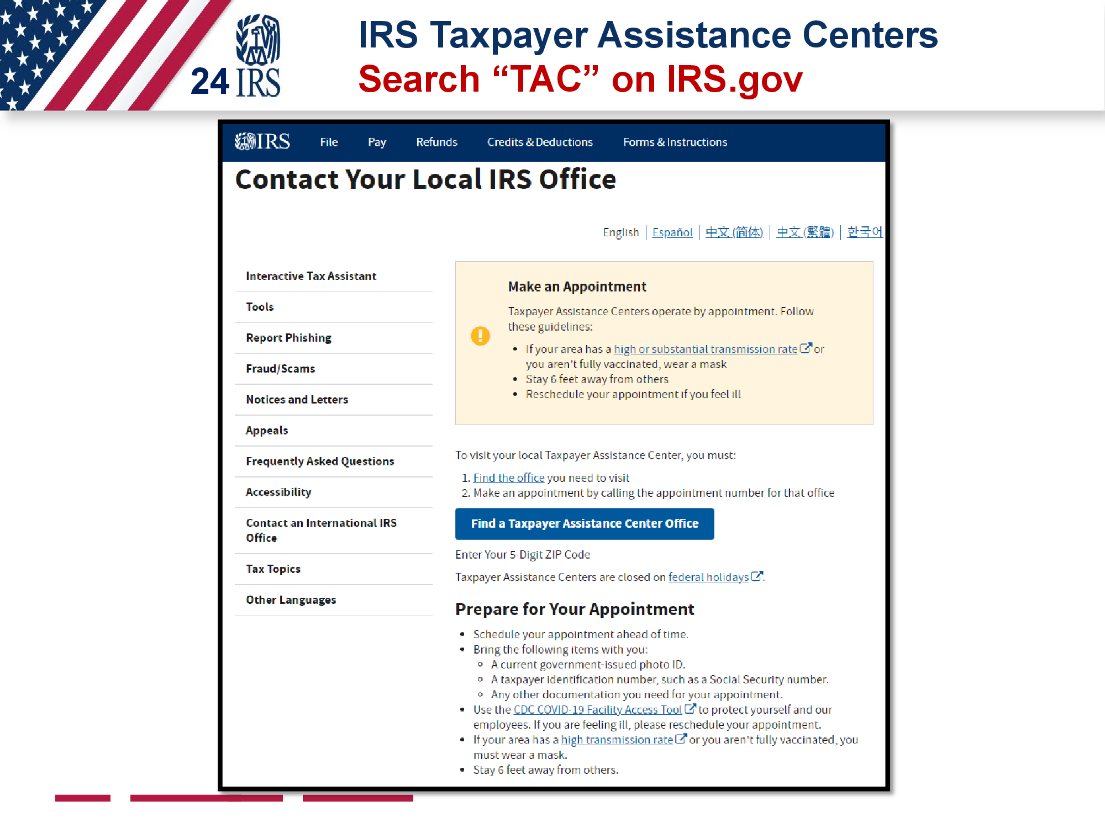

Slide 26
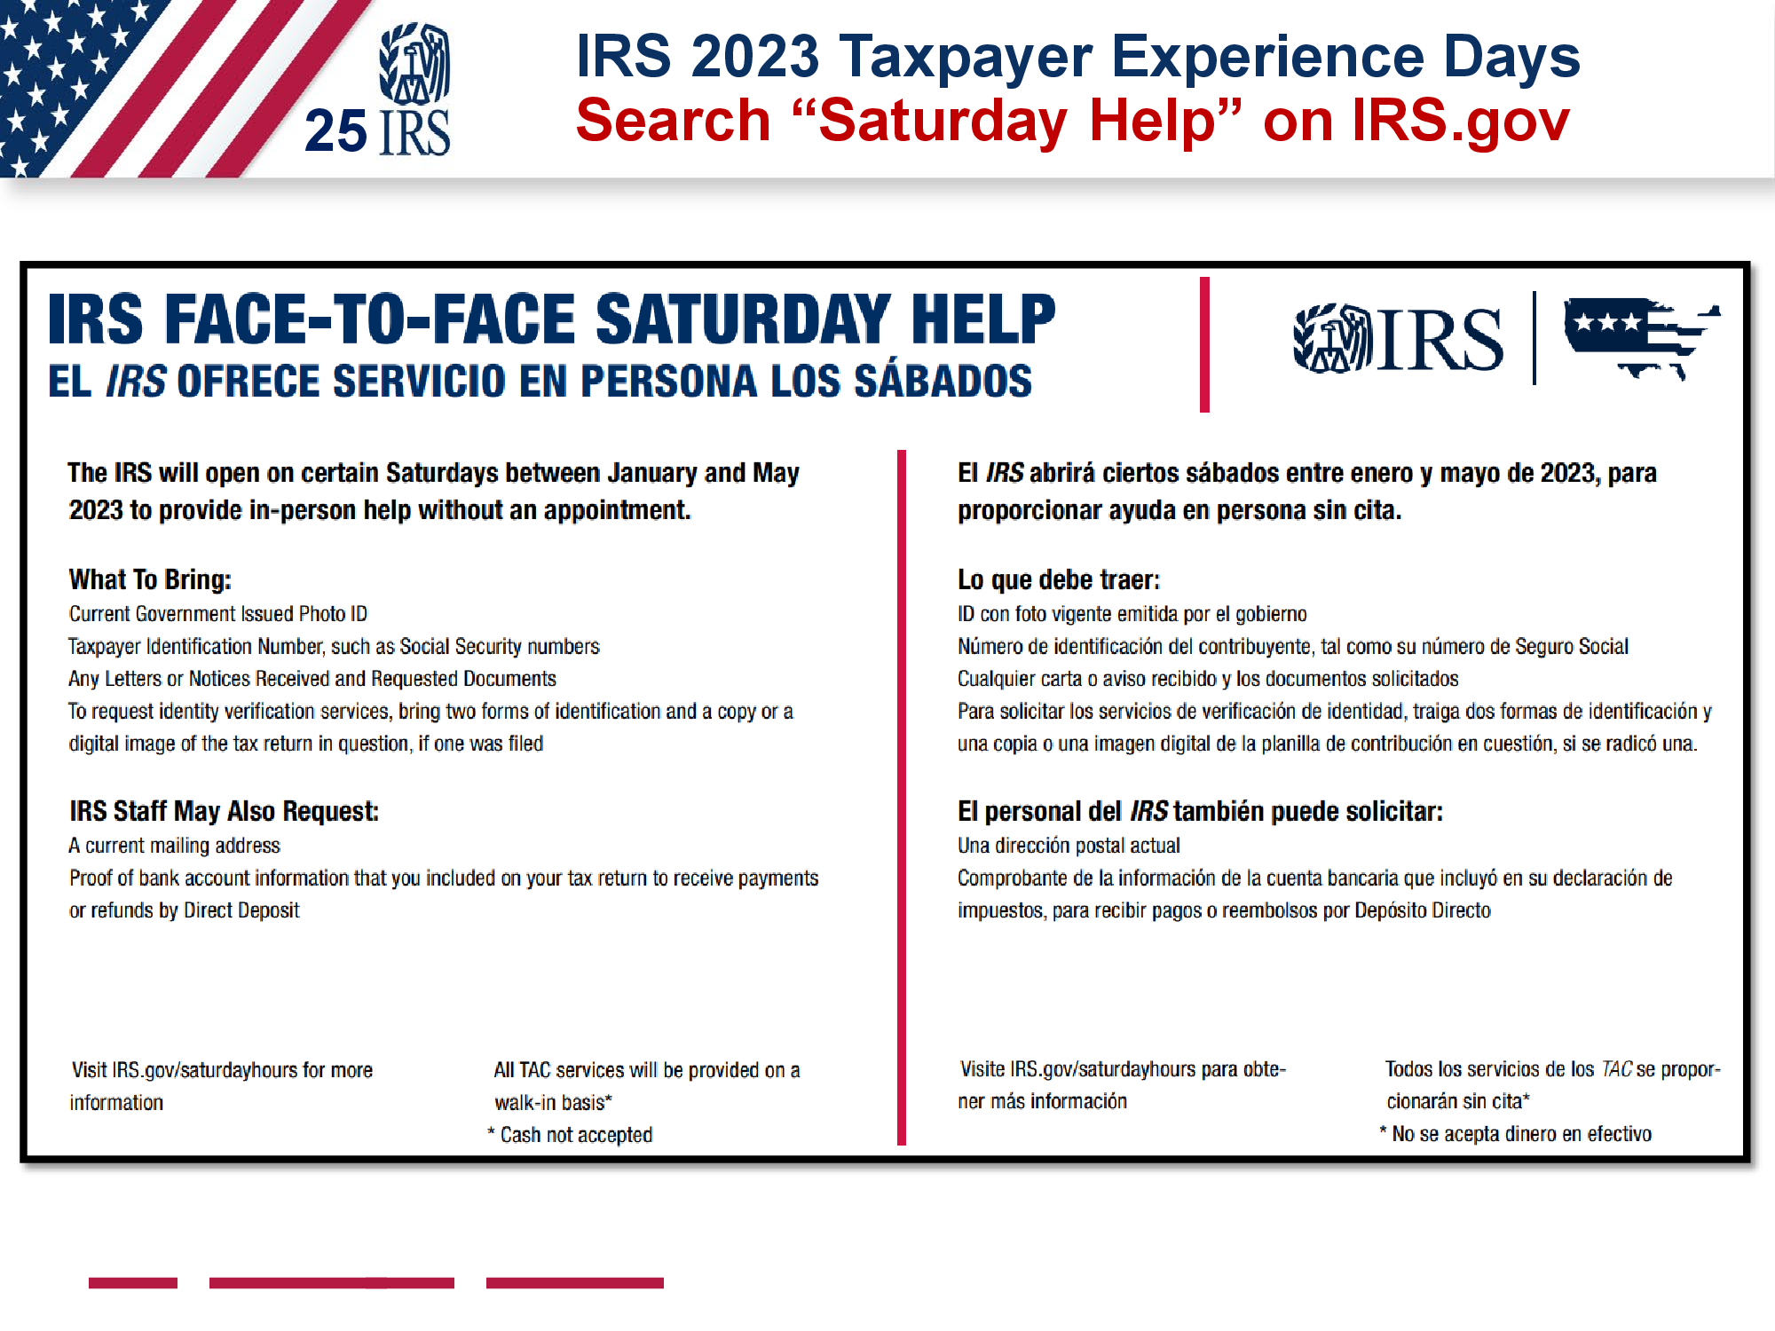

Slide 34
Saturday, February 18,2023 2:00pm- 5:00 pm
IACCGH Tax Seminar
India House, 8888 W Belfort St, Houston TX 77031
Rajiv Bhavsar
President
Jagdip Ahluwalia
Executive Director
Panelist
Mahesh Desai
CPA, CFP, CFA
Sage Point Financial
Indo-American Chamber of Commerce of Greater Houston 1 Riverway, Suite 1700 Houston TX 77056 E: info@iaccgh.com www.iaccgh.com

Slide 35
Individual Tax – International- Income, Assets, Sale and Repatriation
1 US CITIZEN AND RESIDENT - LIVING IN USA
Citizenship or GC test Or substantial presence test – 31 days in a year or 183/ 3 years including current year. > USA TAX RESIDENT > KYC - US Person
File Resident tax Return> Include worldwide income - US Tax Return> claim
credit of foreign tax payment the prof of payment > IRS Form 1116 up to treaty Rates> PAY TAX
Foreign Bank Account-> File FinCEN Form 114, Report of Foreign Bank and Financial Accounts (FBAR) >$10K
Form 8938 Report holding of - Specified Foreign Financial Assets 100K>
Mutual fund, Stock, Bond, Cash Value Life insurance
Form 5471 : US Investor >10% of ownership in the foreign Entity – or penalty of $ 10K/year
Form 3520 Receipt of Gift and Estate from Nonresident- A foreign gift> money or other property received by a U.S. person from a foreign person that the
recipient treats as a gift or bequest and excludes from gross income.
Tax Credit under DTAA: U.S. Person who receives income from a treaty country and who is subject to taxes imposed by foreign countries may be
entitled to certain credits, deductions, exemptions, and reductions in the
rate of taxes of those foreign countries.
Tax Residency Certificate: Form 8802 – Annual Requirement FOR Tax Deduction at Treaty Rate U.S. treaty partners require U.S. citizens/ residents to provide a U.S. Residency Certificate on Form 6166
Inter government Agreement – IGA Legally Binding AND Sharing of Information is ongoing
– Bank update >KYC
Taxpayer attempt to stop sharing of information – Rejected by Judiciary Sabena Puri Case 2020 IRS wanted info from a Bank> Taxpayer wanted to prevent IRS from getting info.
Increased Enforcement as IRS has now manpower and resources ($$)with improved technology.

Slide 36
What if I or my tax prepare failed/missed to File as required under the rules:
Failed to file FBAR ACCURATELY - late or not at all > A violation subject to penalties.
IRS hasn’t contacted you about a late FBAR AND not under civil or criminal investigation by the IRS, file late FBARs to keep potential penalties to a minimum.
IRS has contacted you? Have a meeting with tax professionals.
Failed to include worldwide Income/Failed to include all the assets on 8938 or failed to file 5471 > Seek professional advice to Amend Tax Return
Streamlined Filing Compliance Procedures
Non-Willful Omission – and IRS has not initiated Civil examination of return for any taxable year. > Consult tax professional for Voluntary Disclosure> Pay tax, Interest and reduced penalty by amending past year tax return
Willful and intentional disregard: Subject to Criminal Investigation >Consult with tax professional/ legal advisers.
Feb 2022: IRS New Form 14457 For Comprehensive Domestic and International Voluntary Disclosure Program incuding IRS-CI Voluntary Disclosure - Preclearance
Covers Domestic, Offshore, Virtual currency, Trust, HUF, Gift, Estate, Corporations and Partnership
Timeliness is Critical to come forward.- IRS must NOT have started Civil or criminal exam, non-receipt of third party information or informant or Jon Deo Summons.

Slide 37
2: US CITIZEN AND RESIDENT LIVING ABROAD – OUTSIDE USA
Know Tax Treaties - AS it generally reduce the U.S. taxes of residents of foreign countries treaties
> Tax credit is based on Treaty rates.
Be familiar with Term “TAX RESIDENT” Most country tax worldwide income to RESIDENT TAX PAYERS INCULDING INDIA
Disclosure and FBAR reporting requirements apply – as you continue to be US CITIZEN OR GC HOLDERS aka US PERSON.

Slide 38
3: India Investment Sale of Assets- Taxes and Repatriation
Indexation of Cost: Cost is determined based on FMV (if acquire prior to 1st April 2021) as on 1st April 2001 and indexed for inflation to calculate resulting Gain - subject to Stamp Duty value in case of land and buildings as of April 1 2001
Sale the assets AND Repatriation of proceeds> Deposit the money in to NRO Account > File a return in India and Pay taxes > Get a Certificate of Indian Chartered Accountant in the form of 15CB > File Form 15CA with Indian Income tax Department > Take it to the bank where your NRO account is with Form A2 (FEMA Declaration form) and wire the money to your US BANK account. Report this transaction/income on US TAX return to claim appropriate tax credit for tax paid to Indian Government.

Slide 39
4: Business International tax:
Know the term “United States Persons or US Person”
o A citizen or resident or a domestic partnership or corporation, any estate other than a foreign estate or trust domiciled in the United States.
Foreign Persons
Nonresident alien individual, foreign corporation, Foreign partnership, Foreign trust, A foreign estate - Any other person that is not a U.S. person
U.S. branches of foreign persons
o W-8 IMY, Certificate of Foreign Intermediary, Foreign Flow-Through Entity, or Certain
U.S. Branches for United States Tax Withholding and Reporting Withholding on Payments of U.S. Source Income to Foreign Persons Under IRC 1441 to 1443 (Form 1042)
W-8BEN- Certificate of Foreign Status of Beneficial Owner for United States Tax Withholding and Reporting (Individuals)
Fixed, Determinable, Annual, Periodical (FDAP) Income- The 30% (or lower treaty) applies to the amount of U.S. source fixed or determinable, annual, or periodical gains, profits, or income.
Foreign persons are subject to U.S. tax at a 30% rate on income they receive from U.S. sources.
Effectively Connected Income (ECI)
Foreign person engages in a trade or business in the United States, all income from sources within the United States connected with the conduct of that trade or business is considered to be Effectively Connected Income (ECI)- Tax rate based on Graduated rates as it applies to regular US PERSON. – Form W-8 ECI given by foreign person to Withholding Agent to withhold taxes.

Slide 40
5:Frequently Asked Questions:
Can my relative who lives in India invest in real-estate with me?
Yes, Form 8288, U.S. Withholding Tax Return for Dispositions by Foreign Persons of U.S. Real Property Interests. Also need ITIN.
Who can own an S-Corporation (be an S-Corp shareholder)?
A foreigner that is a non-resident alien cannot own an S-Corp. As per the IRS, a non-resident alien is an individual who is not a US citizen or a US resident alien.
No S Corporation Tax Election for LLC if its members are non US Person and wants to be treated as S Corp- Must file 1065 Partnership Return.
Can a Non-U.S. Business or Entity Create and run/manage a U.S. LLC? Yes. Typically, there are no restrictions on foreign entities and businesses forming, owning and running an LLC in the U.S.
Who Can Be a Member of an LLC or run and manage LLC?
U.S. citizens. Residents, Non-U.S. citizens, On-resident aliens, U.S. business entities, NON-U.S. business entities.
5. Can I have LLC Members that are NOT U.S. Residents or Citizens? AND What are the Tax Implications for Non-U.S. Resident Owners of an LLC?
Yes. The nationality of an LLC’s business owner has no impact on ownership in an LLC. However, you Must have a withholding agent: You are a withholding agent if you are a U.S. or foreign person that has control, receipt, custody, disposal, or payment of a income of a foreign person that is subject to withholding.
An LLC member, wherever they are located, will need to pay U.S. taxes on any LLC profits earned in the USA, specifically if they are “engaged in a trade or business in the USA.” It means Filing the relevant tax returns and forms with the IRS and states where you do business, including Form 5472, Information Return of Foreign-Owned U.S. or Foreign Corporation Engaged in a U.S. Trade or Business. Paying taxes on income earned in the U.S. including federal taxes, state taxes, self-employment taxes on Partnership K- 1 Income and estimated taxes. Withholding Agent is responsible.

Slide 41
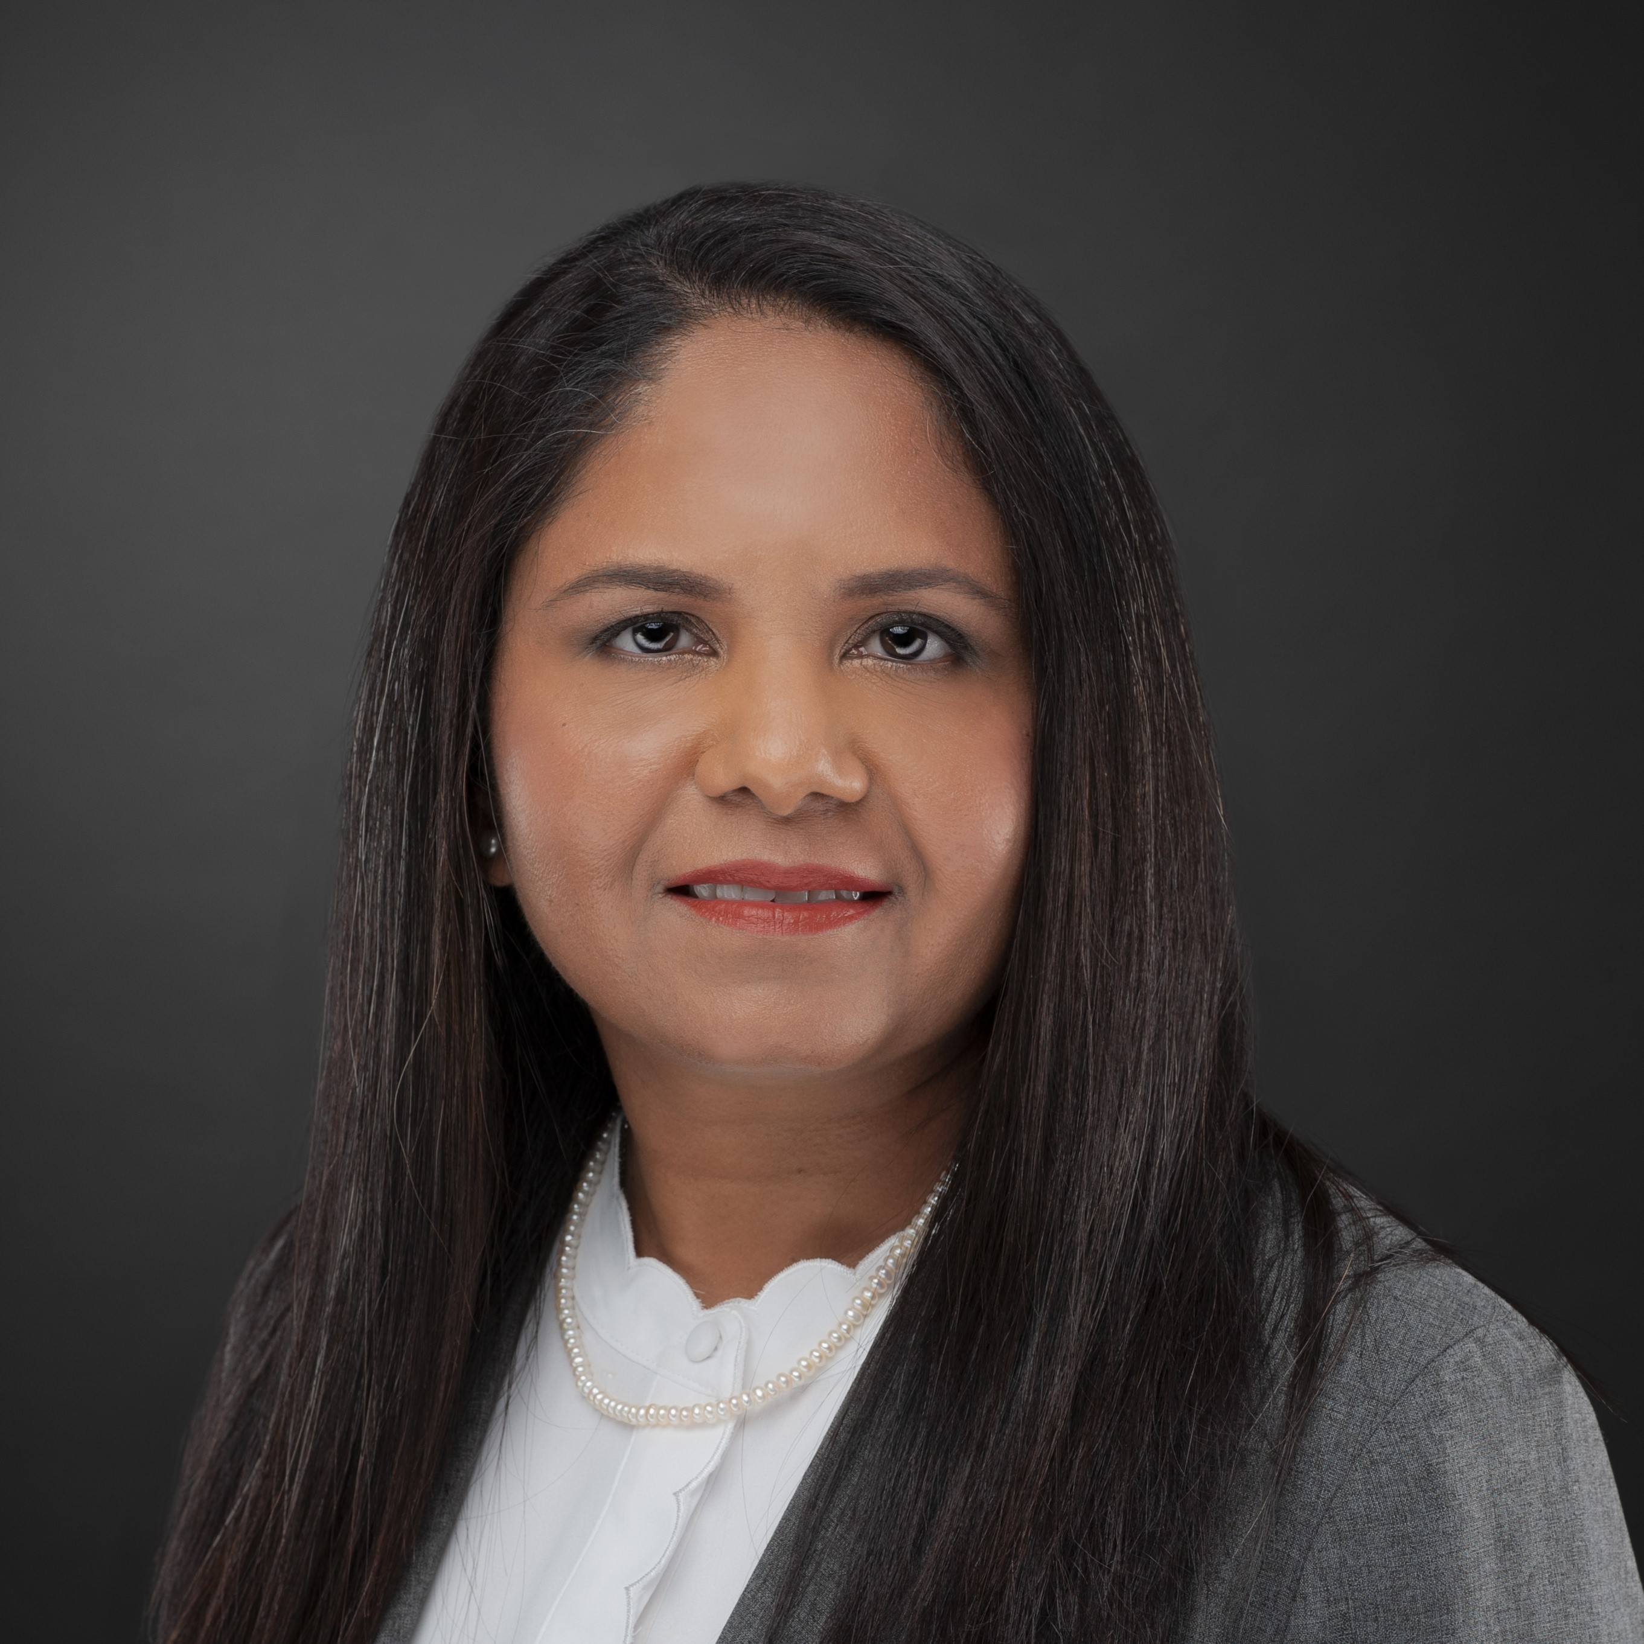
Saturday, February 18,2023 2:00pm- 5:00 pm
IACCGH Tax Seminar
India House, 8888 W Belfort St, Houston TX 77031
Rajiv Bhavsar
President
Jagdip Ahluwalia
Executive Director
Panelist
Rimple Mashruwala
CPA & President,
Rimple Mashruwala CPA LLC
Indo-American Chamber of Commerce of Greater Houston 1 Riverway, Suite 1700 Houston TX 77056 E: info@iaccgh.com www.iaccgh.com

Slide 42
SECURE 2.0

Slide 43
Main Highlight
· SECURE 2.0 signed on Dec. 23, 2022
· Items are effective 2023 and beyond
· Effective 2023: changes to RMD
· RMD is age 73 for individuals turning 72 after 2022, and 73 before 2033
For individuals who turn 74 after 2032, RMD must begin at 75
· Reduction in RMD failure excise tax from 50% to 25%

Slide 44
SECURE 2.0
Exceptions To The 10% Penalty
Qualified Birth and Adoption
Terminally Ill
Federally Declared Disasters
Corrective distributions of excess contributions and earnings
Emergency Personal Expenses
Domestic Abuse Victims

Slide 45
SECURE 2.0
Federally Declared Disasters
SECURE 2.0 and federally declared disasters
SECURE 2.0 made permanent the ability for an early withdrawal without the 10% penalty when made in result of a federally declared disaster
Must be made within 180 days of the disaster if the taxpayer’s principal residence is within the disaster area
Maximum distribution is $22,000
Three-year income reporting spread is available
Recontribution within three (3) years possible
Increased loan amounts available
Effective 2022

Slide 46
SECURE 2.0
Birth and Adoption Distributions
SECURE 2.0 and birth/adoption distributions
Original SECURE Act permitted a penalty free distribution of $10,000 and allowed the distribution to be repaid/recontributed, with no time limit
SECURE 2.0 limits the repayment/recontribution within three years, for distributions after enactment

Slide 47
SECURE 2.0
SECURE 2.0 and Domestic Violence
After 2023
Penalty free up to the lesser of $10,000 or 50% of account present value
More guidance will follow
SECURE 2.0 and Emergency Personal Expenses
Up to $1,000 for personal financial emergency after 2023
More guidance will follow

Slide 48
SECURE 2.0
SECURE 2.0, effective 2023
New penalty exception for terminally ill
529 and Roth, effective 2024
Allows for a 529 plan to be distributed into a ROTH IRA
$35,000 lifetime limit
Annual amount is the ROTH IRA contribution limit
529 plan must be in existence for 15 years

Slide 49
SECURE 2.0
SECURE 2.0 and Tax Year 2025
· Automatic Enrollment for employers with more than 10 employees is effective
· Increased Catch Up for 60, 61, 62 and 63 is effective
· Long time part time employees change for eligibility for QPR falls from three (3) years of service to two (2)
SECURE 2.0 and Tax Year 2027
· Save’s Credit is repealed and replaced with a federal matching contribution to retirement accounts, not to exceed $2,000 and limited by MAGI (similar to the current Saver’s Credit)

Slide 50
SECURE 2.0
SECURE 2.0 and Miscellaneous Items
Credit for small employers
After 2022, credit will apply for five years (increased from the original three years) for businesses with 50 or fewer employees
Credit increased to 100% of startup costs, limited to $1,000 for employers with 50 or fewer employees
Phaseout applies for employers with 51 to 100 employees
Retroactively to 2019, permits small businesses that joined a multiple employer plan (MEP)
Employers offering 403 (b) plans can join a MEP, after 2022

Slide 51
SECURE 2.0
SECURE 2.0 and Miscellaneous Items
Employers will be able to offer small incentives to encourage employees to contribute to the qualified retirement plans, effective 2023
After 2023, student loan payments
Employers may make payments to a QRP that match qualified student loan payments by employees. However, the matching contributions for the student loan payments must be at the same rate as the elective deferrals.
More guidance will follow

Slide 52
SECURE 2.0
SECURE 2.0 and Safety Officers Effective 2023
In addition to permitting Safety Offices to receive substantially equal and periodic payments starting at age 50 when separated from service, SECURE 2.0 creates a new condition 25 years of service
Public Safety officer definition is expanded to include correction officers
$3,000 exclusion for health insurance from the retirement income of public safety officers will no longer contain the requirement that the plan directly pay for the health insurance

Slide 53
Thank You

Slide 54
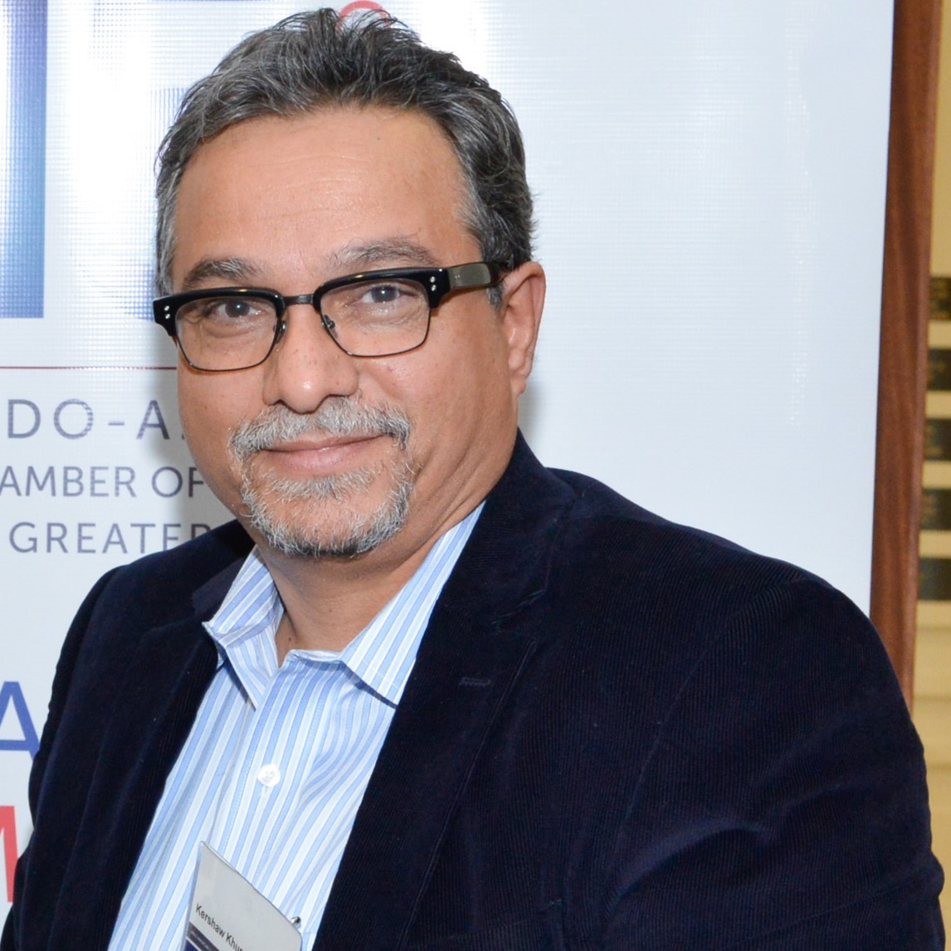
Saturday, February 18,2023 2:00pm- 5:00 pm
IACCGH Tax Seminar
India House, 8888 W Belfort St, Houston TX 77031
Rajiv Bhavsar
President
Jagdip Ahluwalia
Executive Director
Panelist
Kershaw Khumbatta
CPA & Owner,
Kershaw K Khumbatta PLLC
Indo-American Chamber of Commerce of Greater Houston 1 Riverway, Suite 1700 Houston TX 77056 E: info@iaccgh.com www.iaccgh.com

Slide 55
Understanding Business Entities & Estate Planning
Kershaw K Khumbatta, CPA
1455 Highway 6 South, Suite A
Sugar Land, TX 77479
Tel: 281-313-8006

Slide 56
Introduction
When starting a business, it's important to choose the right business entity that suits your needs.
There are various types of business entities in the USA, including sole proprietorships, partnerships, limited liability companies (LLCs), corporations, S corporations, cooperatives, and limited liability partnerships (LLPs).
It's also important to consider estate planning as a business owner to ensure that your assets are distributed according to your wishes.

Slide 57
Sole Proprietorship
A sole proprietorship is a business owned by one person who is responsible for all aspects of the business.
The owner has unlimited liability for the debts and obligations of the business.
This is the simplest and most common type of business entity.

Slide 58
Partnership
A partnership is a business owned by two or more people who share the profits and losses of the business.
There are two types of partnerships: general partnerships and limited partnerships.
In a general partnership, all partners have unlimited liability for the debts and obligations of the business.
In a limited partnership, there are general partners who have unlimited liability, and limited partners who have limited liability and are not involved in the management of the business.

Slide 59
Limited Liability Company (LLC)
An LLC is a hybrid entity that provides the limited liability of a corporation and the flexibility of a partnership.
The owners of an LLC are called members, and they are not personally liable for the debts and obligations of the business.
An LLC can be taxed as a pass-through entity, which means that the income or losses of the business are passed through to the members and reported on their personal tax returns.

Slide 60
Corporation
A corporation is a legal entity that is separate from its owners and provides limited liability protection to its shareholders.
The owners of a corporation are called shareholders, and they are not personally liable for the debts and obligations of the business.
A corporation can be taxed as a C corporation, which is taxed as a separate entity, or as an S corporation, which is taxed as a pass-through entity.

Slide 61
S Corporations
An S corporation is a type of corporation that is taxed as a pass-through entity.
The income or losses of the business are passed through to the shareholders and reported on their personal tax returns.
To qualify as an S corporation, the business must meet certain requirements, such as having no more than 100 shareholders.

Slide 62
Cooperative
A cooperative is a business owned and operated by a group of individuals who share the profits and benefits.
The members of a cooperative are not personally liable for the debts and obligations of the business.
Cooperatives can be either non-profit or for-profit.

Slide 63
Limited Liability Partnerships (LLP)
An LLP is a partnership in which some or all of the partners have limited liability.
Each partner is responsible for their own actions and is not liable for the actions of other partners.
LLPs are recognized in most states in the USA and are typically used by professional service firms.

Slide 64
Estate Planning
Estate planning is the process of planning for the distribution of your assets after you pass away.
As a business owner, it's important to have a plan in place to ensure that your business and other assets are distributed according to your wishes.
Common estate planning tools include wills, trusts, and powers of attorney.

Slide 65
Forms K-2 & K-3
Forms K-2 and K-3 are actually tax forms used by S corporations and partnerships to report information about a shareholder or partner's share of income, deductions, and credits.
Specifically, Form K-2 is used by S corporations to report a shareholder's share of income, deductions, and credits that are not reported on the shareholder's Form K-1. This includes income, deductions, and credits that are separately stated, such as capital gains or losses and charitable contributions. Form K-2 is filed along with the S corporation's tax return, which is Form 1120-S.
Form K-3, on the other hand, is used by partnerships to report a partner's share of income, deductions, and credits that are not reported on the partner's Form K-1. This includes separately stated items such as capital gains or losses and charitable contributions. Form K-3 is filed along with the partnership's tax return, which is Form 1065.
It's worth noting that Forms K-2 and K-3 are relatively new forms, having been introduced in 2021. They are intended to provide more detailed information to the IRS about a shareholder or partner's share of income, deductions, and credits, and to help prevent errors and discrepancies in reporting.

Slide 66
K-2 & K-3 Filing
Form K-2 is used by S corporations to report certain items of income, deductions, and credits that are not reported on the shareholder's Form K-1. However, the filing of Form K-2 is optional, and S corporations are not required to file it with their tax return.
Similarly, Form K-3 is used by partnerships to report certain items of income, deductions, and credits that are not reported on the partner's Form K-1. However, the filing of Form K-3 is also optional, and partnerships are not required to file it with their tax return.
The IRS has indicated that the use of Forms K-2 and K-3 is voluntary, and it is up to the S corporation or partnership to decide whether to use these forms to report certain separately stated items of income, deductions, and credits. If an S corporation or partnership does choose to file Forms K-2 or K-3, these forms should be attached to the respective tax return (Form 1120-S for S corporations or Form 1065 for partnerships).
If a partner or shareholder notifies the partnership or S corporation before the partnership or S corporation files its return, the conditions for the exception are not met and the partnership or S corporation must provide the Schedule K-3 to the partner or shareholder and file the Schedules K-2 and K-3 with the IRS.

Slide 67
Conclusion
Choosing the right business entity is an important decision that can affect your liability and tax obligations.
Estate planning is also an important consideration for business owners to ensure that their assets are distributed according to their wishes.

