Slide 1
Communications & Liaison
Stakeholder Liaison
1
Resources & Guidance for the
2024 Tax Filing Season
Presented by:
Arlene Good, IRS Sr. Stakeholder Liaison
Feb. 25. 2024
Presenter Notes
2024-02-16 13:07:25
--------------------------------------------
Good afternoon, Thank you for the invitation to come back to attend this meeting today. We are currently in filing season it he filing season, the purpose of this presentation, etc. Tailor it to your stakeholders – make it yours!

Slide 2
Communications & Liaison
Stakeholder Liaison
2

Slide 3
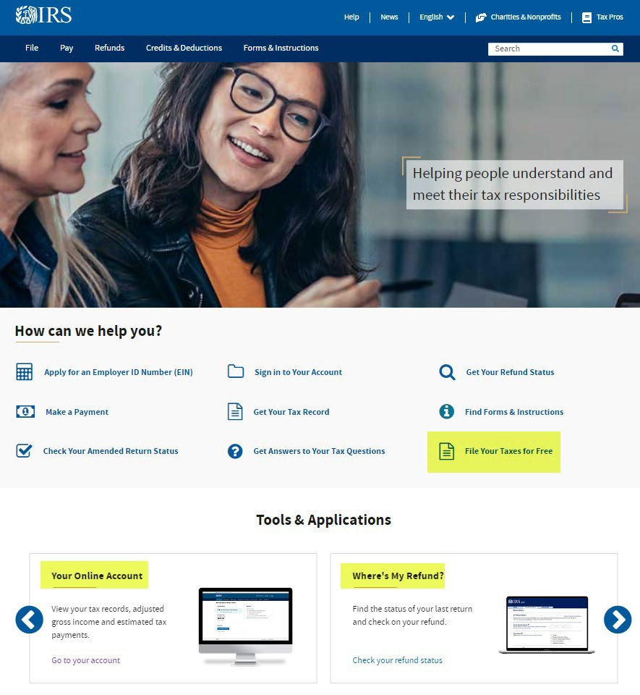
Navigating the IRS? Start here…
3
www.irs.gov
www.irs.gov/help/tools
Presenter Notes
2024-02-16 13:07:26
--------------------------------------------
First, let’s begin by looking at the IRS website…
Millions of taxpayers take advantage of the easy-to-use tools available 24 hours a day on the official website − IRS.gov. Whether on your home computers or mobile devices, the number of taxpayer visits to IRS.gov continues to grow year after year. Nearly every tax issue can be resolved online. Notice I’ve highlighted Free File, Where’s My Refund and Your Online Account. I’ll have more information on these in a few minutes There’s also a Tools page which lists many of the tools taxpayers frequently use. Go to IRS.gov/help/tools.

Slide 4
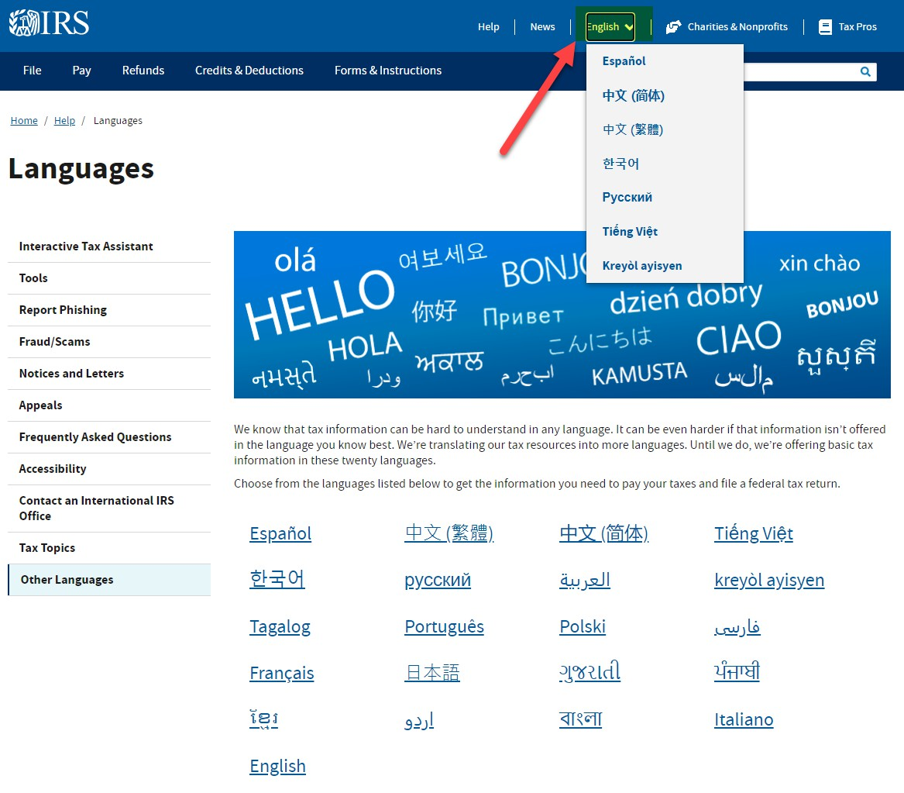
IRS.gov in 21 Languages http://www.IRS.gov/mylanguage
4
Presenter Notes
2024-02-16 13:07:26
--------------------------------------------
We know that tax information can be difficult to understand in any language. It can be even more challenging if the information isn’t offered in the language the taxpayer knows best.
To enhance the taxpayer experience, IRS has/is translating tax resources into more languages. Many pages on IRS.gov are now available in 7 other languages: Spanish, Vietnamese, Russian, Korean, Haitian Creole and Chinese − Simplified and Traditional. In addition, basic tax information is now available in 21 languages as shown on the slide. Taxpayers can choose from these languages to get the information they need to pay their taxes and file a federal tax return. And the Form 1040 income tax return and the related instructions are available in Spanish. Taxpayers can also change their language of preference for IRS-issued written communications by using Form 1040 Schedule LEP. Schedule LEP has instructions available in English and 20 other languages and can be filed with a tax return by those taxpayers who prefer to communicate with the IRS in another language. Also, taxpayers who interact with an IRS representative have access to over-the-phone interpreter services in more than 350 languages.
We continue to incorporate multilingual information into its social media platforms. We’re also inserting information into the main notices sent to taxpayers to inform them about translation services and other multilingual options. For more information, visit the Languages page on IRS.gov.

Slide 5
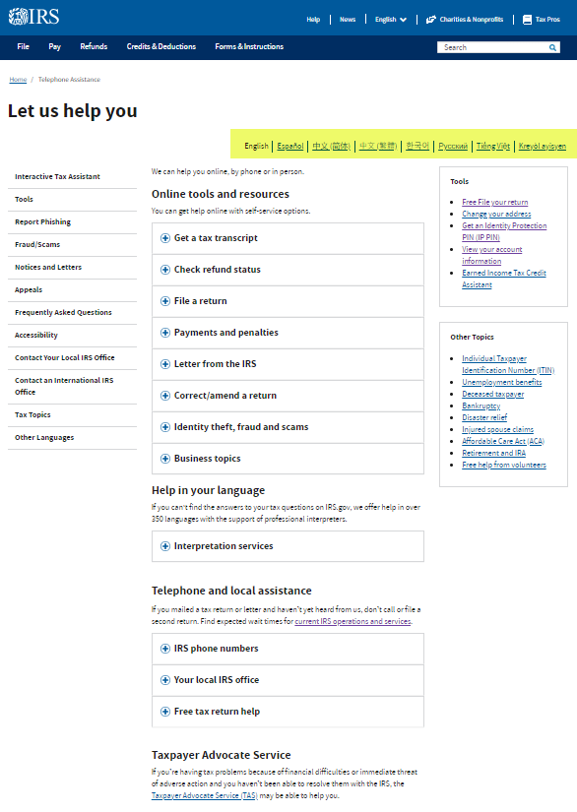
Have Questions? Need Help? http://www.IRS.gov/Help
5
Presenter Notes
2024-02-16 13:07:26
--------------------------------------------
As I mentioned, taxpayers should use IRS.gov as their first and primary resource for accurate tax information. The Let Us Help You page on IRS.gov has links to information and resources on a wide range of topics. As just mentioned, many IRS.gov pages are translated in 6 different languages, generally shown toward the top left of the translated site pages – see the highlighted area section on the slide. Just click on the preferred language to see the translated information.

Slide 6
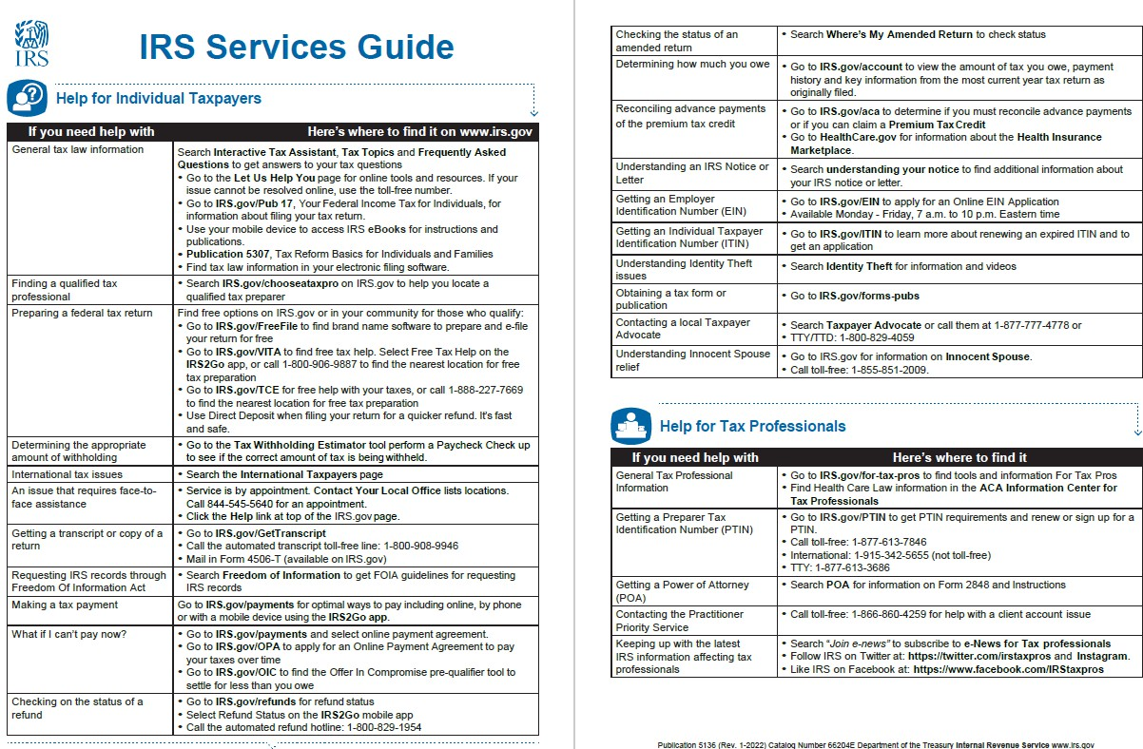
Pub 5136 IRS Services Guide (Spanish)
6
Presenter Notes
2024-02-16 13:07:26
--------------------------------------------
The IRS Services Guide explains how taxpayers can get help and guidance for many of the most common procedural questions they call into the Service about, such as filing and payment options, checking on a refund and understanding notices and letters. Please share Publication 5136 IRS Services Guide with your members, clients and customers. All the publications referenced in this presentation are available for sharing directly by hyperlink from IRS.gov or downloadable for electronic distribution.

Slide 7
IRS Interactive Tax Assistant www.IRS.gov/ITA
7
Presenter Notes
2024-02-16 13:07:26
--------------------------------------------
The Interactive Tax Assistant (ITA) is a tool that provides answers to several tax law questions specific to taxpayers’ individual circumstances. Based on their input, it can determine if there’s a requirement to file a tax return, filing status, eligibility to claim a dependent, if the type of income is taxable, eligibility to claim credits like the Child Tax Credit and the Earned Income Tax Credit, or if expenses are deductible. Reactive: The information provided is anonymous and will be used for purposes of answering questions. It will not be shared, stored or used in any other way, nor can it be used to identify the individual who enters it. It will be discarded when you exit a topic.

Slide 8
Individuals
ONE User ID and Password accesses:
8
Online Account delivers tax records, balance due, payoff amounts, payment history, view or create payment plans, view select notices/letters, Tax Pro Account notifications (also in Spanish!)
8
Get Transcript Online delivers Tax Return, Tax Account, Record of Account and Wage & Income transcripts
Online Payment Agreement initiates or revises installment agreements and can be used by taxpayers AND tax professionals
Get an IP PIN creates an Identity Protection PIN for requesting taxpayers and retrieves a previously issued IP PIN
Identity Verification Service validates identify for taxpayers who receive an IRS letter asking for identity verification before processing a (refund) return
Presenter Notes
2024-02-16 13:07:26
--------------------------------------------
The IRS has many online services for individual taxpayers that are accessible with the same user ID and password. To register, simply select any of these tools on IRS.gov which will redirect to ID.me, a trusted IRS identity verification partner. Create an IRS account on the ID.me site with a USER ID and PASSWORD, which can then be used to access all the services shown here.

Slide 9
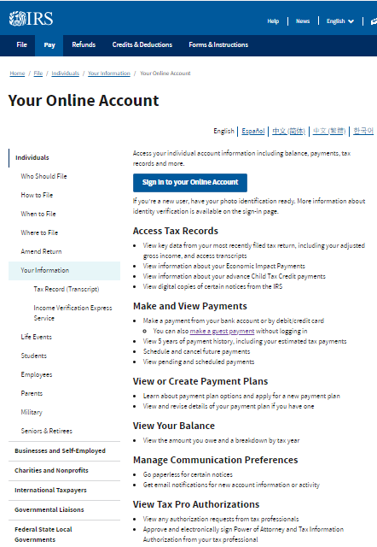
IRS Online Account www.IRS.gov/Accounts
9
Account Balance Tab
View Balance, Tax Records and Notices
Payments
Make and View Payments
View Payment Plan Details
Make a same day payment
Set up payment plan if eligible
Tax Records
Get Transcripts Online
Prior Return Years Summary
Notices and letters
View Account Notifications
View digital copies of select notices from the IRS
Authorizations
View & Approve Authorizations from your representative
Profile
View Name, Address, Email Address on File
Change Password update sign-in settings
Manage Paperless or Email Notification Preference
Presenter Notes
2024-02-16 13:07:27
--------------------------------------------
One of the most important online services is the IRS Individual Online Account. We’re encouraging all individual taxpayers, when possible, to enroll for an IRS Online Account. This secure electronic feature lets taxpayers securely access their personal tax information, including tax return transcripts, payment history, certain notices, prior year adjusted gross income and power of attorney information

Slide 10
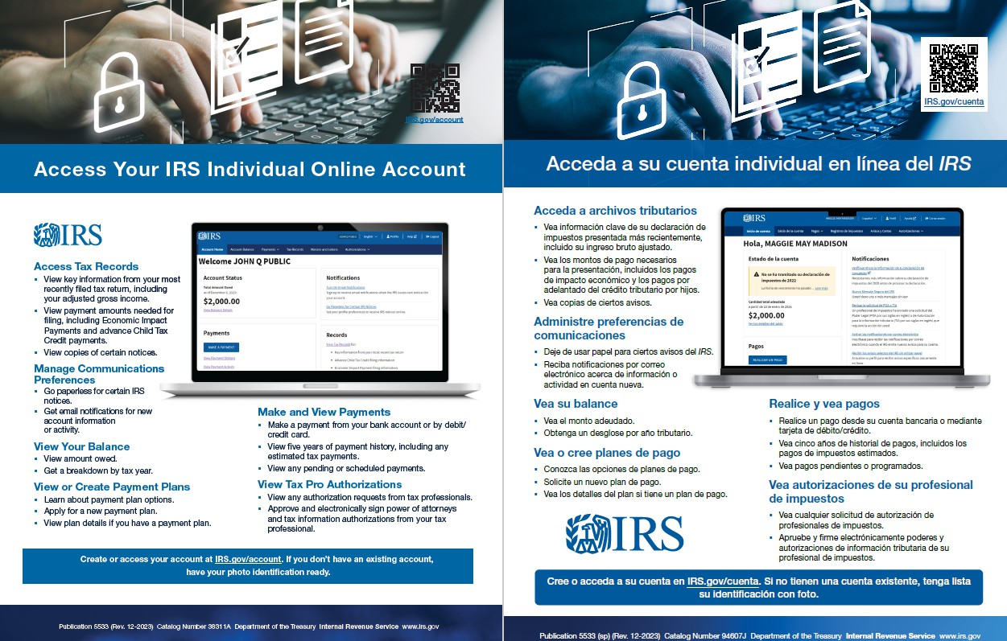
Pub 5533 Access Your
IRS Online Account (Spanish)
10
Presenter Notes
2024-02-16 13:07:27
--------------------------------------------
The Online Account application is also available in Spanish as well as English. Please help the IRS to promote the Online account by sharing Publication 5533 Access Your IRS Online Account with your members, clients and customers.

Slide 11
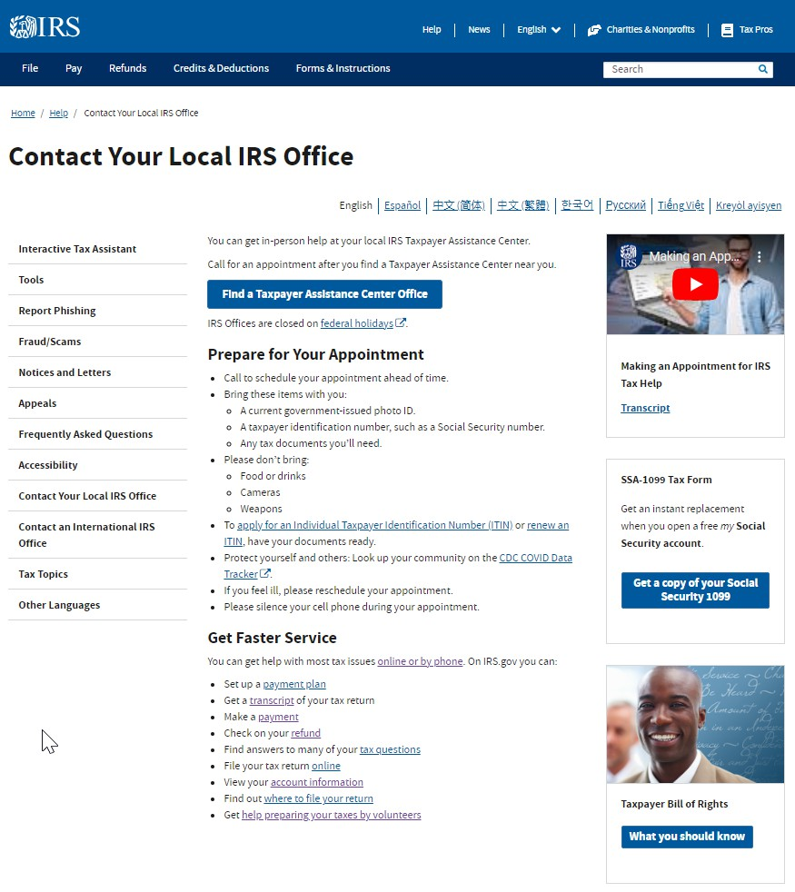
IRS Taxpayer Assistance Centers Search “TAC” on IRS.gov
11
Presenter Notes
2024-02-16 13:07:27
--------------------------------------------
In addition to IRS.gov and telephone assistance, taxpayers can also get IRS help in-person. IRS Taxpayer Assistance Centers, or TACs around the country are open year-round by appointment-only to provide services as shown on the slide. Taxpayers can make an appointment for in-person assistance. TACs are generally open weekdays from 8:30am to 4:30pm local time. However, during the 2024 filing season, most TACs will offer extra office hours from 7:30 to 8:30am and 4:30pm to 6:00pm, when taxpayers who are not making cash payments can walk in without an appointment. Publication 4995-A Services By Appointment for Taxpayer Assistance Centers overviews the TAC services provided and the phone number for making appointments. Please share with your members, clients and customers. Please note that TAC employees do not prepare tax returns.

Slide 12
Communications & Liaison
Stakeholder Liaison
12

Slide 13
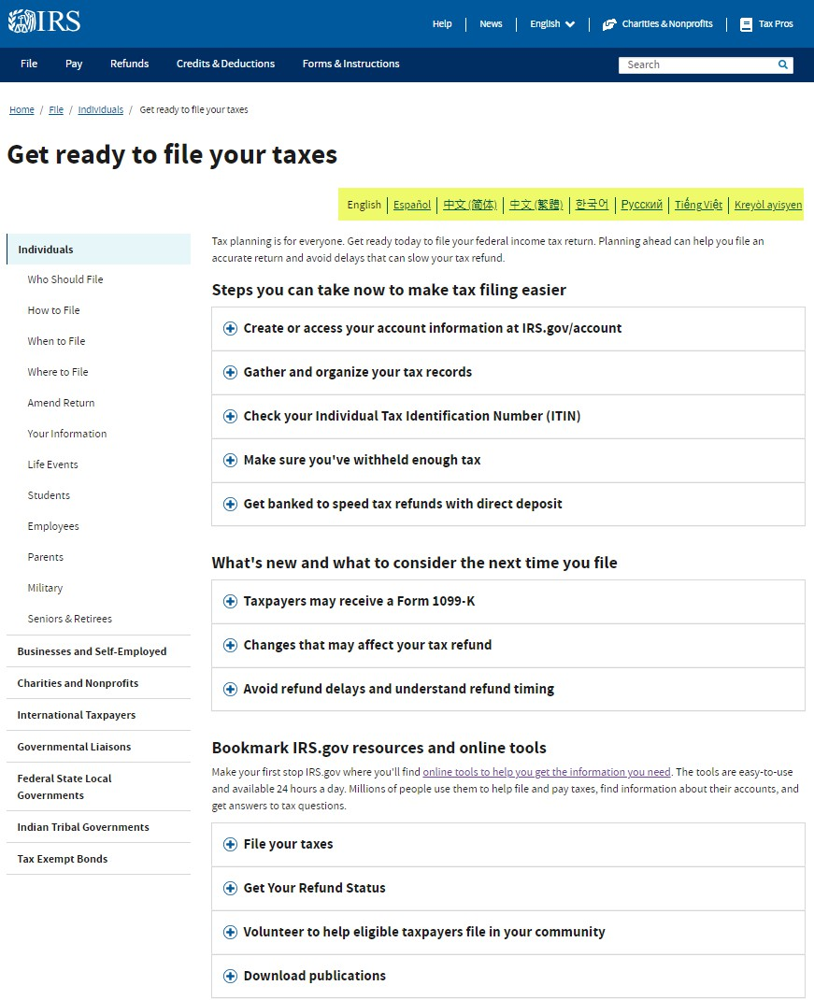
Getting Ready to File www.IRS.gov/getready
13
Presenter Notes
2024-02-16 13:07:27
--------------------------------------------
The Internal Revenue Service encourages taxpayers to check out IRS.gov Get Ready to File Your Taxes page for tips, tools and resources to help them get ready to file their 2023 federal income tax return. Once again, note how many IRS site pages are available in other languages as highlighted in the yellow section on the slide.

Slide 14
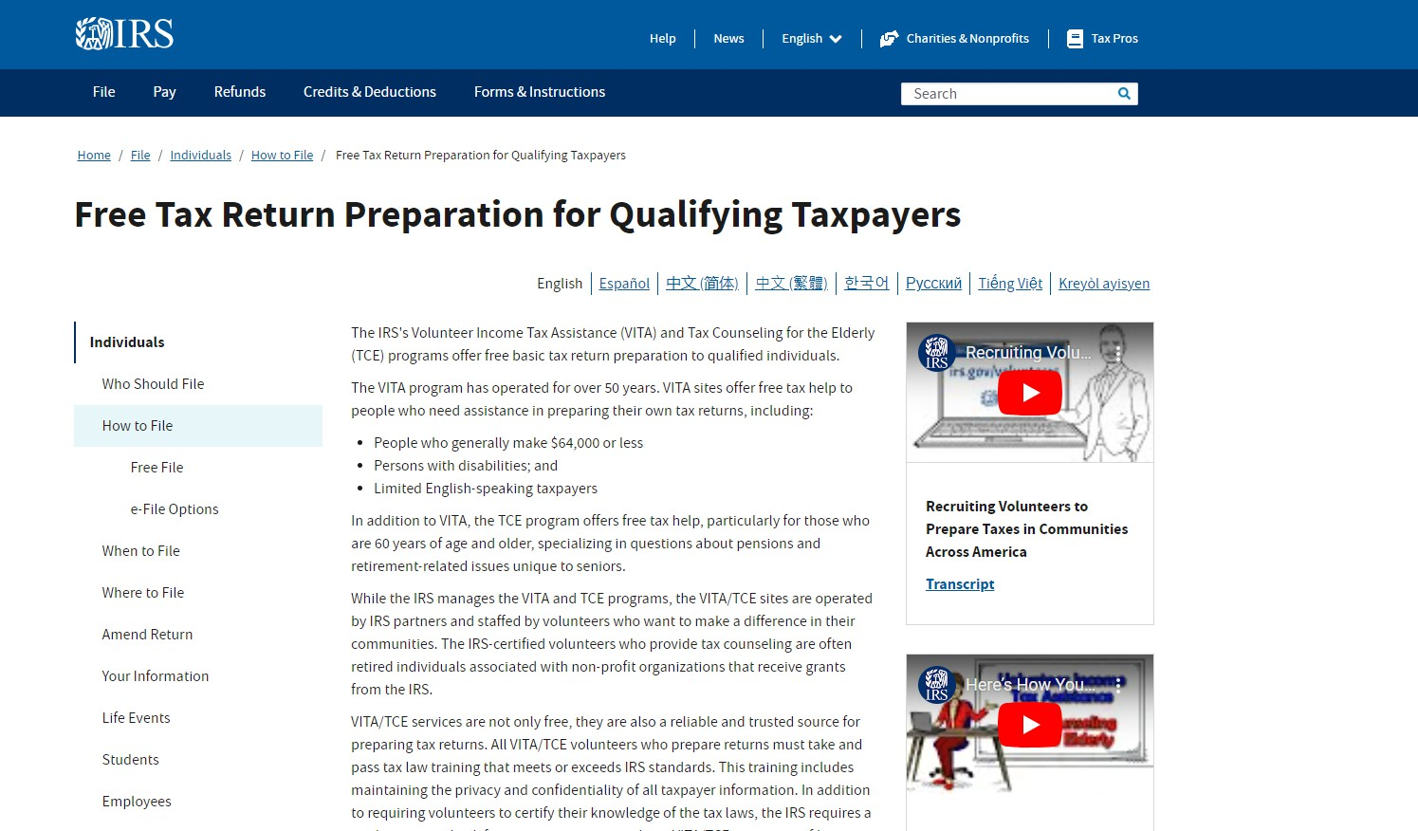
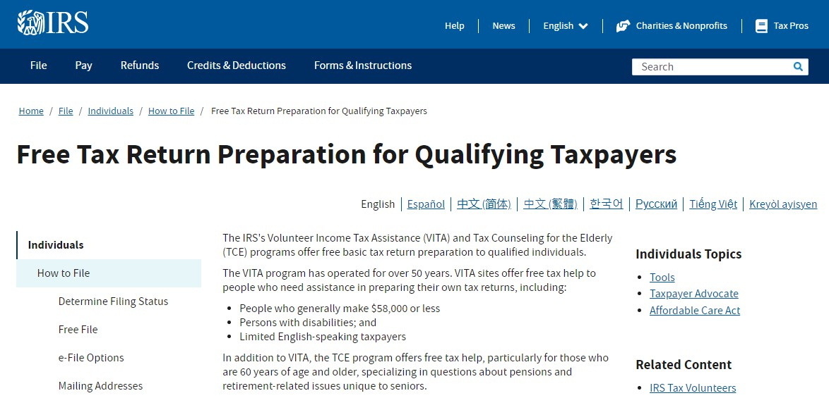
Free Tax Return Preparation Volunteer Income Tax Assistance
14
www.IRS.gov/VITA
Presenter Notes
2024-02-16 13:07:28
--------------------------------------------
The Volunteer Income Tax Assistance program, or VITA, has operated for over 50 years. VITA sites and volunteer return preparers offer free tax help to qualifying taxpayers who need assistance in preparing their own tax returns, including: People who generally make $64,000 or less
Persons with disabilities; and Limited English-speaking taxpayers
VITA can also assist in preparing tax returns for previous years, including taxpayers who want to claim the 2021 Child Tax Credit and the 2020 and 2021 Recovery Rebate Credits –more about that later.
In addition to VITA, the Tax Counseling for the Elderly program offers free tax help, particularly for those who are 60 years of age and older, specializing in questions about pensions and retirement-related issues unique to seniors. Taxpayers can find the closest free tax return preparation help using the VITA Locator Tool on rIRS.gov or by calling 800-906-9887.
The IRS Free File Program is a public-private partnership between the IRS and many tax preparation and filing software industry companies who provide their online tax preparation and filing for free. It provides two ways for taxpayers to prepare and file their federal income tax online for free:

Slide 15
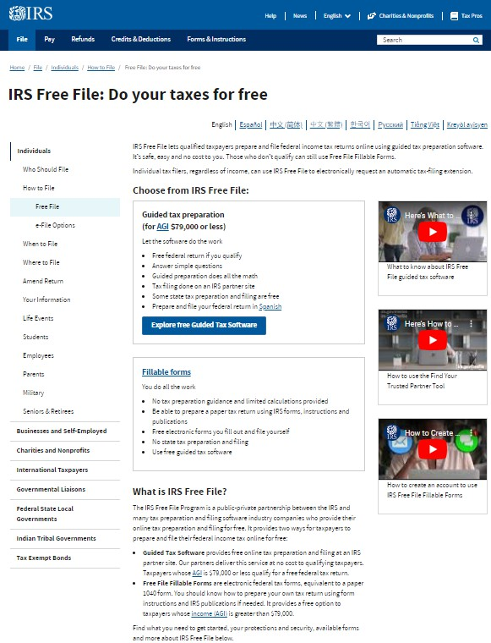
Free Tax Return Preparation Free File
15
www.IRS.gov/FreeFile
Presenter Notes
2024-02-16 13:07:28
--------------------------------------------
The IRS Free File Program is a public-private partnership between the IRS and many tax preparation and filing software industry companies who provide their online tax preparation and filing for free. It provides two ways for taxpayers to prepare and file their federal income tax online for free: Guided Tax Preparation provides free online tax preparation and filing at an IRS partner site. Our partners deliver this service at no cost to qualifying taxpayers. Taxpayers whose Adjusted Gross Income is $79,000 or less qualify for a free federal tax return.
Free File Fillable Forms are electronic federal tax forms, equivalent to a paper 1040 form. Taxpayers should know how to prepare their own tax return using form instructions and IRS publications if needed. It provides a free option to taxpayers whose income (AGI) is greater than $79,000. Unlike VITA, Free File services are for only the current tax year.
Publication 5776 provides more details about the VITA and Free File programs. Please share with your members, clients and customers.

Slide 16
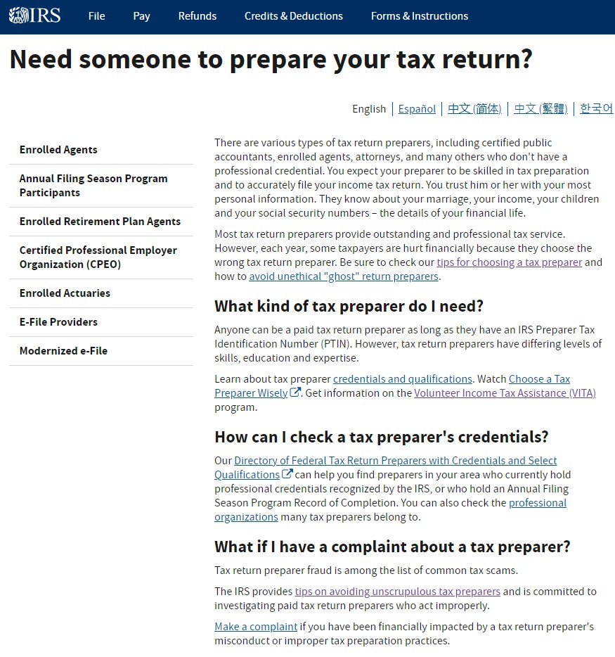
Choosing a Return Preparer www.IRS.gov/chooseataxpro
16
Presenter Notes
2024-02-16 13:07:28
--------------------------------------------
If taxpayers don’t use a free return preparation option or don’t qualify, and they want to use a paid preparer instead, they should exercise caution in choosing one. This page on IRS.gov explains how to choose a reliable tax preparer. There are various types of tax return preparers, including certified public accountants, enrolled agents, attorneys, and many others who don't have a professional credential. Taxpayers expect their preparer to be skilled in tax preparation and to accurately file their income tax returns. Taxpayers should be able to trust their preparer with their personal information and financial information, including their social security. Most tax return preparers provide outstanding and professional tax service. However, each year, some taxpayers are hurt financially because they choose the wrong tax return preparer. Be sure to check our tips for choosing a tax preparer and how to avoid unethical "ghost" return preparers. Ghost return preparers do tax returns for a fee, but they don’t sign them as required by law because they may be illegally preparing tax returns and want to avoid scrutiny.
The following points will assist taxpayers when selecting a tax return preparer:
Be wary of tax return preparers who claim they can obtain larger refunds than others can.
Avoid tax return preparers who base their fees on a percentage of the refund or who offer to deposit all or part of the refund into their financial accounts.
Ensure the preparer with a Preparer Tax Identification Number, or PTIN. Paid tax return preparers must have a PTIN to prepare all or substantially all of a tax return. Use a reputable tax professional who enters their PTIN on the tax return, signs the tax return, and provides a copy of the return (as required).
Consider whether the individual or firm will be around for months or years after filing the return to answer questions about the preparation of the tax return. Never sign a blank tax form.
Check the person's credentials. Only attorneys, CPAs, and enrolled agents can represent taxpayers before the IRS in all matters, including audits, collections, and appeals. Other tax return preparers who participate in the IRS Annual Filing Season Program have limited practice rights to represent taxpayers for audits of returns they prepared and signed. In addition, the Directory of Federal Tax Return Preparers with Credentials and Select Qualifications on IRS.gov can help find local preparers who hold professional credentials recognized by the IRS, or who hold an IRS Annual Filing Season Program Record of Completion.
Please help protect taxpayers from bad preparers by sharing Publication 5895 Who Do You Trust to Preparer Your Return? with your members, clients and customers, which explains how to choose a reliable tax preparer.

Slide 17
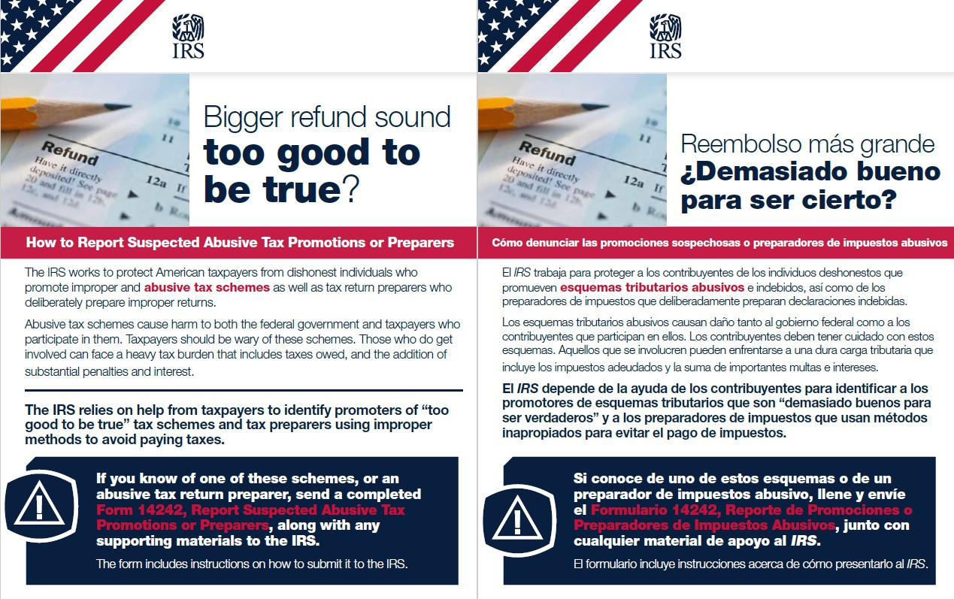
Pub 5610 How to Report Suspected Abusive Preparers (Spanish)
17
Presenter Notes
2024-02-16 13:07:28
--------------------------------------------
Unfortunately, there will be taxpayers who will be come upon or become victims of promoters of abusive tax schemes or bad preparers, especially during the filing season. Those taxpayers can refer to Publication 5610 on IRS.gov to find out How to Report Suspected Abusive Tax Promotions or Preparers.

Slide 18
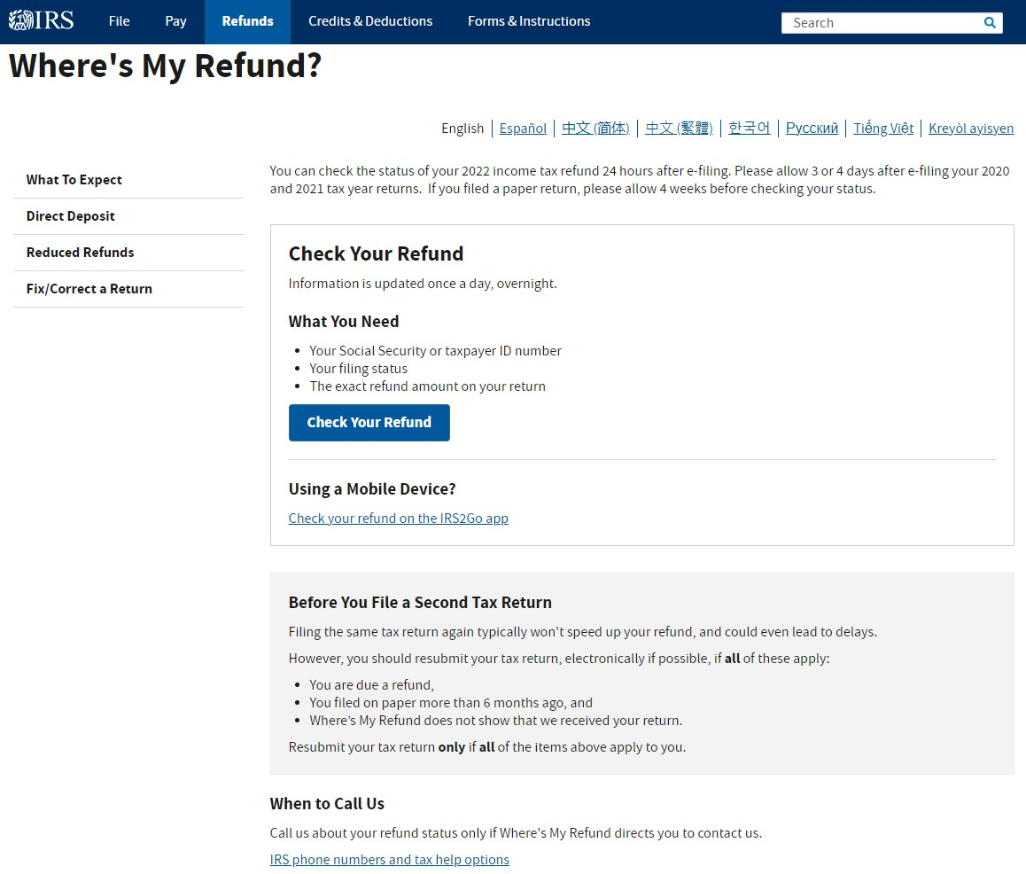
Tax Refund Status www.irs.gov/refunds
18
Presenter Notes
2024-02-16 13:07:28
--------------------------------------------
Many taxpayers are unaware they can easily check the status of their 2023 income tax refunds as soon as 24 hours after e-filing by using the Where’s My Refund Tool on IRS.gov. Where’s My Refund gives a personalized refund date after the IRS processes a refund return and approves the refund. The tracker displays progress through three stages:
Return Received Refund Approved Refund Sent
To use Where’s My Refund, taxpayers need to provide their Social Security number, filing status and the exact whole dollar amount of their expected refund. This helpful tool is located at www.IRS.gov/refunds

Slide 19
Pub 5063 Where’s My Refund?
19
Presenter Notes
2024-02-16 13:07:29
--------------------------------------------
Taxpayers can also check refund status using the IRS2GO app from the Google Play or Apple App stores, or by calling the Refund Hotline. By the way, IRS2GO is also available in Spanish. Please share Publication 5063 Where’s My Refund? with your members, clients and customers.

Slide 20
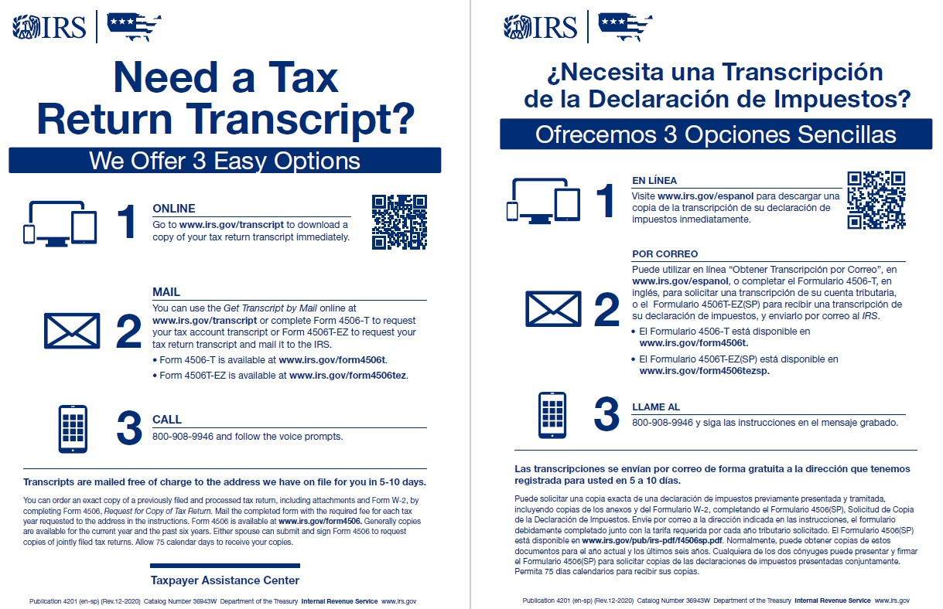
Pub 4201 Need a Transcript? www.IRS.gov/Transcript
20
Presenter Notes
2024-02-16 13:07:29
--------------------------------------------
Taxpayers who need return and tax account information for this year or prior years from the IRS have 3 methods where they can order transcripts. The quickest way to obtain transcripts is through an IRS Online Account, which is a benefit of the Online Account I mentioned earlier. They generally will receive their transcripts instantly with this method. Transcripts can also be obtained by mail or by telephone. The transcripts IRS offers include these:
Tax Return Transcript - shows most line items from the original Form 1040-series tax return as filed, along with any forms and schedules. It doesn't show changes made after the original return is filed. This transcript is available for the current and three prior tax years. A tax return transcript usually meets the needs of lending institutions offering mortgages.
Tax Account Transcript - shows basic data such as filing status, taxable income, and payment types. It also shows changes made after the filing of the original return. This transcript is available for the current and nine prior tax years through Get Transcript Online, and the current and three prior tax years through Get Transcript by Mail or by ordering by telephone. Wage and Income Transcript - shows data from information returns we receive such as Forms W-2, 1098, 1099, and 5498.
Taxpayers can find more information about obtaining transcripts at www.IRS.gov/transcript. Please share Publication 4201 Need a Transcript with your members, clients and customers.

Slide 21
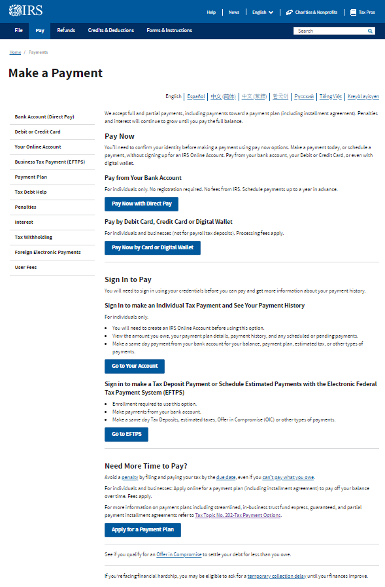
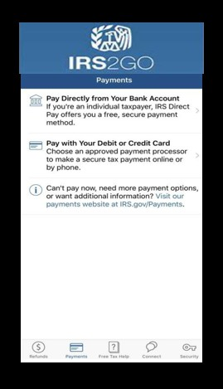
Pay Online at www.IRS.gov/pay and www.IRS.gov/IRS2GO
21
Presenter Notes
2024-02-16 13:07:29
--------------------------------------------
If there is a balance due on a tax return, paying electronically is a convenient way to pay. There are options for initiating payments online, by phone, or from a mobile device using the ITS2GO app previously mentioned. Direct Pay, credit cards or digital wallets and the Electronic Federal Tax Payment System are online options. The IRS uses the latest encryption technology, so paying electronically is safe and secure. IRS electronic payment options put taxpayers in control of paying their tax bill and gives peace of mind. Payments can be scheduled in advance, and confirmation is provided after submission. It's quick, easy, secure, and much faster than mailing in a check or money order.

Slide 22
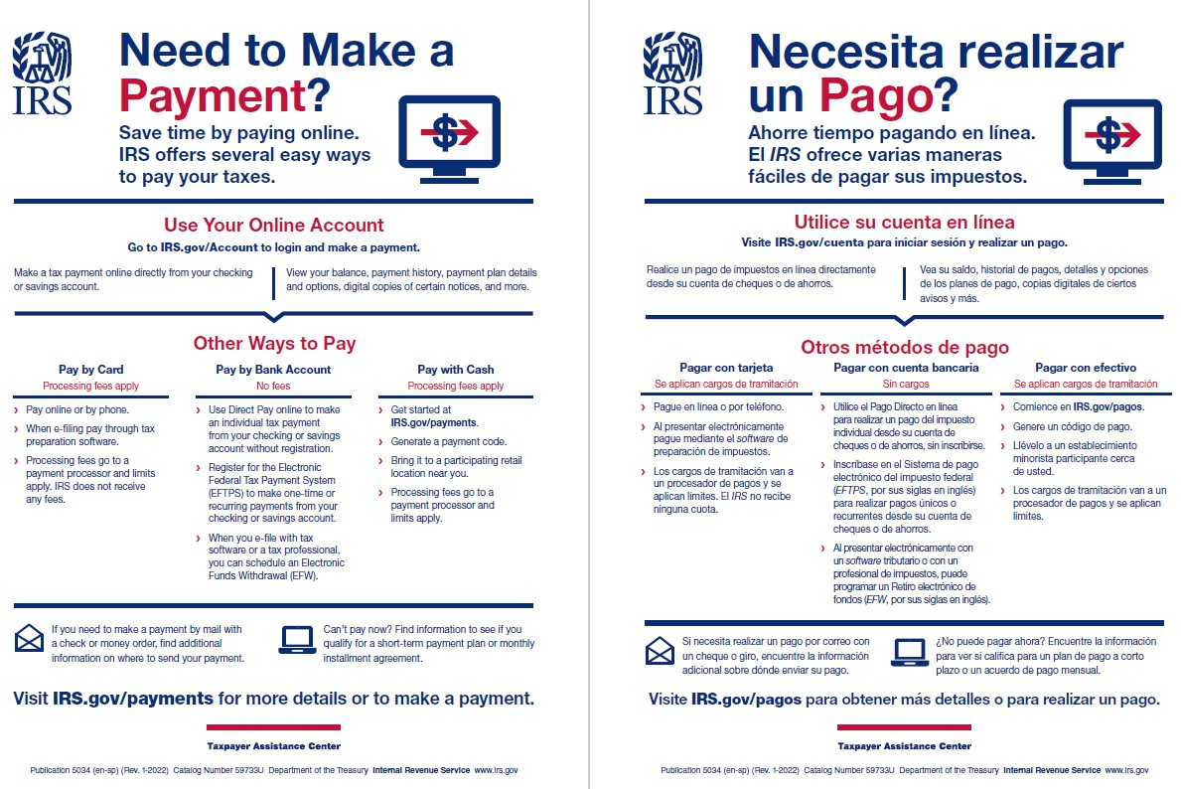
Pub 5034 Need to Make a Payment? www.IRS.gov/payments
22
Presenter Notes
2024-02-16 13:07:29
--------------------------------------------
Pub 5034 Need to Make a Payment overviews the payment options just discussed. Please share it with your members, clients and customers.

Slide 23
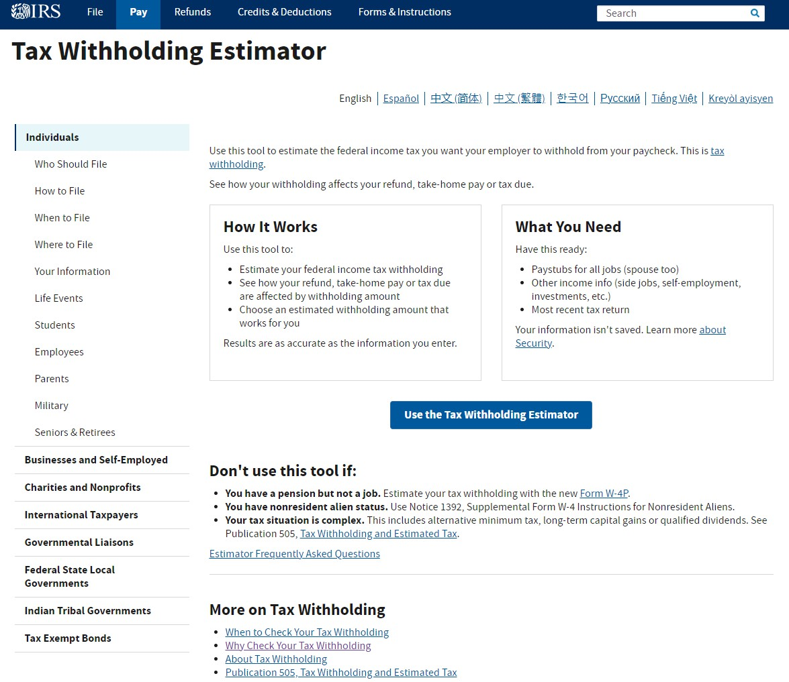
Paycheck Checkup www.IRS.gov/withholding
23
Presenter Notes
2024-02-16 13:07:29
--------------------------------------------
After completion of the tax return, there may be a balance due or refund, indicating the need to adjust federal tax withholding for this year. So, this is the perfect time of year to do a Paycheck Checkup using the IRS’ Tax Withholding Estimator. Doing so can: Protect against having too little tax withheld and facing an unexpected tax bill or penalty at tax time next year, and
Can let the taxpayer adjust the amount withheld up front, so they’ll receive a bigger paycheck during the year and smaller refund at tax time. Taxpayers should check your tax withholding every year, especially:
When there is a major life change New job or other paid work
Major income change Marriage
Childbirth or adoption Home purchase

Slide 24
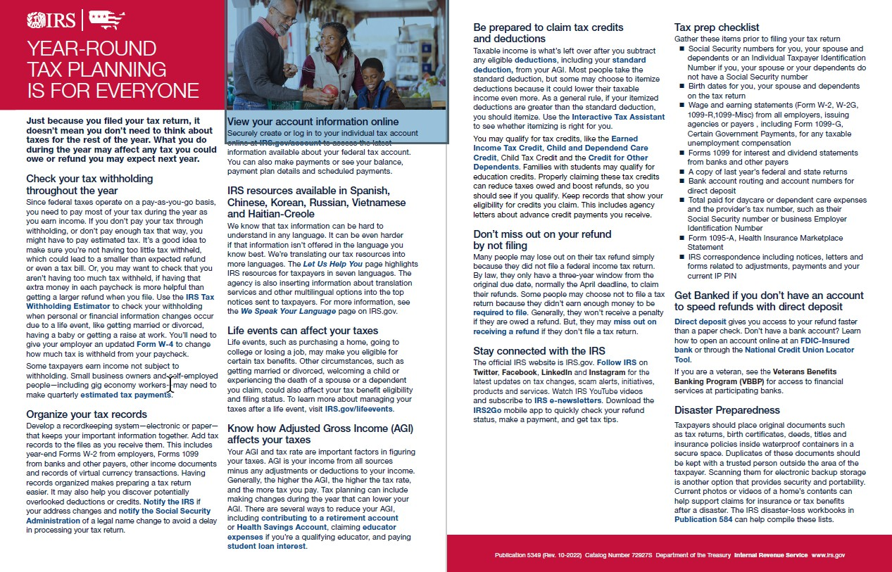
Pub 5349 Year-round Tax Planning is for Everyone
24
Presenter Notes
2024-02-16 13:07:30
--------------------------------------------
In addition to checking tax withholding, Publication 5349 Year-round Tax Planning is for Everyone provides information on how taxpayers can keep on top of their taxes year-round, from organizing records and maintaining a tax preparation checklist, to being aware how life events can affect their tax situation. Pub 5349 is not yet available in Spanish but is available in Chinese on IRS.gov.

Slide 25
Communications & Liaison
Stakeholder Liaison
25

Slide 26
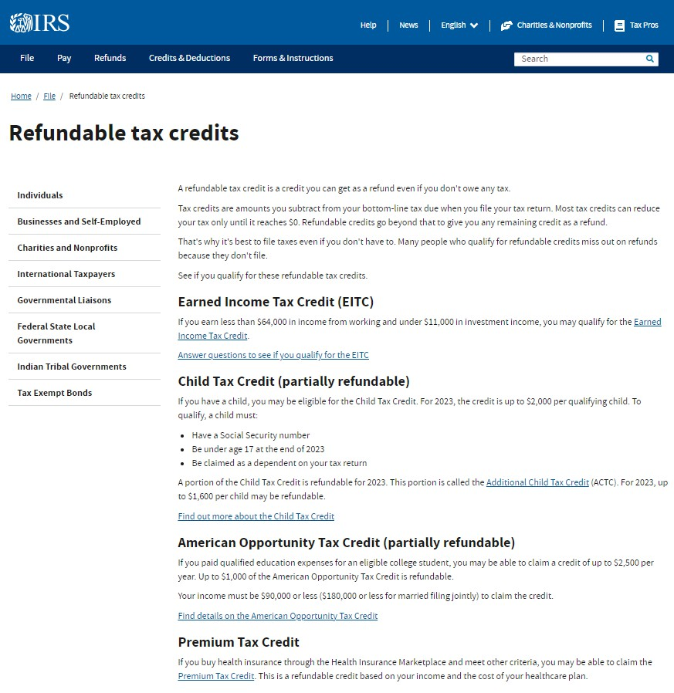
Refundable Tax Credits www.IRS.gov/credits
26
Presenter Notes
2024-02-16 13:07:30
--------------------------------------------
Many taxpayers whose income is so low that they are not typically required to file a tax return may be eligible for several credits that can be refunded or partially refunded even if they have little or no tax liability. These include the Earned Income Tax Credit, the Child Tax Credit, the American Opportunity Tax Credit for qualified education expenses and the Premium Tax Credit for health insurance paid through the marketplace pursuant to the Affordable Care Act.

Slide 27
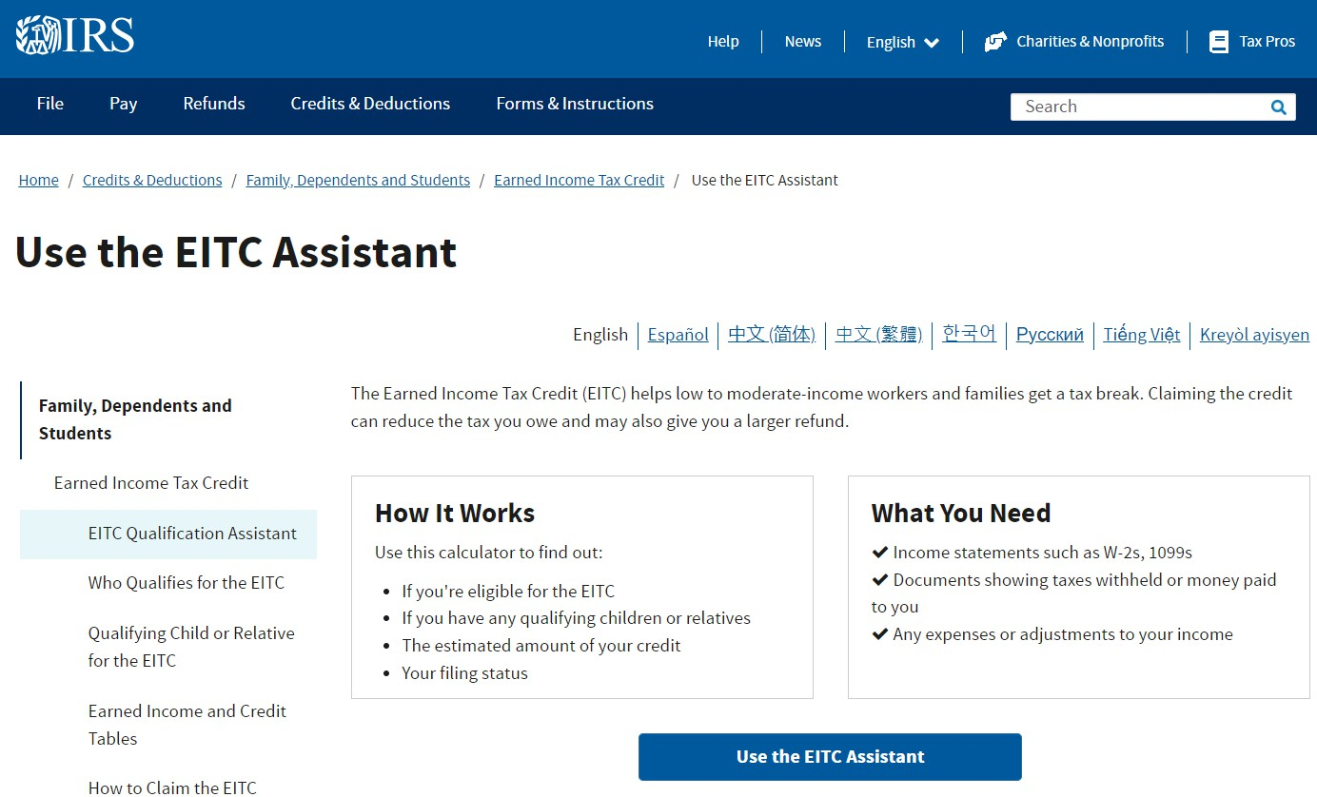
Earned Income Tax Credit Assistant www.IRS.gov/eitcassistant
27
Presenter Notes
2024-02-16 13:07:30
--------------------------------------------
Taxpayers can use the Earned Income Tax Credit Assistant on IRS.gov to determine eligibly for the EITC.
The Earned Income Tax Credit, or EITC, is a refundable credit for people who work for someone else, or are self-employed, or received certain disability payments. To qualify, the amount of income earned must be less than $63,698, depending on filing status and number of children. The maximum credit is $7,430. A federal tax return must be filed to get the EITC even if no tax is owed or there is no filing requirement. Publication 3211 provides a detailed overview of the EITC.

Slide 28
Pub 5811 Child Tax Credit
28
Presenter Notes
2024-02-16 13:07:30
--------------------------------------------
The Child Tax Credit, or CTC is a partially refundable credit for people who have an eligible child or children who have a Social Security Number, are under age 17 at the end of 2023 and can be claimed as a dependent on the tax return. The credit is up to $2,000 per qualifying child. A portion of the Child Tax Credit is refundable for 2023. This portion is called the Additional Child Tax Credit (ACTC). For 2023, up to $1,600 per child may be refundable. A federal tax return must be filed to get the CTC even if no tax is owed or there is no filing requirement. Publication 5811 provides an overview of the CTC. Please share it with your members, clients and customers.

Slide 29
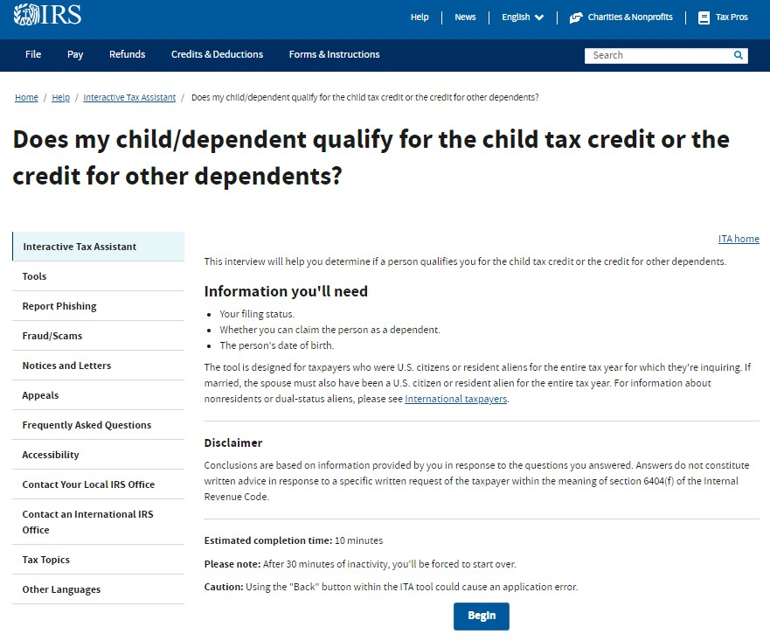
Child Tax Credit Eligibility Tool www.IRS.gov/ITA
29
Presenter Notes
2024-02-16 13:07:31
--------------------------------------------
Taxpayers can use the IRS Interactive Tax Assistant tool “Does My Child/Dependent Qualify for the Child Tax Credit or the Credit for Other Dependents?” to determine if a person qualifies you for the Child Tax Credit.
The Child Tax Credit, or CTC is a partially refundable credit for people who have an eligible child or children who have a Social Security Number, are under age 17 at the end of 2023 and can be claimed as a dependent on the tax return. The credit is up to $2,000 per qualifying child. A portion of the Child Tax Credit is refundable for 2023. This portion is called the Additional Child Tax Credit (ACTC). For 2023, up to $1,600 per child may be refundable. A federal tax return must be filed to get the CTC even if no tax is owed or there is no filing requirement. Publication 5811 provides an overview of the CTC. Please share it with your members, clients and customers.

Slide 30
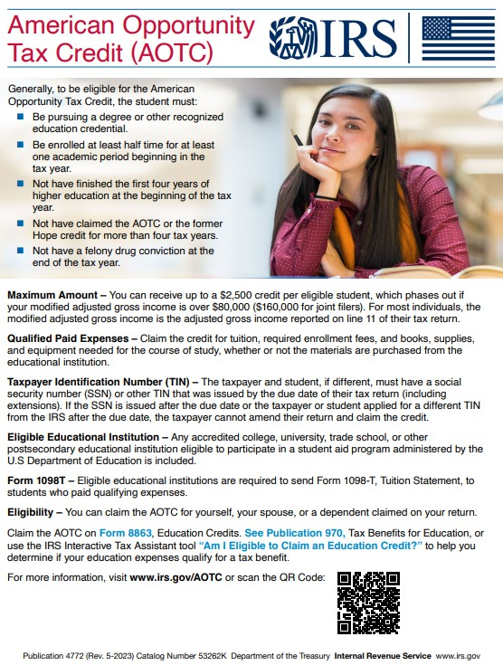
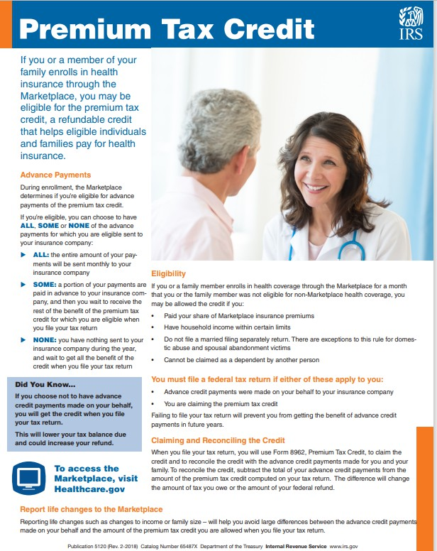
Pub 4772 American Opportunity Tax Credit Pub 5120 Premium Tax Credit
30
Presenter Notes
2024-02-16 13:07:31
--------------------------------------------
The American Opportunity Tax Credit, or AOTC is a partially refundable credit for taxpayers with income of $90,000 or less ($180,000 for married couples filing jointly) who paid qualified education expenses for an eligible college student. The maximum credit is $2,500 per year and up to $1,000 of the credit is refundable. As like the Child Tax Credit, the Interactive Tax Assistant also has an eligibility tool for the AOTC. The Premium Tax Credit, or PTC, is a refundable credit that helps eligible individuals and families cover the premiums they paid for their health insurance purchased through the Health Insurance Marketplace. There are various eligibility requirements and Publication 5120 Premium Tax Credit provides an overview.
As with the Earned Income and Child Tax Credits, the American Opportunity and Premium Tax Credits, a federal tax return must be filed to get the AOTC and the PTC even if no tax is owed or there is no filing requirement. Please share Publications 4772 American Opportunity Tax Credit and 5120 Premium Tax Credit with your members, client and customers.

Slide 31
2021 Expanded Child Tax Credit
It’s not too late to claim the …
31
$3,600/per child 5 and under
$3,000/child over 6 to 17
2021 Recovery Rebate Credit
$1,400/adult or dependent
2020 Recovery Rebate Credit
$1,800/adult
$1,100/child
Presenter Notes
2024-02-16 13:07:31
--------------------------------------------
We want to advise low and no-income eligible individuals and families that normally don’t file a tax return that it’s not too late to claim pandemic-related tax benefits they may not have previously received or claimed on a tax return, such as the 2021 expanded Child Tax Credit and the 2020 and 2021 Recovery Rebate Credits in lieu of the Economic Impact Payments. An eligible family of two adults and two young children could receive up to $18,600 in combined refundable credits for 2020 and 2021; that’s a lot of money sitting on the table. Please help us get the word out. And the Volunteer Income Tax Assistance program can assist these low and no-income taxpayers with free preparation and filing to claim these refunds.

Slide 32
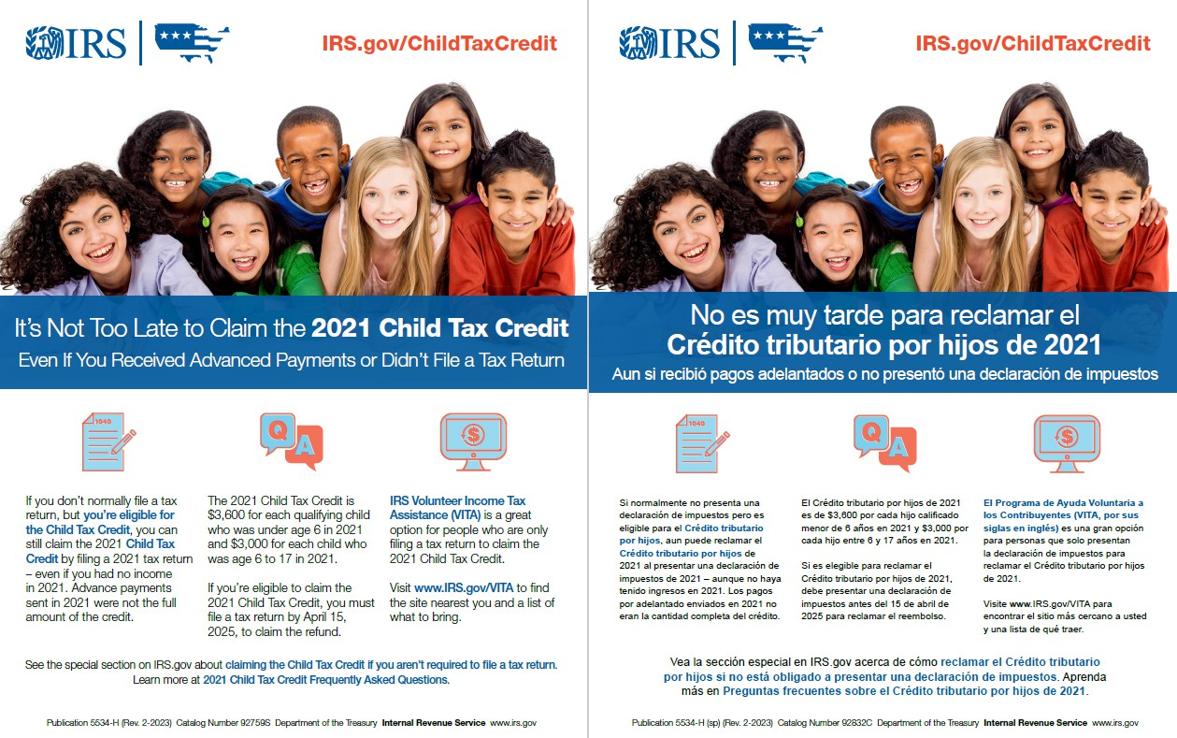
Pub 5534-H Claiming the 2021 Child Tax Credit When You Don't Normally File a Tax Return (Spanish) (Chinese)
32
Presenter Notes
2024-02-16 13:07:31
--------------------------------------------
Please share Publication 5534-H Claiming the 2021 Child Tax Credit When You Don't Normally File a Tax Return with your members, clients and customers. Eligible taxpayers have until April 15, 2025, to file a return to claim the credit, and those who are eligible for Volunteer Income Tax Assistance, or VITA, can have those returns prepared for free.

Slide 33
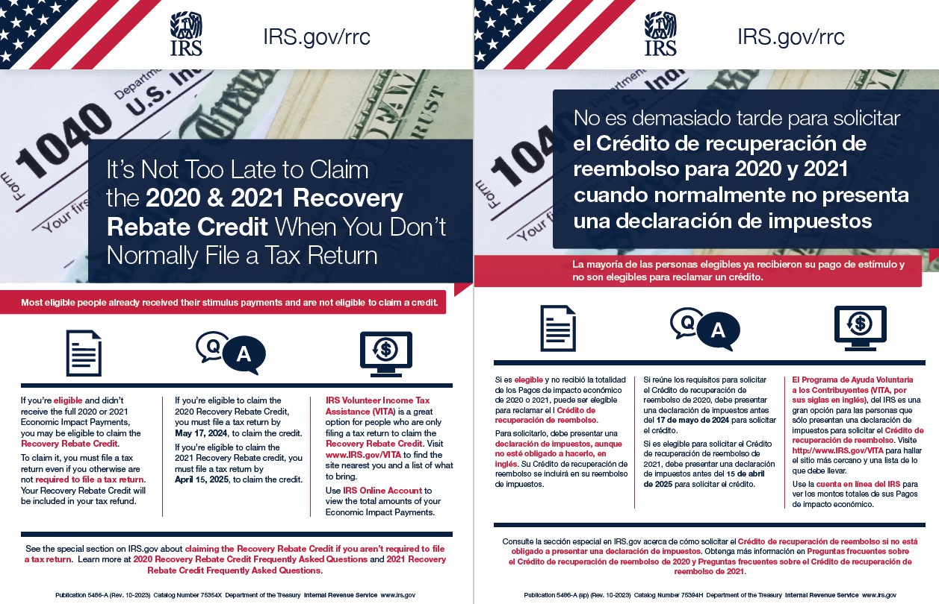
Pub 5486-A Claiming the 2020/2021 Recovery Rebate Credit When You Don't Normally File a Tax Return (Spanish) (Chinese)
33
Presenter Notes
2024-02-16 13:07:31
--------------------------------------------
Please share Publication 5486-A Claiming the 2020/2021 Recovery Rebate Credit When You Don't Normally File a Tax Return with your members, clients and customers. Eligible taxpayers have until May 17, 2024, to file a return to claim the credit for tax year 2020, and those who are eligible for VITA, can have those returns prepared for free.

Slide 34
Communications & Liaison
Stakeholder Liaison
34

Slide 35
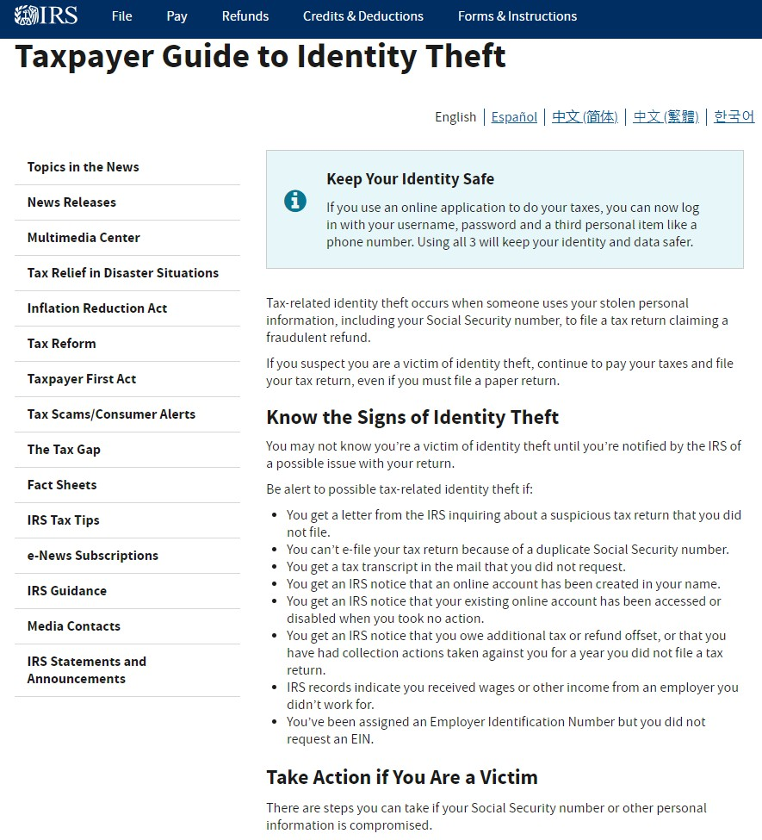
Taxpayer Guide to Identity Theft www.IRS.gov/idtheft
35
Presenter Notes
2024-02-16 13:07:32
--------------------------------------------
January through April is not only tax season for the IRS, it’s the most active time of the year for tax scammers. Identity thieve will do almost anything to get taxpayers’ personal identification so they can file fraudulent refund returns. Now that we’re in the filing season, the IRS wants to remind taxpayers to be aware that criminals continue to make aggressive calls posing as IRS agents in hopes of stealing their money and your personal information. Here are some telltale signs of a tax scam along with actions taxpayers can take if they receive a scam call.
The IRS will never:
Call to demand immediate payment using a specific payment method such as a prepaid debit card, gift card or wire transfer. Generally, the IRS will first mail a bill to any taxpayer who owes taxes. Threaten to immediately bring in local police or other law enforcement groups to have the taxpayer arrested for not paying.
Demand that taxes be paid without giving taxpayers the opportunity to question or appeal the amount owed, or Call unexpectedly about a tax refund.
Download Publications 4524 Security Awareness and 5027 Identity Theft Information for Taxpayers from IRS.gov to find out how to protect yourself from scammers and what to do if you’re a victim of tax-related identity theft.
35

Slide 36
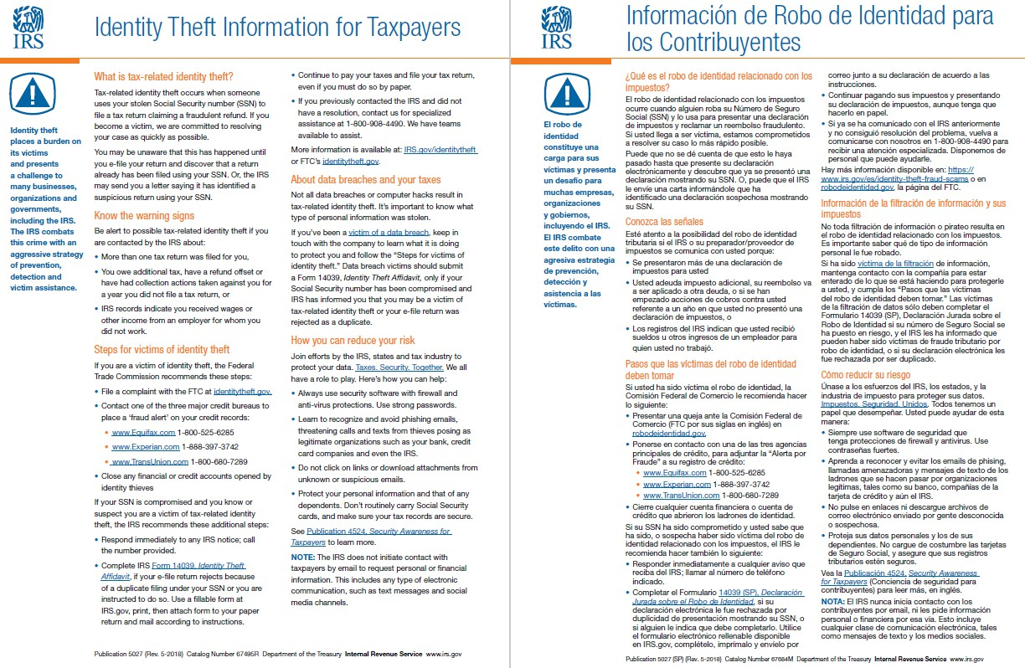
Pub 5027 Identity Theft Information for Taxpayers (Spanish)
36
Presenter Notes
2024-02-16 13:07:32
--------------------------------------------
Publication 5027 Identity Theft Information for Taxpayers overviews how a taxpayer can recognize the signs of tax-related identity theft and what to do if they’re a victim of identity theft of a data breach.

Slide 37
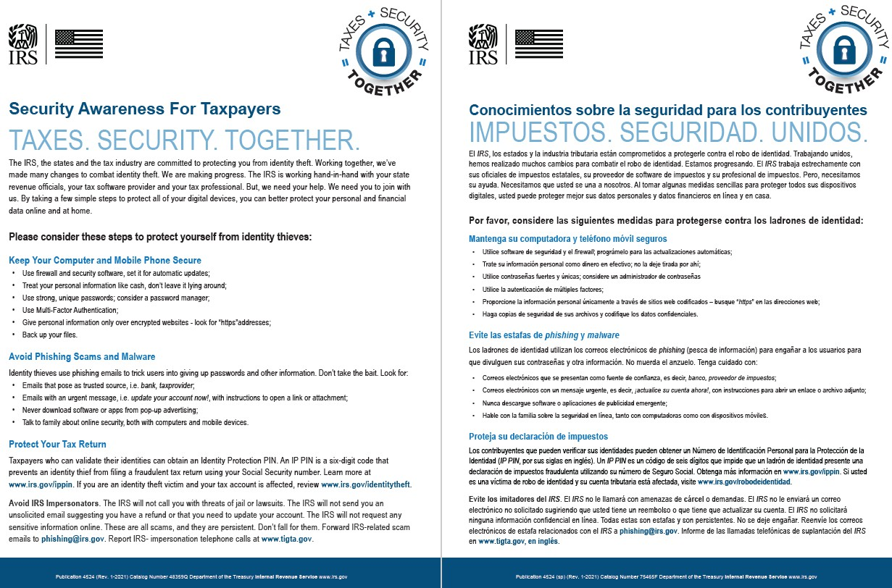
Pub 4524 Security Awareness for Taxpayers (Spanish)
37
Presenter Notes
2024-02-16 13:07:32
--------------------------------------------
Publication 4524 Security Awareness for taxpayers provides important information for protecting personal information that could lead to data loss and identity theft, with your members, clients and customers. Please share Publications 5027 and 4524 with your members, clients and customers.

Slide 38
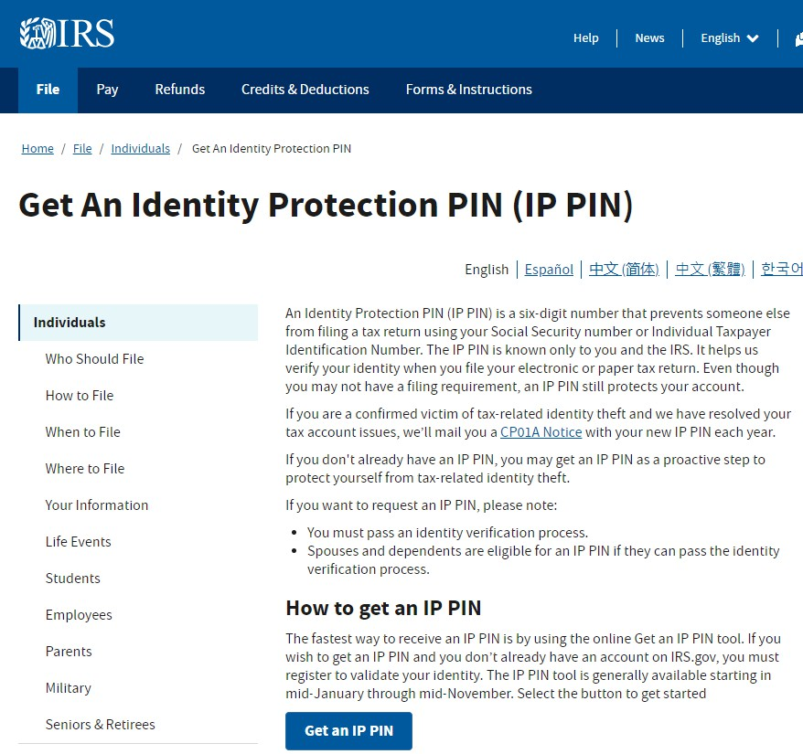
Identity Protection PIN www.IRS.gov/IPPIN
38
Presenter Notes
2024-02-16 13:07:32
--------------------------------------------
The best way taxpayers can ensure that scammers can’t use their identification numbers to file returns with fraudulent refunds is to use an IRS Personal Identification Number, or IP PIN when filing their tax returns. After a taxpayer establishes their IRS Online Account, we highly encourage them to use it to obtain an IRS Identity Protection Personal Identification Number, especially now since we’re just starting the tax return filing season. Using an IP PIN will help protect against tax-related identity theft.
An Identity Protection PIN (IP PIN) is a six-digit number that prevents someone else from filing a tax return using your Social Security number or Individual Taxpayer Identification Number. The IP PIN is known only to the taxpayer and the IRS, and their trusted tax professional if used to prepare the return. It helps the IRS verify the taxpayer’s identity when they file the return electronically or on paper. Even though a taxpayer may not have a filing requirement, an IP PIN still protects the taxpayer’s IRS account.

Slide 39
Pub 5367 Identity Protection PIN Opt-In Program for Taxpayers
39
Presenter Notes
2024-02-16 13:07:32
--------------------------------------------
Please share Publication 5367 Identity Protection PIN Opt-In Program for Taxpayers with your members, clients and customers to help protect their IRS tax account from fraud.

Slide 40
Resources
Pub 5136 IRS Services Guide
Pub 4995-A Services By Appointment for Field Assistance Taxpayer Assistance Centers
Pub 5348 Get Ready to File
Pub 5776 Free Tax Return Preparation and Filing Pub 5895 Who Do You Trust to Prepare Your Return?
Pub 5610 How to Report Suspected Abusive Preparers
Pub 4201 Need a Transcript?
Pub 5034 Need to Make a Payment?
Pub 5349 Year-round Tax Planning is for Everyone
Pub 3211 Earned Income Tax Credit
40
2/25/24

Slide 41
Resources cont.
Pub 5811 Child Tax Credit
Pub 4772 American Opportunity Tax Credit Pub 5120 Premium Tax Credit
Pub 5534-H Claiming the 2021 Child Tax Credit When You Don't Normally File a Tax Return (Spanish) (Chinese)
Pub 5486-A Claiming the 2020/2021 Recovery Rebate Credit When You Don't Normally File a Tax Return
(Spanish) (Chinese)
Pub 5027 Identity Theft Information for Taxpayers
Pub 4524 Security Awareness for Taxpayers (Spanish)
Pub 5367 Identity Protection PIN Opt-In Program for Taxpayers
41
2/25/2024

Slide 42
IRS FEEDBACK QUESTIONS
How the IRS communicate with hard-to reach taxpayers and underserved communities?
Do you have any suggestion on any material you would like to see created?
Are the IRS Notices easy to understand? If not, provide examples of specific notices that you are your clients are having
42
2/25/24

Slide 43
Contact Information
Arlene.J.Good@irs.gov
43
2/25/2024

Slide 44
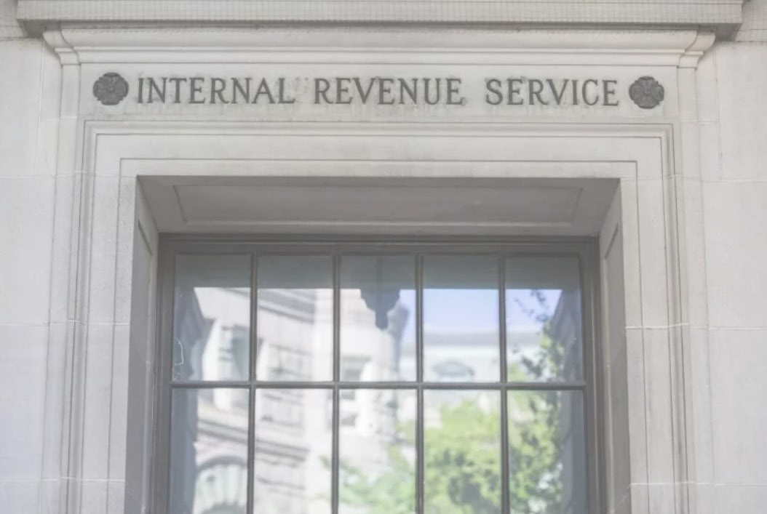
Communications & Liaison
Stakeholder Liaison
44
Presenter Notes
2024-02-16 13:07:33
--------------------------------------------
Thank you.

