Slide 1



Celebrating Entrepreneurship:
The Foundation of America’s Economy!
Maya Durnovo, AVC Entrepreneurship
Sandra Louvier, Director of Entrepreneurship
Connie Leon, Program Coordinator, West Houston Institute
Ravi Brahmbhatt, Director of Student Innovation & Entrepreneurship
Michelle Ngome, Goldman Sachs Outreach Director
Marshette Turner, MBDA Director

Slide 2
U.S. has 31.7 million small businesses;
they are the lifeblood of the U.S. economy.
Yet 60-70% fail in first 10 years
  SBA identifies the following reasons why businesses fail:
    Financial management
    Marketing, sales and customer service
    Communication and negotiation
    Leadership
    Project management and planning
    Delegation and time management
    Problem Solving
    Networking
    No or insufficient market for product or service

Slide 3
HCC’s entrepreneurial mission is to help entrepreneurs start and grow their businesses and to bolster the local economy, create jobs, and build Houston’s ecosystem by starting and growing small businesses, including minority, micro, Veteran, LGBT, senior, and women-owned businesses.
Three Centers for Entrepreneurship: Northwest, Southwest and Southeast Colleges
Three Grant Programs:
Goldman Sachs 10,000 Small Businesses Program
Minority Business Development Agency (MBDA)
Verizon Innovative Learning Initiative (for middle school students)
https://www.hccs.edu/smallbusiness

Slide 4
PROGRAMS FUNDING-$22m
Small Business Success Series © Goldman Sachs Foundation
HCC Business Plan Competition Wells Fargo Foundation
Mattress Mack School of Selling © Department of Commerce-MBDA
Patent Academy Truist Foundation
Export Academy AARP
Financial Academy QualCOmm
Business Match Making with SBA NACCE
Marketing Workshops Verizon
Negotiation Skills Wallis Bank
Digital Skills/Canva Allegiance Bank
Leadership for Women Capital One Bank
Programs in Spanish LiftFund
Programs for STUDENTS Amegy Bank

Slide 5
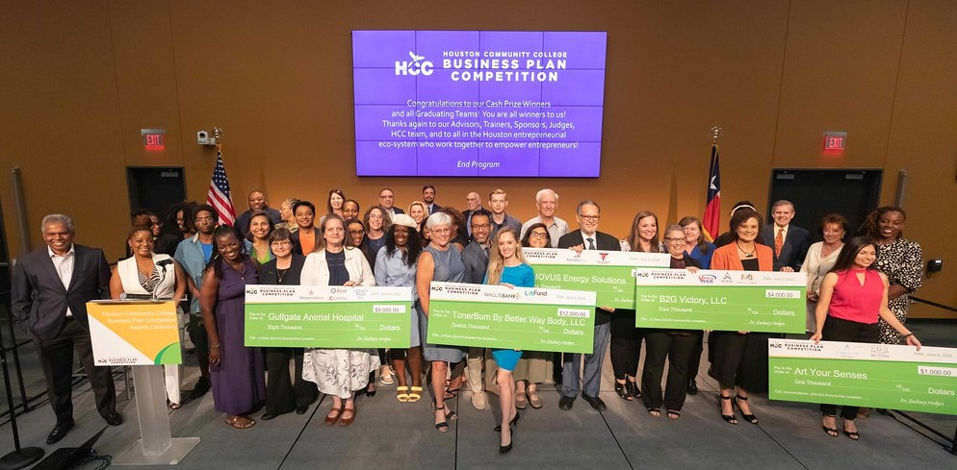
HCC Business Plan Competition
For Proposed, Startup and Existing Entrepreneurs.
Free training & advising to refine and polish
business plans.
Top five teams win prize money!
All teams win in-kind prizes
All graduating teams are winners as they all
develop value:
  a stronger written plan
  slide deck
  Video
…to pursue their business goals and seek funding.

Slide 6
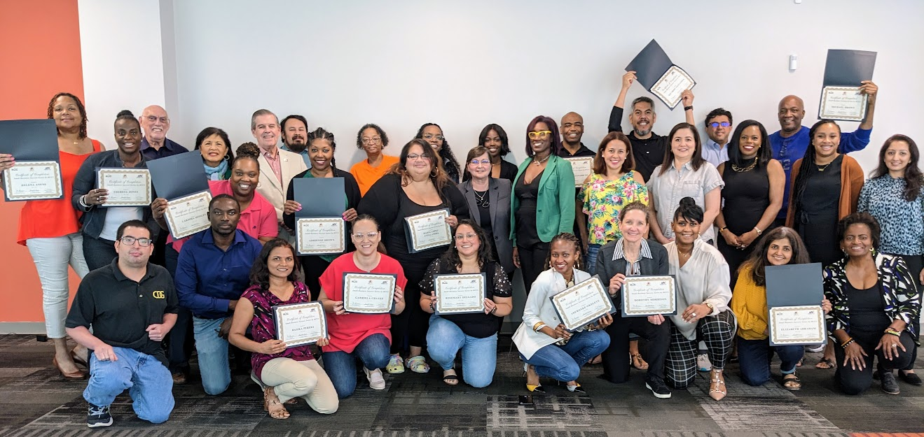
Small Business Success Series © by HCC
Mod 1 - Vet the Venture- Are My Ideas Lucrative?
Mod 2 – Ignite The Entrepreneur in You
Mod 3 - Sales & Marketing Powered Up
Mod 4 - Financials for Small Business Launch and Growth
Mod 5 - Managing Risk – Protect Your Business, Your Assets & Your Future
23 Cohorts
13 Onsite
10 Virtual
587 Graduates

Slide 7



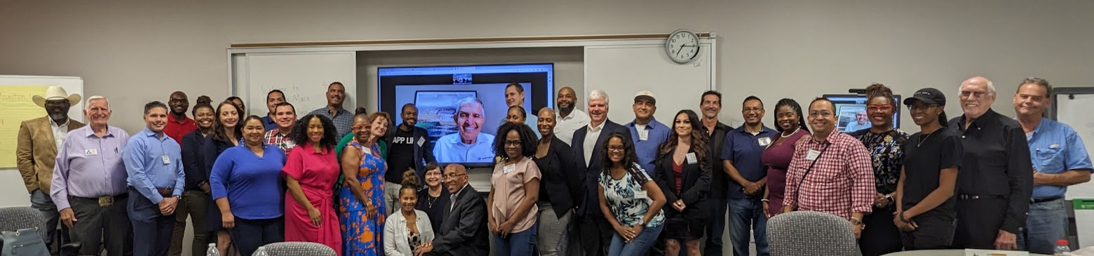
HCC Mattress Mack School of Selling©
The Art of Listening
Persistence
The Ability to say NO
Caring Customer Service
Building a Book of Business
What You Learn After You Know It All
Onsite Cohorts
and Virtual Cohorts
7 Cohorts Graduated
283 Alumni Graduates
Notes:
25 teams teams of proposed, startup and existing entrepreneurs chosen from 100 applications to win free training and advising February thru May.
1,300 Advisor Hours - participating in interactive group training with contestant teams and in one-on-one advising. In-Kind hours valued at $250,000 for competition advising, delivery and training.
$26,000 - Prize Money
$20,000 - In-Kind Prizes – all graduating teams
$51,000 - Discounted Post Competition Services
$4,000 - Event Expenses for 9 competition events.
$350,000 Total Value - Raised and Delivered by the Center for Entrepreneurship HCC Northwest through the 2019 HCC Business Plan Competition.
HCC has attracted over 550 applicant teams (with over 1,000 team members) and chosen 250 teams to compete and benefit from the rigorous mentoring and training delivered in this working competition.
Nearly 225 teams, with over 450 team members have successfully completed the BPC.
Awarded to Winners and Graduating Teams:
$260,000 cash prizes
$86,000 in-kind prizes,
$129,000 discounted post competition resources
$1,775,000 in-kind mentoring & training; resulting in
$2.25 million total value of cash prizes, in-kind prizes and resources, mentoring and training.
This $2.25 million value delivered to our proposed, startup and existing entrepreneurs was supported and raised by the Center for Entrepreneurship and all contributed from the

Slide 8
Business Leadership for Women Entrepreneurs
* Leadership Mindset
* Roles of a Leader
* Qualities of an Entrepreneurial Leader
* Growing Your Business Leadership

Slide 9
HOUMade- a local Houston Collaborative
for Creatives & Makers (developed from an EDA Grant)
* Developing a Creative Business- how to develop a creative plan & successfully build a collaborative team
* Creative Branding and Design- most updated tools and how to use them effectively and effortlessly
* Growing a Creative Business- how to expand your business beyond its current phase and into a sustainable outlook

Slide 10
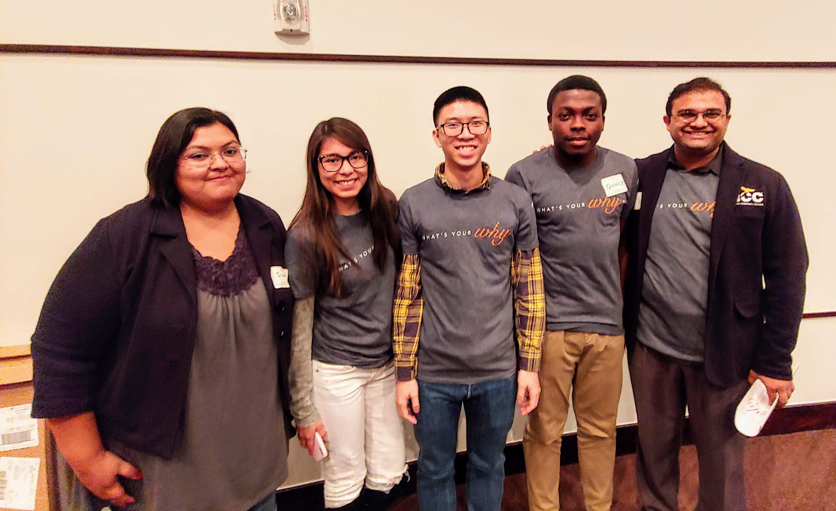
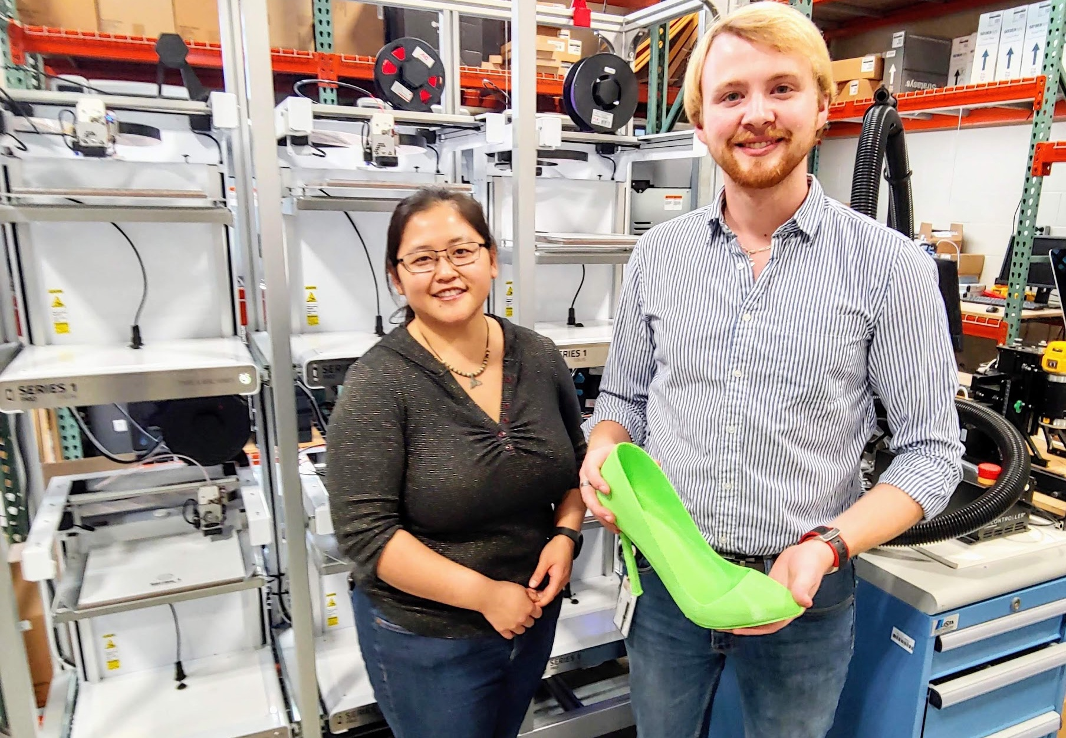
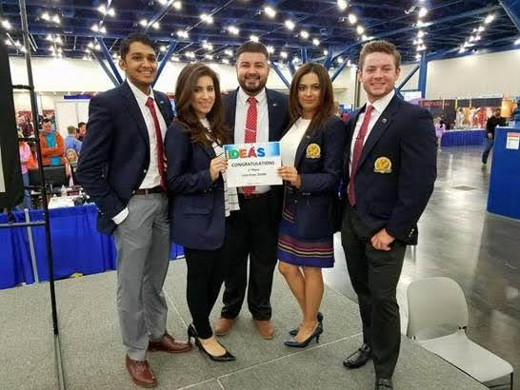
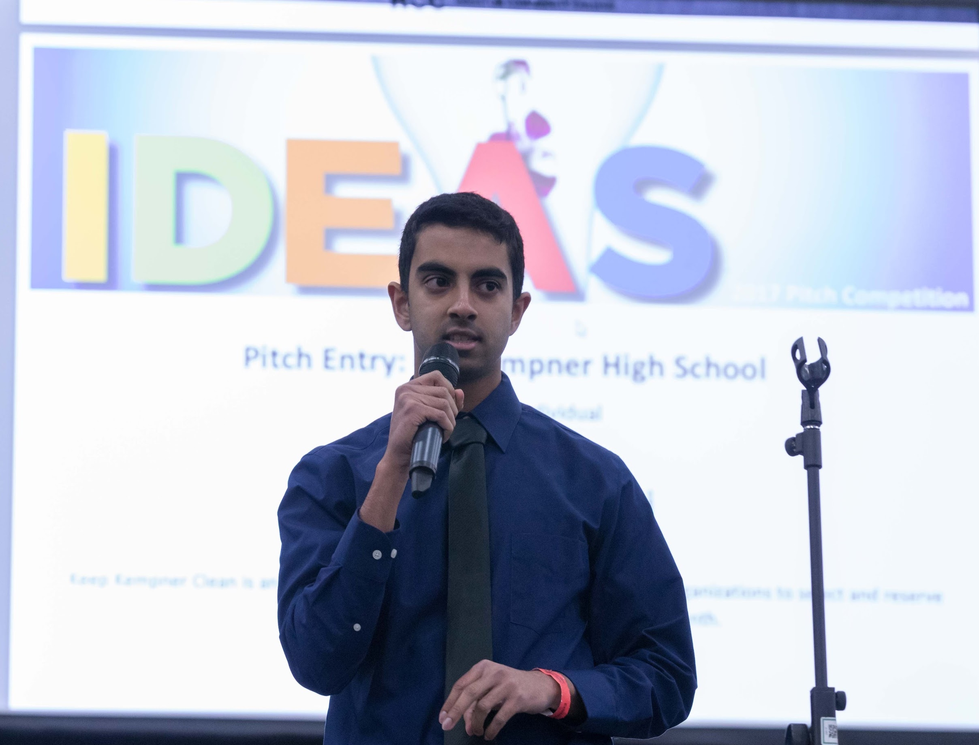
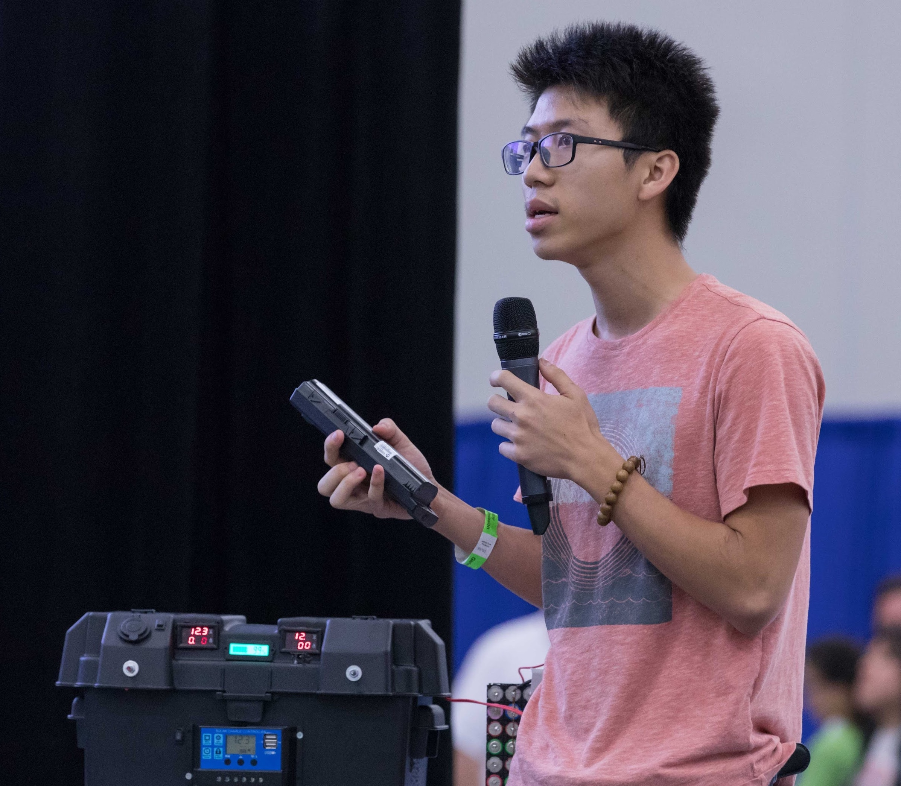
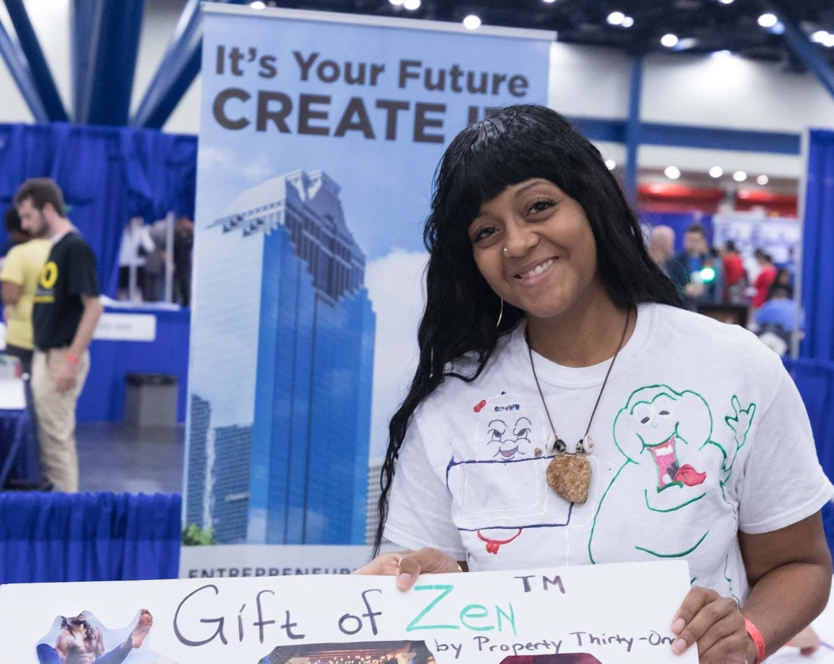
Create
Changemakers by building awareness and inspiring action from our student entrepreneurs
Impact
the world with new products, services and technologies; and
Empower
our communities so that entrepreneurs can launch companies, scale technologies, and create tomorrow's jobs

Slide 11
The Process
engage and teach entrepreneurial mindset AND
help build awareness
and inspire action from student entrepreneurs
hosting workshops & training sessions that

Slide 12
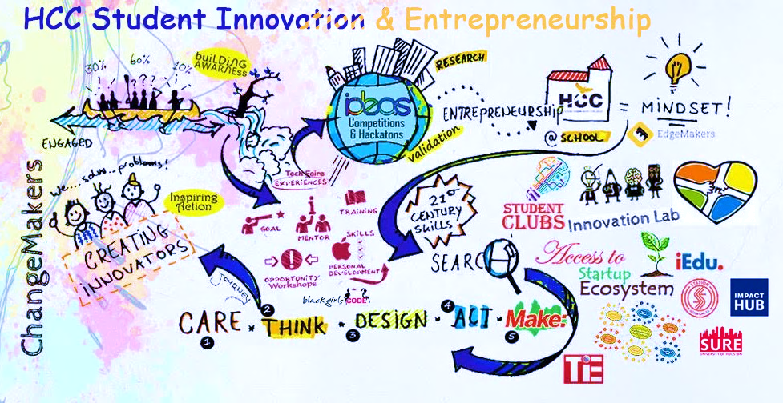

Slide 13
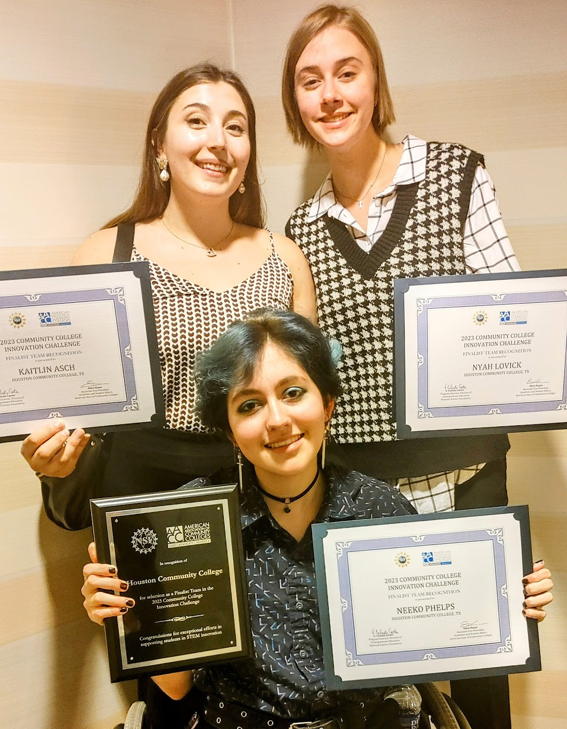
HCC TEAM
Neeko Phelps
(NW Engineering Student)
Kaitlin Asch
(Central Campus)
Nyah Lovick
(SW & Honor Student)
Mentor Dr. Ravi Brahmbhatt
Placed 1st NSF & AACC Community College Innovation Challenge!

Slide 14




11
Goldman Sachs
10,000 Small Businesses
Copyright © Goldman Sachs 10,000 Small Businesses

Slide 15
What We Do
Goldman Sachs 10,000 Small Businesses
12 Week - No Cost Program
Practical Business Education
100 Hours of practical business education
Implementable curriculum
Peer to peer learning
Business Support Services
Offer advice, technical assistance and networking
Integrate business education with business needs
Access to Capital
Learn how to access additional resources
Connect with local CDFI and financial institutions
+
+
=
Revenue Growth and Job Creation
Copyright © Goldman Sachs 10,000 Small Businesses

Slide 16




Who Should Do It
Small Business Owner in the Greater Houston Area
Owner / Co-owner of a small business
At least 2 Years in business
At least 2 FTE employees including self
75k+ in revenue in the last 2 years
Copyright © Goldman Sachs 10,000 Small Businesses

Slide 17
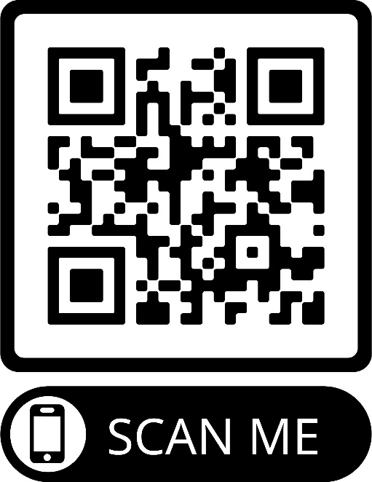
Deadline to Do It!
Houston10ksb.com
Application Deadline for Fall Cohort
June 4, 2024
Michelle Ngome - Outreach Director
Michelle.Ngome@hccs.edu
Copyright © Goldman Sachs 10,000 Small Businesses

Slide 18



Houston Minority
Business Development
Agency Business Center

Slide 19

Our Mission and Vision (Goals)
Our Mission
To foster the growth and global competitiveness of U.S. businesses that are owned and operated by minority, socially or economically disadvantaged individuals. We do this through our business consultations, and matching Minority Business Enterprises (MBEs) to contract opportunities and capital resources. We also connect our clients to our Corporate and Community Partners via our referrals.
Our Vision
Economic prosperity for all American business enterprises.

Slide 20






Service we provide (Our Impact)
Access to Capital
Access to Contracts
Access to Markets
One-on-one
Business Consultations
Invitations to webinars, events and workshops
Strategic Services
(facilitation to certifications,
marketing strategy)

Slide 21
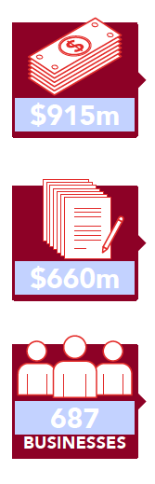
Houston MBDA Performance: Our Impact
Access to Capital
Our center has facilitated more than $915 million in financing transactions.
Access to Contracts
We have assisted minority-owned businesses secure more than $660 million in contracts.
Clients Served & Job Creation
The Houston MBDA has advised 687 minority-owned businesses to help create more than 3,756 jobs.

Slide 22

Signature Programs/Activities

Slide 23
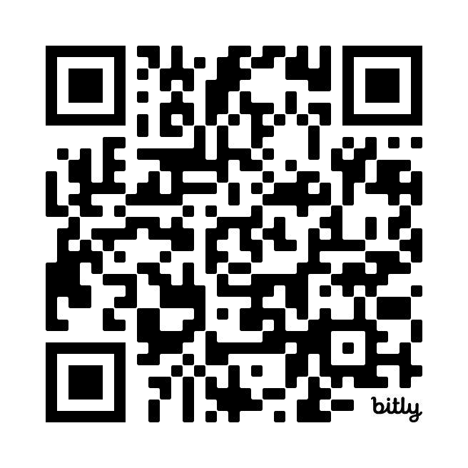
Sign up for Entrepreneurial Initiatives Newsletters!
https://www.hccs.edu/smallbusiness

